Slide 1
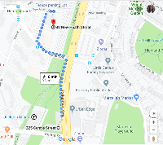
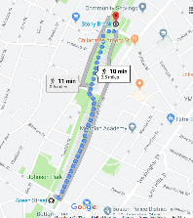
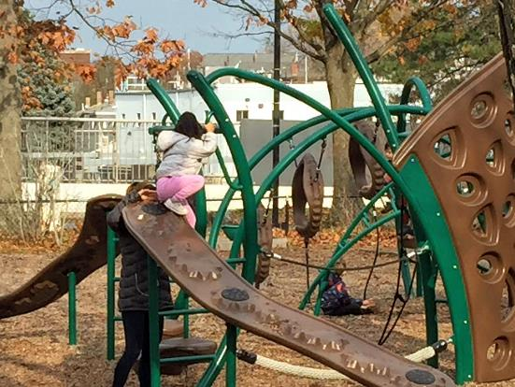
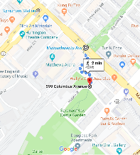
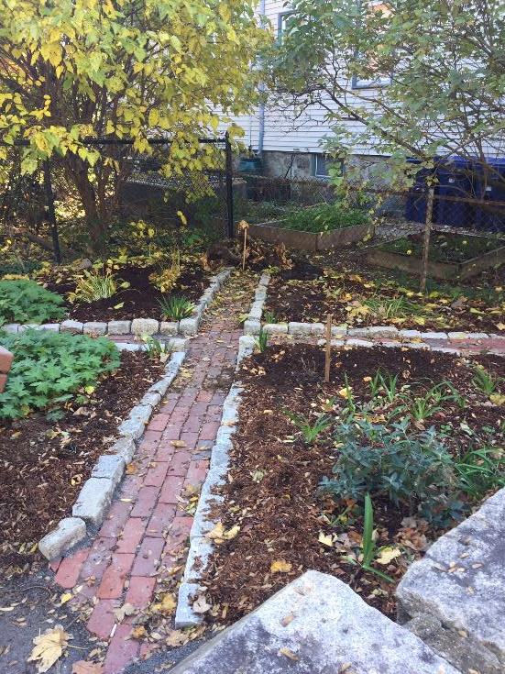
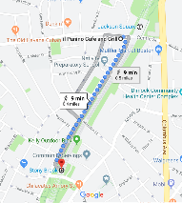
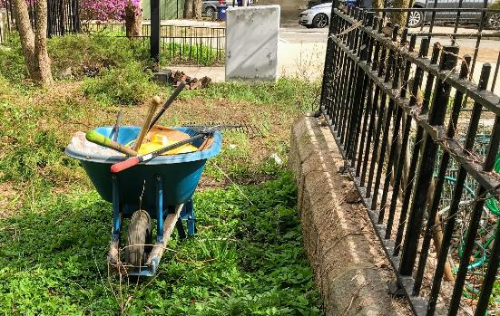
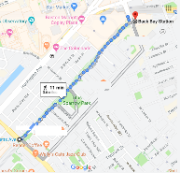
A Walk through the Southwest Corridor Park PMAC Annual Meeting November 2019
Notes:
Welcome! This presentation follows a walk from Forest Hills to Back Bay.

Slide 2
Walk Themes / Focus Areas
Park Stewardship
Community Gardening
Bicycling and Walking Paths
Park Features – Dog Walking, Skateboarding, Sports
Park History
Public Policy, public Health and Public Safety
The importance of parks in creating a sustainable and resilient city
Youth and family Programming

Slide 3
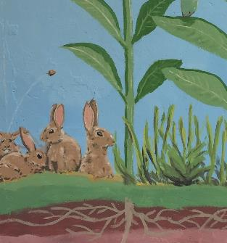
Jamaica Plain

Slide 4
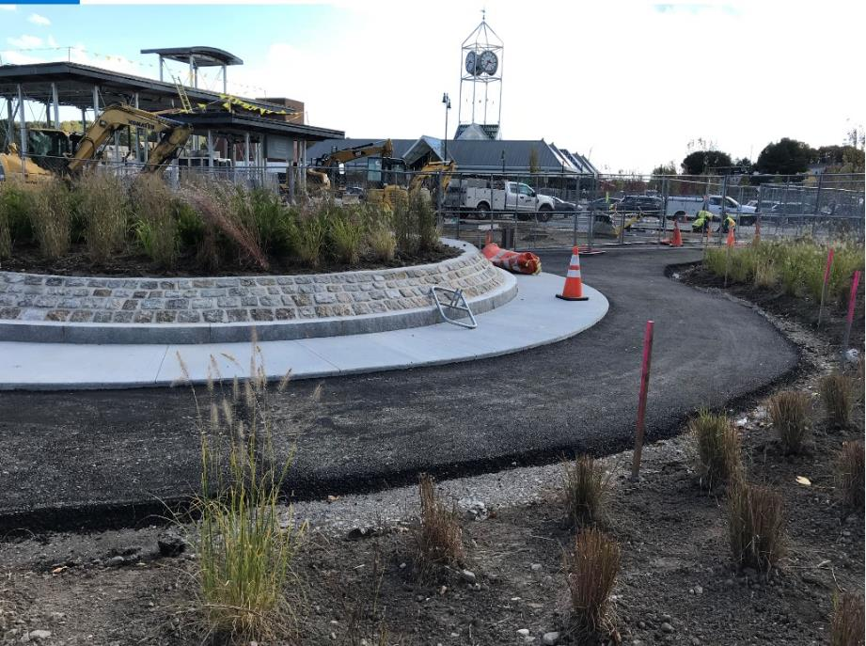
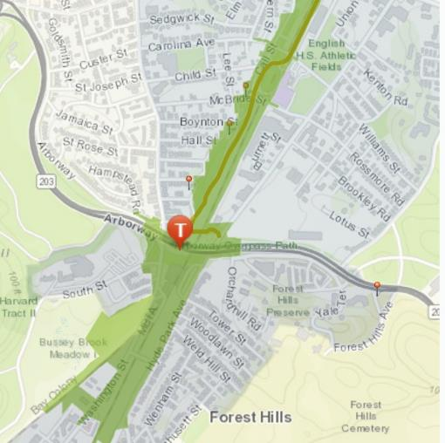
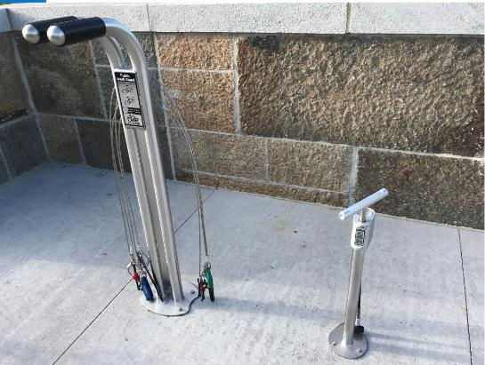
Forest Hills
Notes:
The new station and parkland opened in 2019 and DCR will assume responsibility for this parkland going forward. A PMAC goal = to become involved with this new part of the park, in collaboration with other neighborhood, cycling and parks groups.

Slide 5
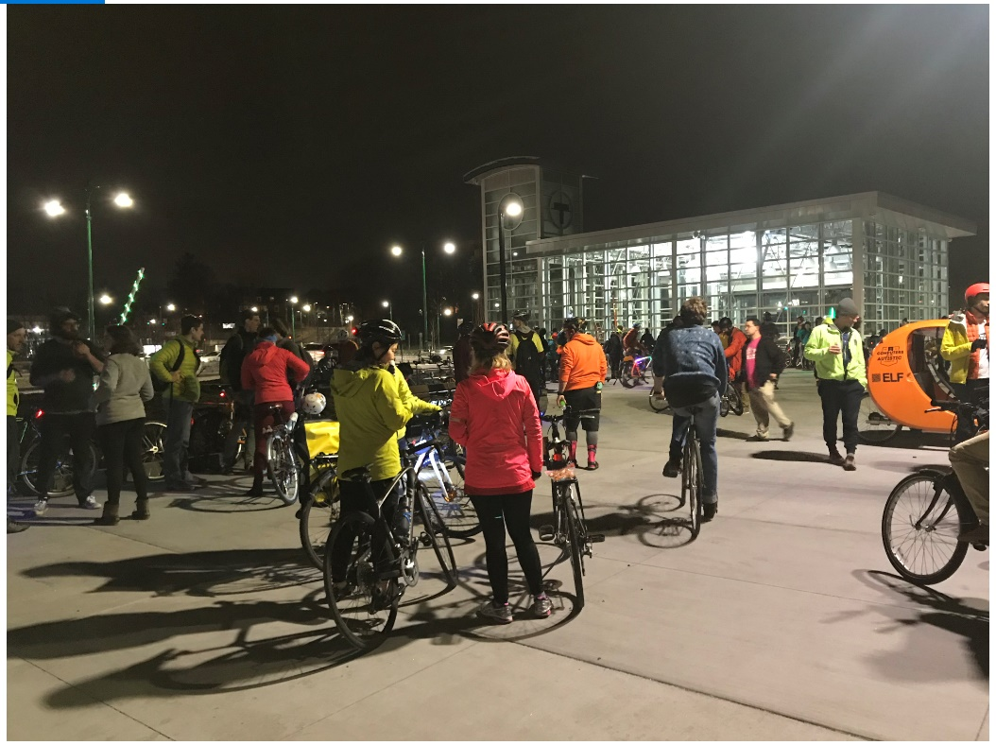
Forest Hills ~ Boston Bike Party Ride
Notes:
Through personal networks and social media we continue to keep communication open among the many bicycle groups in the city.

Slide 6
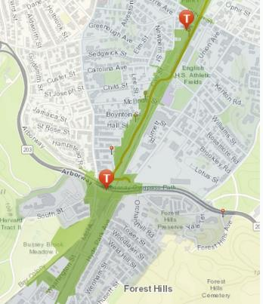
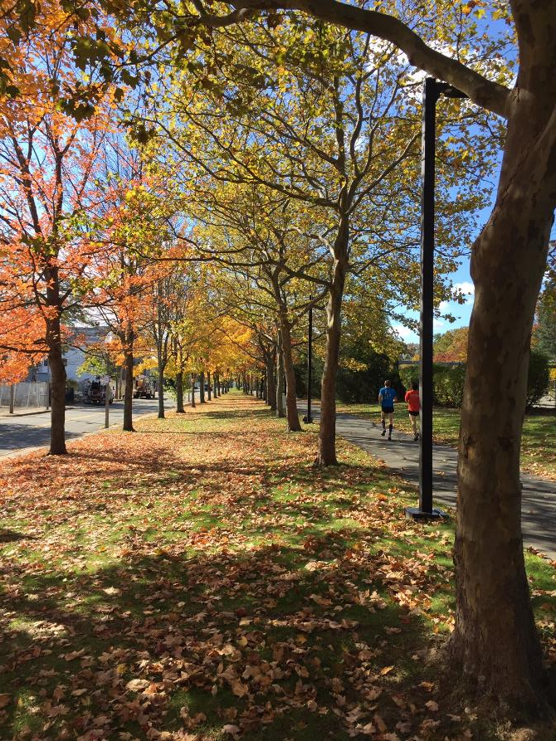
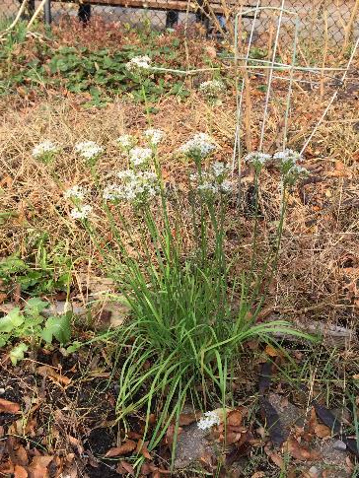
Forest Hills to Green Street
Notes:
The annual meeting presentation is a chance to appreciate the beauty of the park as well as the work of our network of volunteers, neighbors and organizational partners.

Slide 7
Anson Street ~ Laying Cobblestone Path
Notes:
Jenny Jones coordinates a network of volunteers and volunteer events in Section 3 of the park. In this photo, a project at Anson Street outside the community garden.

Slide 8
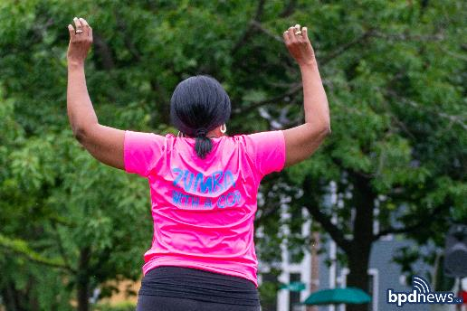
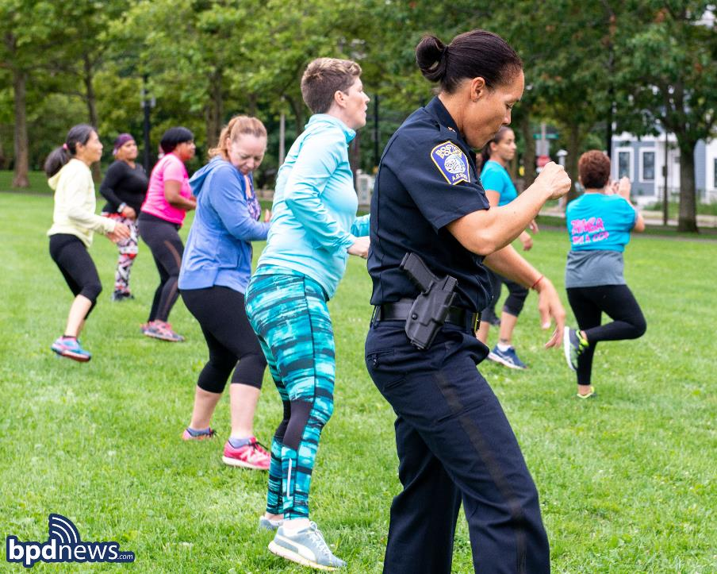
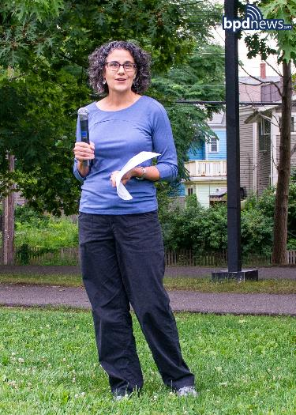
Zumba Series #minigrant
Notes:
One of our mini-grant projects is the “Zumba with a Cop” series, with BPD E-13. On this evening, Tracy O’Brien spoke to the participants with background about the Southwest Corridor Park.

Slide 9
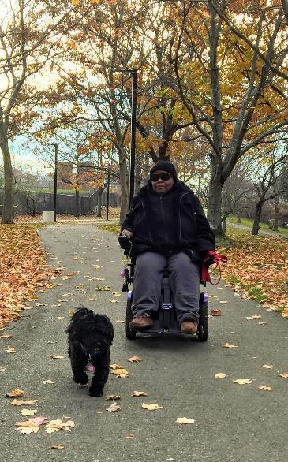
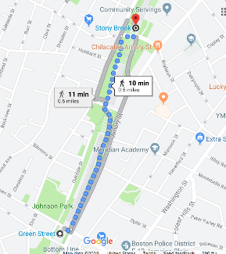
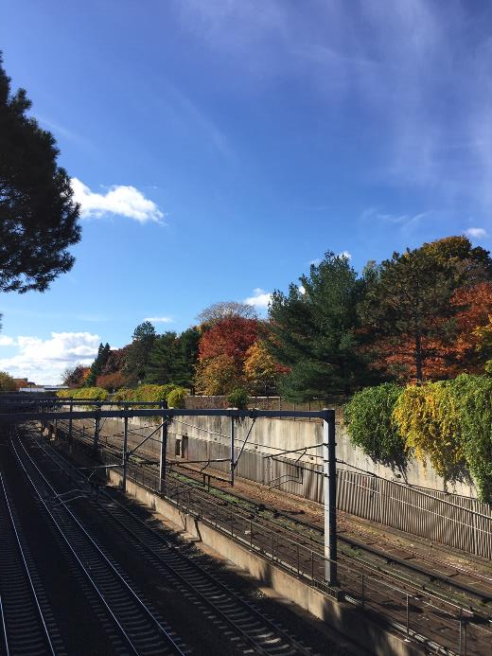
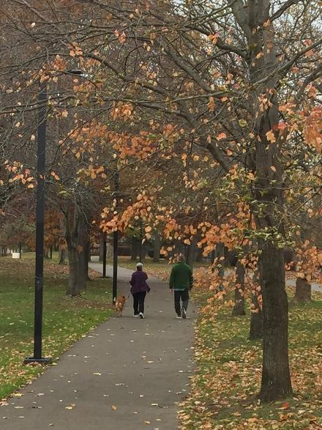
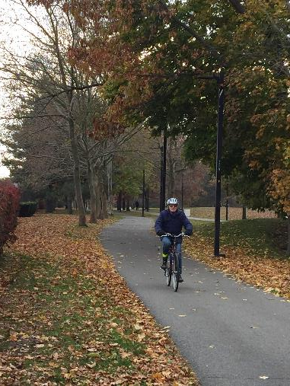
Green Street to Stony Brook
Notes:
The Southwest Corridor is the walking, bicycling, skateboarding, scootering, wheelchair and public transportation route for thousands of residents. Much of our advocacy work focuses on basics about accessibility and safety.

Slide 10
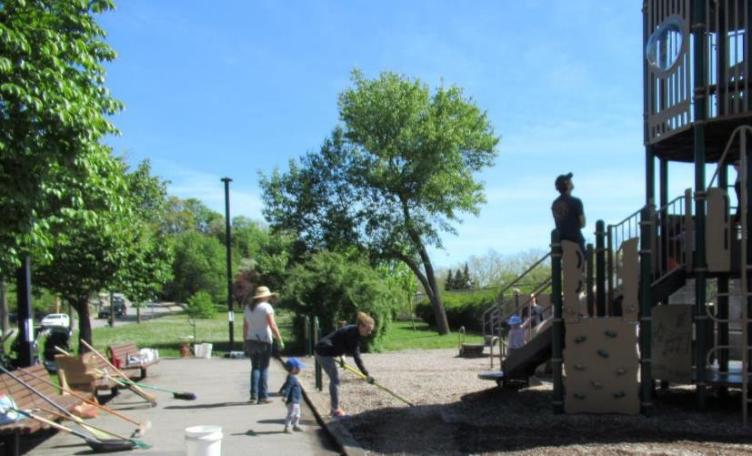
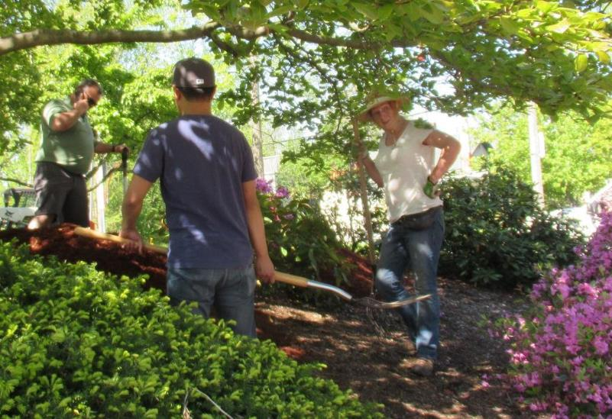
Everett Street Playground Clean-up Day
Notes:
A playground clean-up and landscaping project, May 2019. With DCR, with coordination by Jenny Jones.

Slide 11
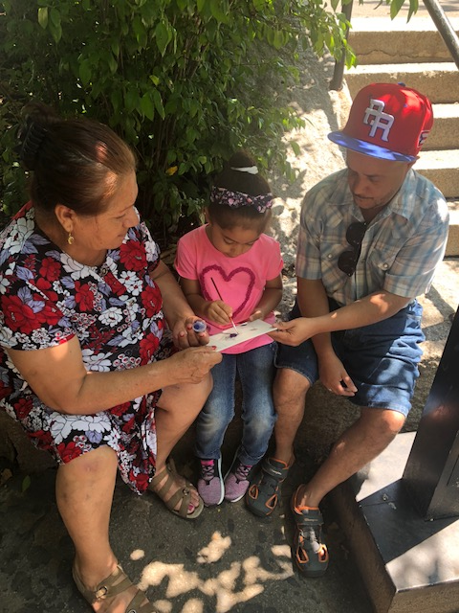
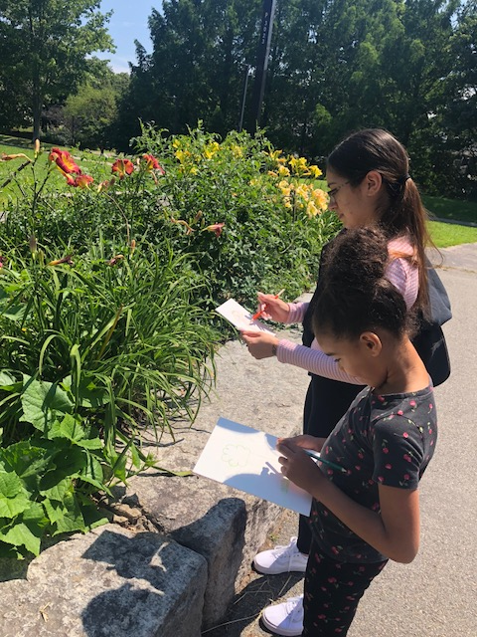
Paint Walk ~ Mom’s Café #minigrant
Notes:
This year, mini-grants supported the Mom’s Café’s at Mildred Hailey (Bromley Heath) and South Street. Mothers and children visited playgrounds in the park and did an “art walk” with their children.

Slide 12
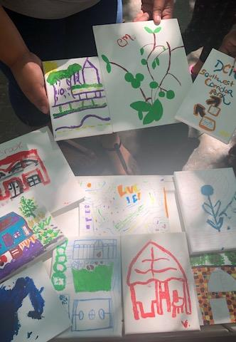
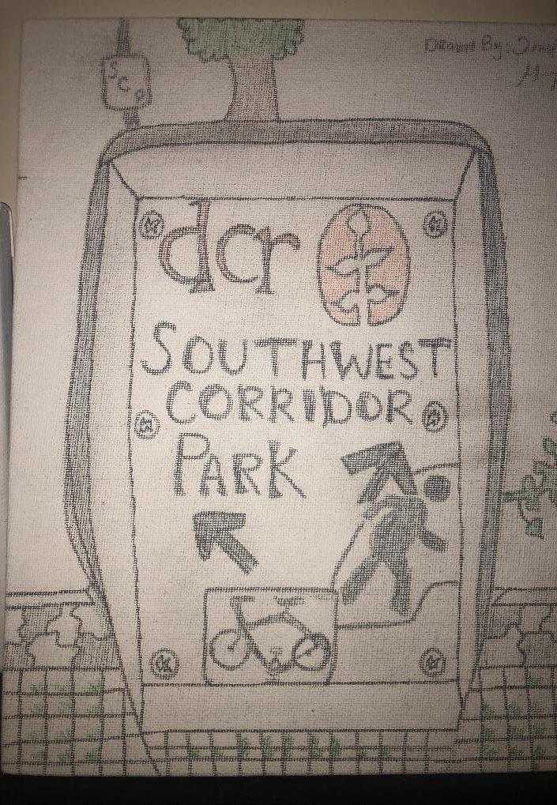
Notes:
Some of the artwork from the mothers and children.

Slide 13
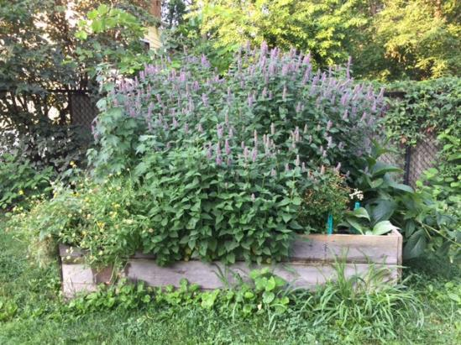
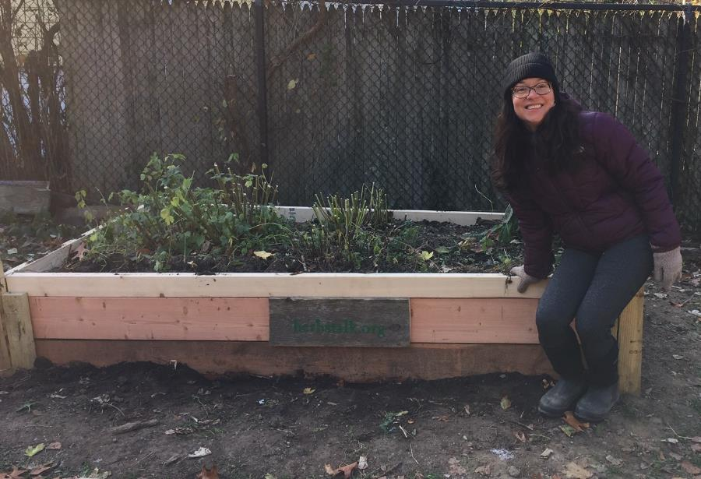
Herbstalk Garden
Notes:
The Herbstalk Garden is a great addition in JP. Herbstalk is a local community organization that provides education about plants and specifically about herbal gardening.

Slide 14
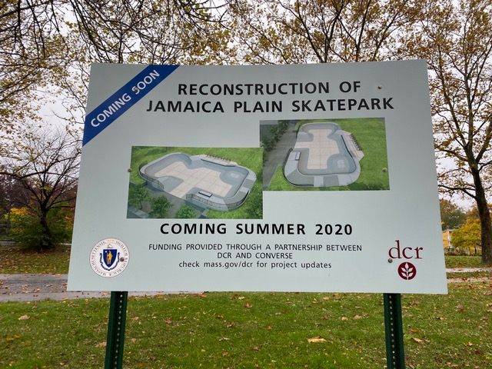
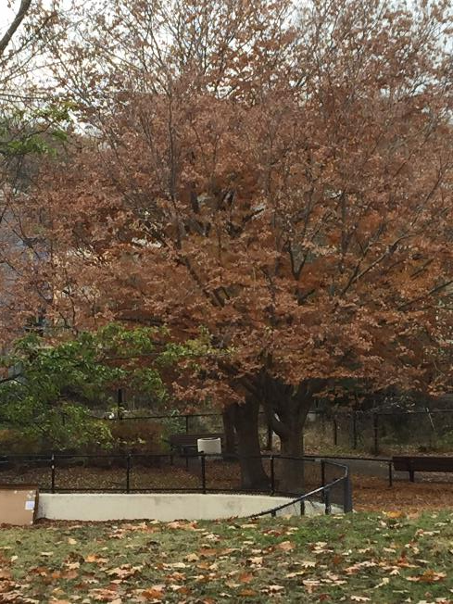
Skateboard Park
Notes:
We are hopeful as we see the skateboard project moving forward.

Slide 15
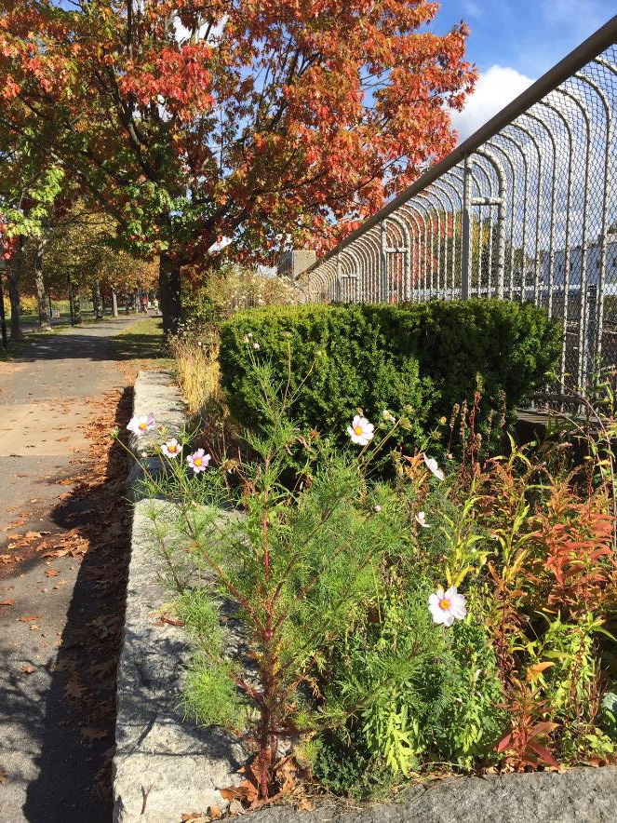
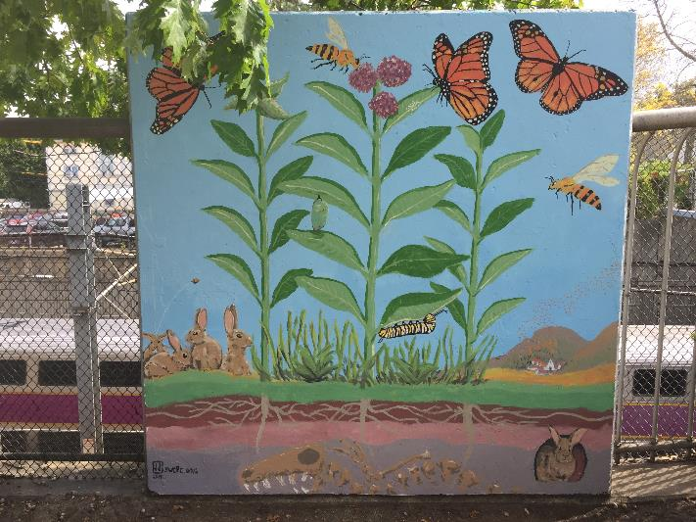
New Minton Street
Notes:
Garden (part of the JP SWCPC network of park stewards) & mural (Jenny J.)

Slide 16
Jamaica Plain / Jackson Square

Slide 17
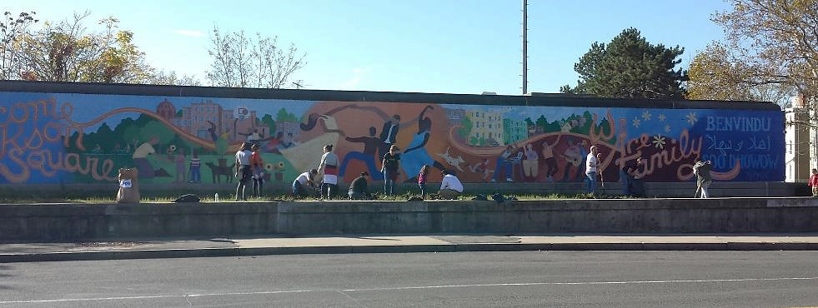
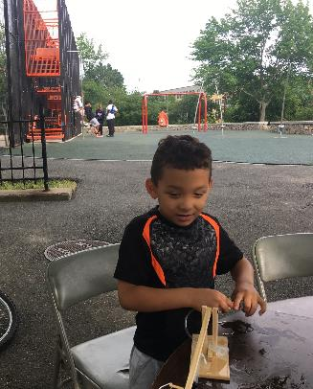
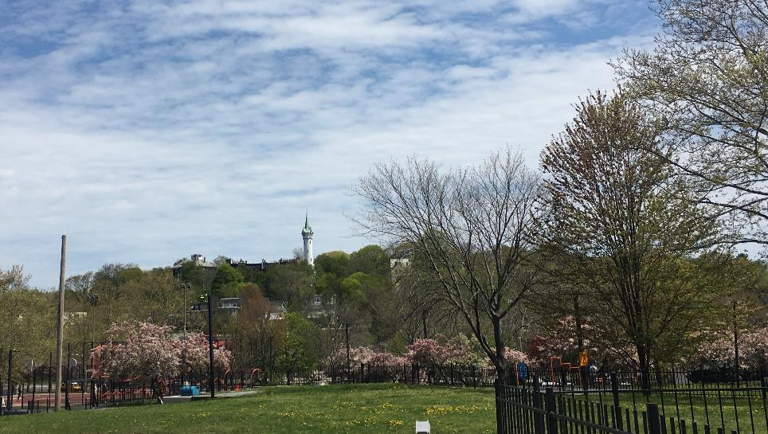
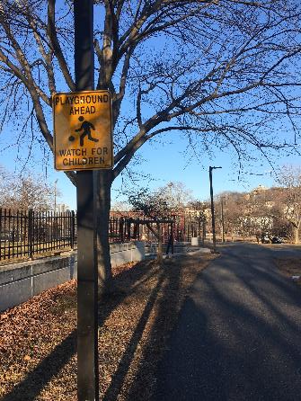
Jackson Square
Notes:
Some views at Jackson Sq. Mural by the Jackson/Hyde Square Main Streets (now Three Squares Main Streets). A playground scene. And our new sign, posted January 2019, “Playground Ahead Watch for Children.”

Slide 18
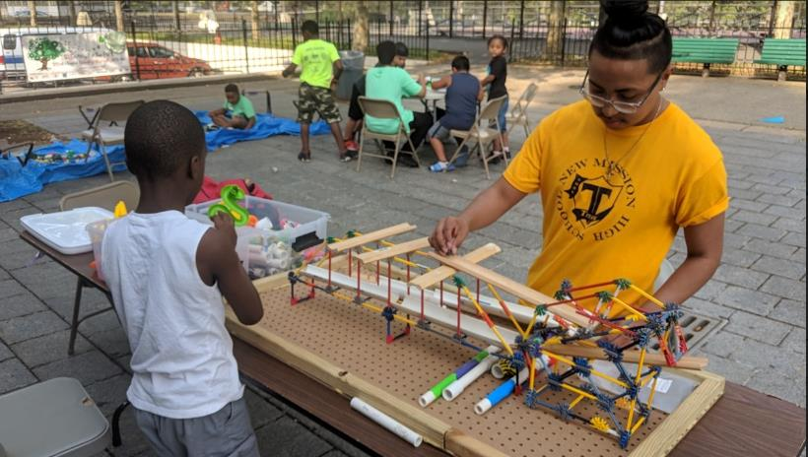
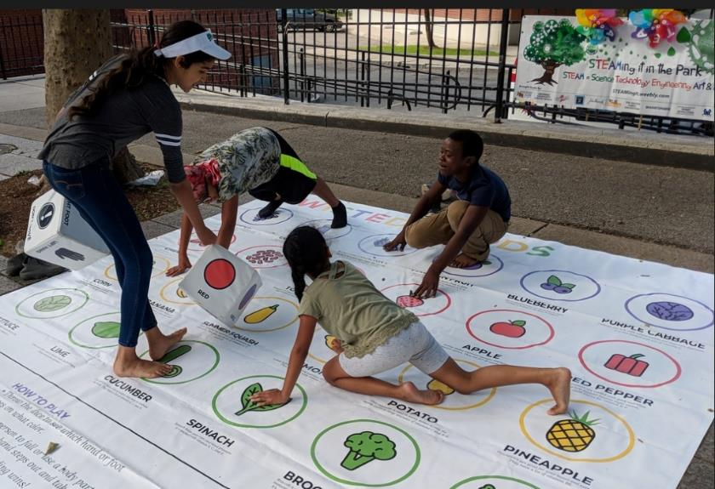
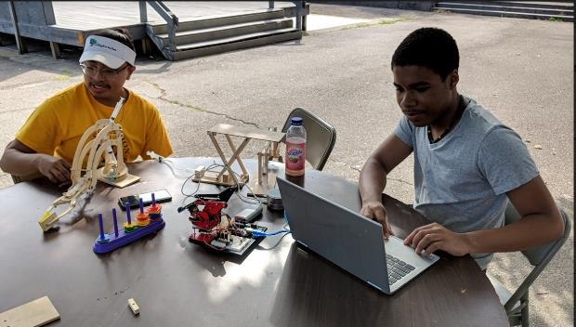
STEAM in the Park and Science Wednesdays
Notes:
DCR supports the STEAM in the Park series and SWCPC/PMAC support our Science Wednesday series. During the summer, we work together every Wednesday afternoon. In these photos, a Twister game about healthy foods, a building project, and two types of robotic arms.

Slide 19
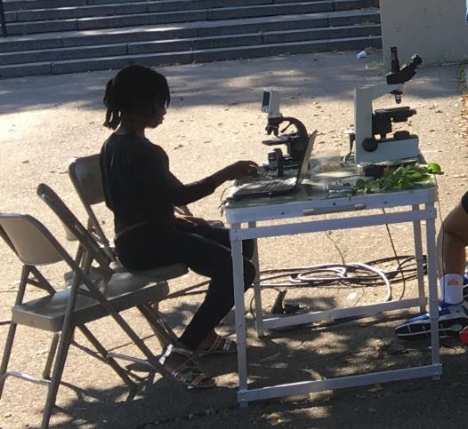
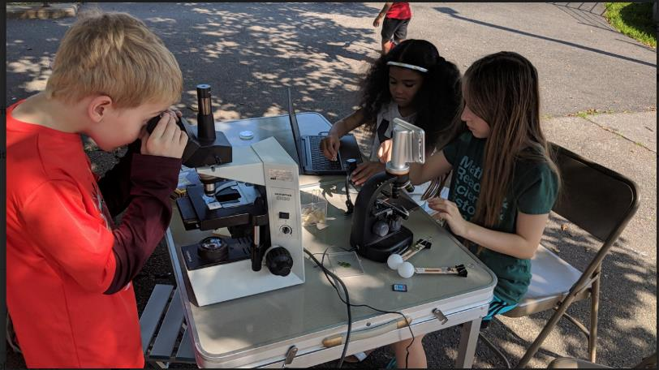
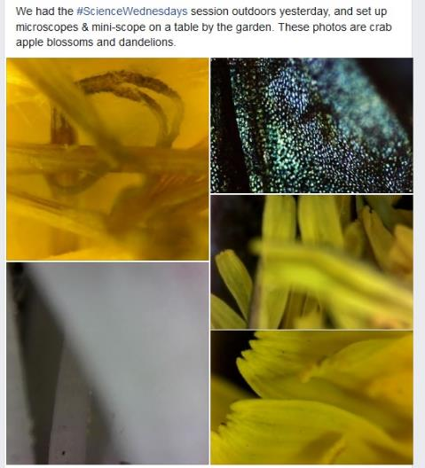
STEAM in the Park and Science Wednesdays
Notes:
Our collection of microscopes and microscope slides ties our garden & science work together. A SWCPC donation supported purchase of a microscope and miniscope; another donation supported another microscope.

Slide 20
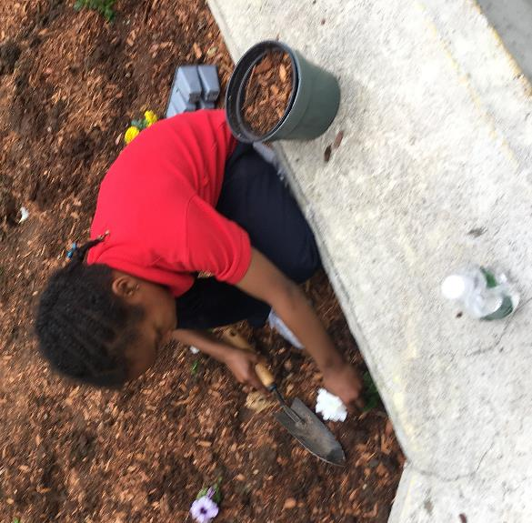
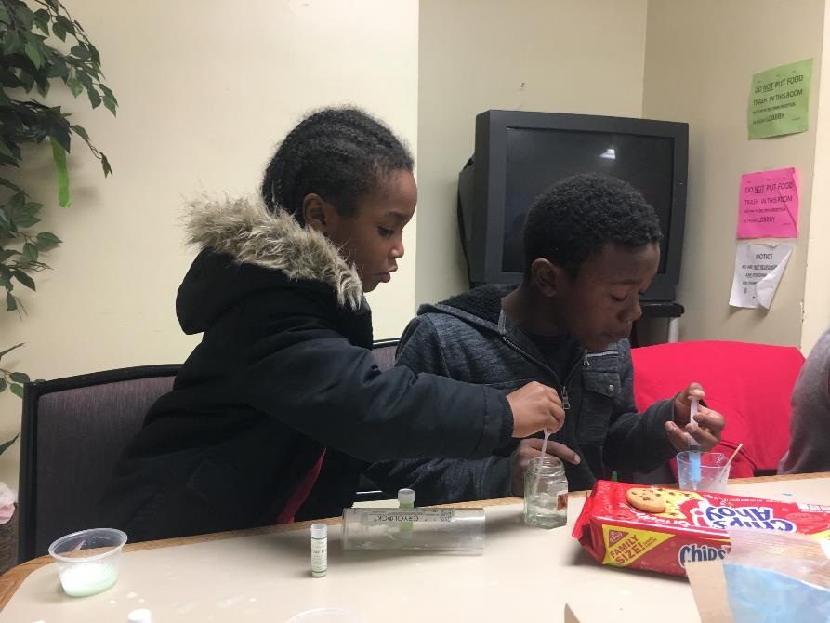
Science Wednesdays (Year-Round)
Children’s Gardening (Summers)
Notes:
The look of concentration in both these photos highlights what we enjoy during both the gardening and science programs.

Slide 21
Roxbury to Fenway

Slide 22
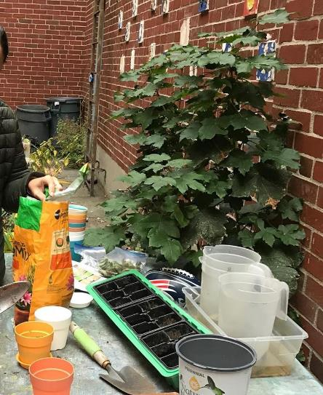
The Rafael Hernandez School is the home base for two #minigrant programs – the Boston Explorers summer program and the Friends of Hernandez After-School Program.
Notes:
As we build partnerships, some of our map sites may be a few blocks off the park.

Slide 23
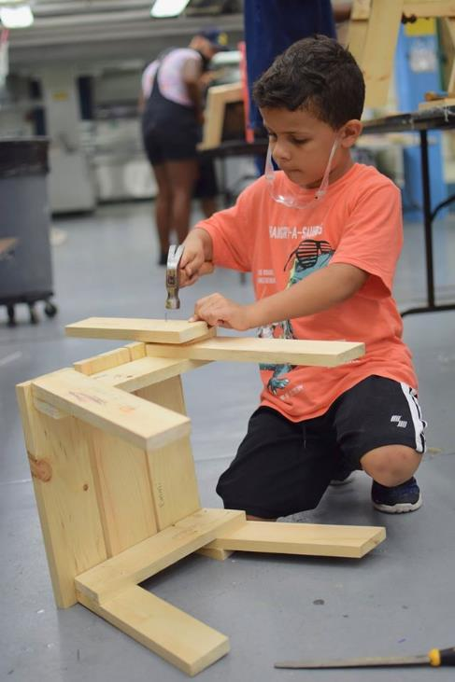
Boston Explorers #minigrant
Notes:
This summer, Boston Explorers worked with the Audobon Center to enhance their nature study programming, both onsite at the Audobon Center and in the park and on other trips around the city. Also pictured: indoor activities during the summer include woodworking, art & more.

Slide 24
Roxbury Heritage Park
In 2019, after a major renovation, DCR re-opened the Roxbury Heritage Park, a state park with natural tie-ins to the Southwest Corridor Park.

Slide 25
The Agricultural Hall’s Urban Agriculture Fair was held at the Roxbury Heritage Park this summer. We had a Southwest Corridor Park table at the event, sharing information about the park.

Slide 26
Ruggles / NEU / Carter
Our connection with Northeastern University’s Community Advisory Board is an important part of our networking.
Notes:
The post-it notes are part of a brainstorming at the NEU CAB meeting about Parcel 18. We can talk more about this at a winter PMAC meeting.

Slide 27
South End and Back Bay

Slide 28
Mass. Ave. to Back Bay
Notes:
This is the classic view from Mass Ave.

Slide 29
Northampton Green
Notes:
The Northampton Green project is moving forward, including designation as the Mary Longley Garden. At DCR SWCP headquarters at 38 New Heath St. we have stones suitable for markers for the Martin Luther King residence. We are networking with the new development behind Northampton Green for collaboration.

Slide 30
Mass. Ave. to Back Bay
Notes:
Photos from some of our volunteer days: Park Serve, Red Pine Scholars & more.

Slide 31
Mass. Ave. to Back Bay
Notes:
Garden views –photos taken by some of the volunteers during one of our largest volunteer days.

Slide 32
United South End Settlements #minigrant
Notes:
United South End Settlements club 48 children’s program sketched and painted in the park and displayed paintings at their STEAM Showcase.

Slide 33
Inquilinos Boricuas en Acción #minigrant
Notes:
Children in the Inquilinos Boricuas en Accion painted a wall, bench, electrical box and many trash receptacles over the summer. IBA’s summer program this year focused on three garden-related spaces, focusing on food/nutrition through a field trip to the BMC Community Garden, nature study through a field trip to Boston Nature Center and public art through their visits to the Southwest Corridor Park.

Slide 34
Notes:
More photos of the IBA artwork.

Slide 35
Butterfly Garden
Notes:
The butterfly garden has been a focal point for the park for 10+ years now.

Slide 36
Tot Lot Nook
Notes:
Carla Coch and Scott Romney organized and carried out a re-design of this corner; families visiting the tot lot playground can enjoy time on the child-sized picnic tables. The electrical box painted by IBA added a fun complement to the tot lot space.

Slide 37
Carleton Court Dog Park
Notes:
Scott Romney and Marcia Sassoon lead the Friends of Carleton Court Dog Park. In these photos, volunteers from the Red Pine Scholars volunteer day helped with painting. You see a “before” photo above; an “after” picture shows up later in this presentation.

Slide 38
Carleton Court Dog Park
Notes:
More photos, and a flyer from the Halloween event that was last week. FOCC relies on donations and fundraisers to maintain the dog park.

Slide 39
Sept. 20, 2019 Walk-Through with DCR, PMAC & SWCPC
Notes:
Photos from our walk-through with DCR, Sept. 20th. The chart of “what we are proud of” and “what we are advocating for” in your annual report is from this walk-through.

Slide 40
PMAC Leadership Team / Re-Election
Notes:
At the annual meeting we elect or re-elect the leadership team. If anyone is ever interested in joining the leadership team, we can also add new leadership team members during the year. The team stays in touch between meetings about issues that arise. (Leadership team members are listed here by park section/geography.)

Slide 41
David Wean is chair of PMAC’s bicycle/walking path subcommittee. He is an active cyclist, connected with many of the bicycle organizations and advocacy networks in the city, and lives in Roslindale. David has worked with subcommittee members and others to develop lists of potential improvements for the Southwest Corridor paths, including intersection improvements that we have shared with Boston Transportation Department and a striping & stenciling proposal which we have shared with DCR. David also took the lead in our work with Northeastern University along the path alongside Carter Playground and the ISEC science building and was PMAC’s representative on the Casey/Arborway CAC.

Slide 42
Tracy O’Brien, Co-Chair of PMAC, is the coordinator of the network of community gardens. The coordinators of the eleven community gardens manage the waiting list and plot assignments, collect dues, meet with gardeners, sponsor garden workdays and special events, troubleshoot issues, and work with DCR on maintenance issues. Tracy lives in JP and gardens in the Lawndale Community Garden.

Slide 43
Fred Vetterlein is a member of the PMAC Leadership Team and works with the Stony Brook Neighborhood Association (SNA) on neighborhood projects.
The Stony Brook Neighborhood Association covers streets near the Forest Hills and Green Street MBTA stations, along the southern end of the Southwest Corridor Park.

Slide 44
Jennifer Leonard, Co-Chair of PMAC, coordinates the children’s programs at Jackson Square and the mini-grant initiative. Jennifer also represents the SWCP on the Northeastern University Community Advisory Board and the Mildred Hailey Apartments Tenant Association Partners meetings. She lives in Mission Hill and gardens in the Jackson Square and South End/Back Bay sections of the park.

Slide 45
Bob Barney is Secretary/Treasurer of PMAC and serves as the liaison between PMAC and the SWCPC. He has been active in working toward the Mary Longley Garden concept for Northampton Green. He lives in the South End and is president of the Claremont Neighborhood Association and active with the South End Forum.

Slide 46
Scott Romney represents the Carleton Court Dog Park on PMAC. Scott provides many hours of hands-on work in the park, providing garden stewardship as well as work in the dog park.
The Carleton Court Dog Park opened in 2006, and is volunteer-managed in partnership with DCR. The Friends of Carleton Court is headed by Marcia Sassoon and Scott Romney.

Slide 47
Franco Campanello is President of the Conservancy (SWCPC) and a member of the PMAC leadership team. Franco coordinates the volunteer network and the many volunteer days in the South End/Back Bay section of the park and dedicates hundreds of hours to hands-on work in the park. Franco lives and works in the South End.

Slide 48
DCR Supervisor Pat Driscoll (with NEU Volunteers – Spring Service Day)

