Slide 1
Southwest Corridor Park PMAC 2018 Priorities
April 3, 2018

Slide 2
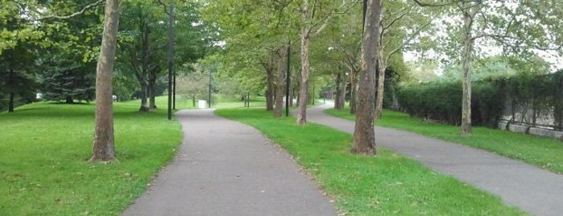
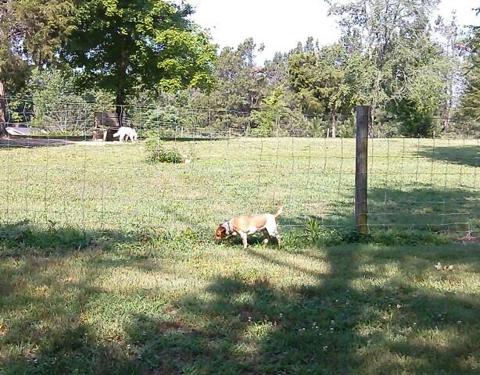
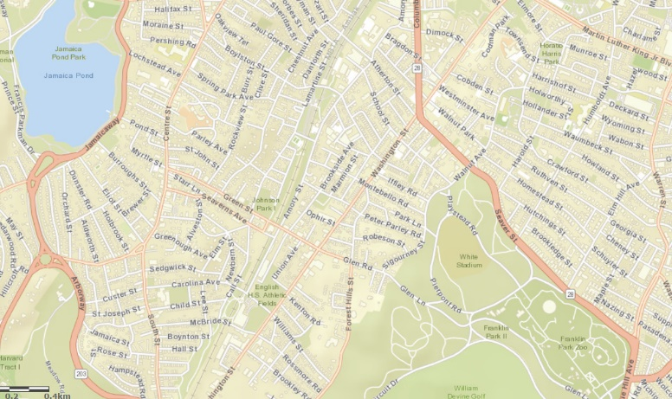
Maintenance of park Infrastructure
Path striping for bikes and pedestrians, improve safety !
Move forward with Greenway Extension
Complete Skate Park
Dog Park Location & Start Process
Notes:
Notes from April 3rd – PMAC to get copy of Care & Control Agreement (have filed request); Rep. Rushing to convene legislators around SWCP; Jennifer to contact Rep. Chynah Tyler to get better acquainted; invite DCR Commissioner to meet; request DCR to attend PMAC quarterly & establish better chain of communication beyond local/park requests. FY2020 budget requests? Specific actions around each project.

Slide 3
Project List
# | Topic: |  | Date Requested: | Project Status:
1 | Skate Park in JP |  | 2011 / 2012
2 | Greenway Extension
3 | Bike/Walking Path Striping |  | May 2015
4 | Water Study Follow-up |  | 2014
5 | Oakdale Community Garden |  | Sept. 2016
6 | Dog Park in JP |  | Aug. 2016
7 | Tree Study & Replacement
8 | Park Signage (Review and Update)
9 | Stenciling and/or Fence for Jackson Square Playground |  | 2014 / 2015 / 2017
10 | Rose Garden Updates |  | Nov. 2017
11 | Northampton Green Updates |  | Nov. 2017
12 | Park maintenance – various items – fences, walls, granite curbs, bricks, etc. |  | Varies

Slide 4
List of Key Projects By Project Stage
Category | Project
[A.] Ready-to-implement | Bike/Walking Path Striping and Stenciling Stenciling and/or fence for Jackson Sq. playground Skate Park
[B.] Seeking commitment for projects | Oakdale Community Garden (MBTA – DCR) Greenway Extension Project (MBTA – DCR) JP Dog Park
[C.] Planning stage Develop scope of work Identify resources or “keep eyes open” for resources | Tree Study and Replacement Park Signage Review and Replacement Water Study Follow-up (Read & Discuss 2015 Study) Rose Garden Project Northampton Green Project
[D.] Ongoing Work / Increased Resources Needed | Increase Resources for Long-Term Maintenance – Park Hardscape Repairs (fences, walls, brick, granite, etc.)

Slide 5
Bicycle/Walking Path Striping and Stenciling
Project: | Background:
Bicycle/Walking Path Striping and Stenciling A request by PMAC for a center stripe on the bike path and stenciling on the bicycle and pedestrian paths, from Mass. Ave. to Forest Hills. Details are included in the written request and accompanying map. | Timeframe: Request shared with DCR in May 2015
 | History: The request is based on analysis of SWCP bicycle/walking path travel patterns and on the results of a PMAC survey about bicycle/walking path courtesy, civility and safety issues. The survey had 600 responses, with extensive comments. Details of the survey, the striping/stenciling request, and a map showing requested markings are available at http://swcpc.org/bicycling.asp There should be no major barriers to implementing this request. We understand that there were delays while DCR considered a uniform policy for all state park striping/stenciling; and then a number of DCR staff changes that may have allowed the request to lose attention.
 | Current/Next steps: * Reconnect with DCR Engineering Network with other bicycle/pedestrian advocates

Slide 6
Stenciling and Path Markings - Jackson Sq. Playground
Project: | Background:
Stenciling and Path Markings Jackson Sq. Playground A request by PMAC for a stenciling on the bike path by the Lorber Family Playground in Jackson Square. Stenciling would say “Playground Ahead – Watch for Children” on the path approachIng the playground from both directions, and white paint would mark a crosswalk where the path runs along the playground. We also request analysis to see if a fence or low plantings could provide additional safety. | Timeframe: Request shared with DCR as part of Striping/Stenciling Request in May 2015. Email to DCR Commissioner in November 2017.
 | History: Prior to PMAC’s October 2017 Annual Meeting, the PMAC Chair shared the annual meeting presentation with children and teens at Mildred Hailey (Bromley Heath) Apartments in Jackson Square. Upon seeing the last slide, which asked for brainstorming about park improvements, the group unanimously asked for safety improvements along the edge of the playground, where the playground meets the bike path. This request had already been part of our requests to DCR, prompted by observation and by numerous concerns raised by park users (via social media, email and conversation). This was requested in June 2014, and again as part of the overall striping/stenciling request in November 2015.
 | Current/Next steps: Advocate for initial steps a.s.a.p., while also integrating this into the overall striping/stenciling request Consider option of signs (rather than paint stenciling) as an immediately do-able option.

Slide 7
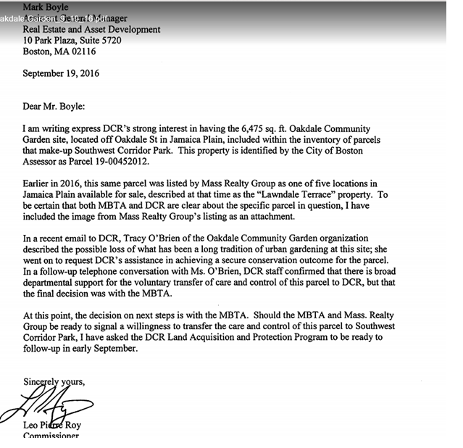
Oakdale Community Garden
Project: | Background:
Oakdale Community Garden A parcel of MBTA-owned land along Oakdale Street in JP has been used as a community garden. There has been a proposal to transfer ownership and care and control from MBTA to DCR. | Timeframe: See attached letter, dated Sept. 19, 2016

Slide 8
Greenway Extension
Project: | Background:
Greenway Extension A parcel of MBTA-owned land in the Stonybrook neighborhood in JP has been identified for open space use, with a proposal to transfer ownership, care and control of the land from the MBTA to DCR. With new development taking place in this neighborhood, developers have provided money, via the Stonybrook Neighborhood Association, to support landscape design or other first steps. | Timeframe: PMAC contacted DCR officials beginning in 2011 that money was available from private developers for development of an extension to the SWCP. DCR has held that the land is under ownership of MassDot and DCR can’t be involved in implementation or design until the land is transferred in a Care and Control agreement similar to that held for the present SWCP. The most recent enquiry of June 2, 2016 to Commissioner Leo Roy of DCR hasn’t been answered.
 | History: The Stonybrook Neighborhood Assoc (SNA) proposed this extension to the SWCP during the process of negotiations for two large developments that are bringing retail and 407 residential housing units to land adjacent to the Orange line. The SNA identified abandoned land on the East side of the Orange line tracks and contacted the MBTA regarding transfer to DCR so that the land could become public parkland and an extension to the SWCP. $50,000. toward design and $75,000. toward construction has been secured from the 2 development teams. PMAC has had a SWCP Ext working committee since 2011. The final Cooperation Agreement between developers and BPDA was signed in October, 2017. It guarantees the additional money that will bring total available funds to $125,000. for implementation of this SWCP Extension. If after 10 years the project is still stopped, the money can be applied to another parkland project.
 | Current/Next steps: Two of the abutting developments will contain 124 units of owner occupied condominium housing. They will be occupied by approximately January of 2020 when we will gain a valuable resource of new committed voices for a campaign to pressure DCR into the transfer of the land from MassDot to DCR control.
Notes:
Matt Lauer

Slide 9
Skateboard Park
Project: | Background:
Skateboard Park The Skateboard Park is an approved public-private partnership, with a completed design, now awaiting implementation. | Timeframe: Project planning since 2011
 | History: Skateboarders began informally using a hockey rink near Stony Brook T station in the SWCP. In 2011 they met with PMAC and DCR to propose a formal skateboard park in that space, wrote a proposal, gained community support, identified matching funds, and applied for, and in 2012 were awarded, a public-private partnership project with DCR. A skateboard park design architect was engaged and developed a park design in 2012-2013. The design has been completed and now awaits implementation.
 | Current/Next steps: * Research current status; read/review the public-private partnership agreement

Slide 10
Tree Study and Replacement
Project: | Background:
Tree Study and Replacement The Southwest Corridor Park Conservancy requests a formal assessment and planning process for looking at trees in the park and making a plan for tree replacement wherever trees are reaching the end of their lifespan. | Timeframe: Identified in Oct 2017 annual meeting; Under discussion for a longer period
 | History: During the brainstorming session at the October 2017 PMAC Annual Meeting, there was strong support for attention to trees, hardscape, signage and other park features. Because the park is now approaching 30 years old, many of the original plantings and structures need rejuvenation or replacement.
 | Current/Next steps: Develop a scope of work Identify plans for a method for managing the study (part of scope of work) Determine which steps can be completed by volunteers, and with what supporting resources and training Identify resources needed for gradual replacement of trees Identify resources currently available; make a plan to watch for, await or seek out resources as needed.
Notes:
Ask Sarah Freeman – did they do a study

Slide 11
JP Dog Park Proposal
Project: | Background:
JP Dog Park Proposal | Timeframe: Petition in Winter/Spring 2017; First DCR public meeting in April 2017
 | History: Dog owners in JP are working with the city and state to advocate for a dog park, potentially in the Southwest Corridor Park. PMAC members assisted the dog owners group and DCR in looking at potential locations. A DCR public meeting in April 2017 assessed one potential location; that location was decided against. The process is still open, with a public meeting expected this coming spring.
 | Current/Next steps: Continue to encourage open communication; help to publicize DCR meeting (Consider a “green dog” dog owner pledge – encourage dog owners to invest in and support local parks)

Slide 12
Long-Term Maintenance – Park Hardscape Repairs (fences, walls, brick, granite, etc.)
Project: | Background:
Park Hardscape Repairs (fences, walls, brick, granite, etc.) | Timeframe: Park Walk-Through in Summer 2016; Project identified in Oct 2017 annual meeting
 | History: During the brainstorming session at the October 2017 PMAC Annual Meeting, there was strong support for attention to trees, hardscape, signage and other park features. Because the park is now approaching 30 years old, many of the original plantings and structures need rejuvenation or replacement. In a prior project, a PMAC subcommittee completed a walk-through of the park, assessing maintenance and landscaping issues and opportunities.
 | Current/Next steps: Identify scope of a potential project for key improvements SWCPC – potential fencing updates around gardens Other -

Slide 13
Park Signage – Review and Updates
Project: | Background:
Park Signage | Timeframe: Project identified in Oct 2017 South End meeting and gained support at the November Annual Meeting
 | History: During the brainstorming session at the November 2017 PMAC Annual Meeting, there was strong support for attention to trees, hardscape, signage and other park features. The issue of outdated and excessive signage, particularly in the area between Mass Ave and West Canton streets in the South End, was also raised. Some members of the community felt that excessive signage takes away from the natural beauty of the park. In addition, the signs are no longer serving a useful purpose and should be removed.
 | Current/Next steps: Schedule a walk-through of the South End section of the park to identify the excessive/extraneous signage.

Slide 14
Water Study Review
Project: | Background:
Water Study Review | Timeframe: Since 2014
 | History: During 2014 (?) DCR conducted a water study to look at the water systems and lay the foundation for a long-term plan for necessary repairs and updates. We would like to review the study and discuss the status. While there may not be funding now, we want to know that there are projects that are ready to implement if funding were to become available.
 | Current/Next steps: Request copy of engineering study.

Slide 15
Rose Garden and Northampton Green
Project: | Background:
Rose Garden and Northampton Green | Timeframe: New
 | History: The SWCPC, prompted by neighborhood interest, seeks to work on landscaping and planting for these two garden areas. PMAC, with SWCPC, completed a neighborhood survey in Winter 2018. See http://swcpc.org/survey for the survey results summary.
 | Current/Next steps: Seek permission and partnerships for potential public art projects. Work with DCR to assess potential landscaping changes for Rose Garden. Work on planting/replanting plan for both areas, planning for initial replantings in Rose Garden, Northampton Green in Spring/Summer 2018; map out ongoing work over time.

Slide 16
Three Principles of PMAC Advocacy
[1.] We approach advocacy from a position of strength.
PMAC is the established advisory council for the park, with a strong history of working on behalf of the park and surrounding communities. We connect a wide network of PMAC members, social media connections, neighbors and volunteers across all of the neighborhoods served by the park. [2.] What we advocate for and what we do are aligned.
Park volunteers and partner organizations invest time, resources and money in the park, in garden stewardship and landscaping, management of the community gardens and dog parks, supporting park-related youth and family programming, researching and documenting park history, and bringing people together to discuss and work on park-related issues and projects. This record of work and accomplishment adds strength to our advocacy on behalf of the park.
[3.] We have many interests and projects; all under a theme of building a more sustainable city.
Park advocacy brings together people with varied interests, such as bicycling, gardening, open space, nature and environment, youth programming, park history, and more. The power in bringing these interests together is that all directly and indirectly support a vision for how parks help in building a more sustainable city.

Slide 17
About the “Sustainability” theme
Building a More Sustainable City
Environmental Awareness and Advocacy
Community Gardening and Garden Stewardship
Youth and Families
Bicycling, Walking and Public Transportation
Open space – Including spaces for activities such as sports, dog walking; skateboarding; etc.
Valuing History
Community Building (Engaged citizens; connections within and across neighborhoods)
Think of everything you have read about the needs of a rapidly-growing city like Boston. To be a truly healthy, viable and sustainable city, city leaders and residents need to address issues including environmental conservation, transportation and open space, and need to have avenues for community building and for connecting people across socioeconomic groups, age groups and neighborhoods.
Parks – both the parkland itself and the active networks of park volunteers and community partnerships such as the in the Southwest Corridor Park -- are an important element in building this sustainability. By recognizing and highlighting the role we play, we can better advocate for, raise funds for, and establish a vision for the park.

Slide 18
Approach to Advocacy - PMAC Partnerships & Relationships
Boston Park Advocates:
City-wide advocacy for city and state parks
Environmental League of Massachusetts
Statewide advocacy for a “green budget” of 1% of state budget for parks and environmental work
Bicycle advocacy networks -
Northeastern University - Community Advisory Board
Through mini-grant programs – connections to youth-serving organizations
Neighborhood associations

Slide 19
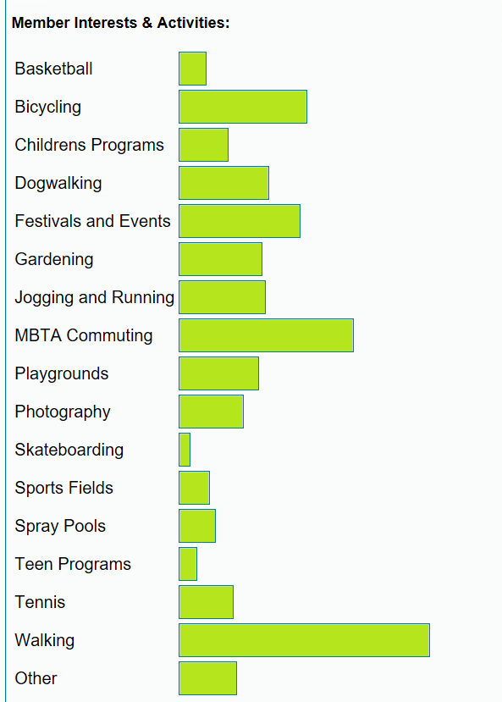
About PMAC strength & advocacy
How PMAC Members Use the Park
240+ PMAC Members
500+ Social Media Followers
1500 to 2000 Volunteer Hours Per Year
15- 30 Volunteer Days Per Year (with BostonCares, Northeastern University, Corporate and School Groups)
200+ Community Gardeners
1500+ Bicycle commuters per day
10,000+ MBTA commuters per day
150+ participants in youth programs & childrens’ gardening

