Slide 1
AGENDA
April 4, 2022 PMAC Meeting
Focus on Master Planning, Meeting With Kate England
Welcome and Thank You
Introduction to PMAC
Priority Topics
FOCUS PROJECTS

Slide 2
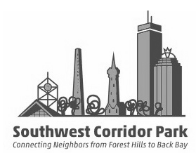
Southwest Corridor Park Management Advisory Committee (PMAC)
PMAC meetings have brought park neighbors together monthly on park-related discussions since the 1980s…. An all-volunteer network with interest and expertise in park history, gardening, active transportation, community development and more.
12 community gardens, with a network of volunteer coordinators, with support from DCR SWCP staff;
Over 2,000 hours of hands-on volunteer park stewardship work in the park each year; in 40+ park garden sections; plus an approximately equal number of hours of behind-the-scenes work;
With 4.7 miles of bike/walking paths, we provide Bike/Walking Path Advocacy | Social media communications with citywide bicycle groups | Share information, surveys, analysis, maps with improvement projects; with DCR, the City of Boston and local bicycle and walking advocacy groups;
200+ participants each summer in park-related youth and family programming, including our mini-grant initiative and our volunteer-led programs at Jackson Square/Mildred Hailey (Children’s Garden, Science Wednesdays and collaboration with DCR-sponsored STEAM in the Park). During the pandemic we have created our new “Circle of Parks” curriculum while many in-person programs have been on hold.
Committee membership and other connections with community partners and projects along the park, including Mildred Hailey Apts. (MHATO) Partners. Alice Taylor Tenant Task Forc; Back Bay MBTA Ventilation CAC; Northeastern University CAB, new development projects near Forest Hills/Stony Brook and much more;
Monthly PMAC meetings include a Public Safety update each month, with the multiple jurisdictions that serve the park, including Massachusetts State Police, three Boston Police Districts (E13, B2 and D4), MBTA police and Northeastern University Public Safety.

Slide 3
A PARK WITH MANY AREAS OF FOCUS
Priority Topics
Environment, Trees, Climate, Active Transportation
Park Stewardship Gardening
Community Gardening
Bike/Walking Path
Playgrounds, Recreation & Sports Facilities
Dogwalking & Dog Parks
Cultural Traditions of the Park → Youth Programs, Arts Projects, History Projects, Community Events & More
FOCUS PROJECTS:
Southwest Corridor Park Extension Proposal
Redevelopment Project at Mildred Hailey Apts.
Other development projects: Parcel 3 – Terrace St – Amory St – Stonybrook Neighborhood – Northeastern
MBTA Back Bay Ventilation Project

Slide 4
Assets that PMAC can bring to the Master Planning Process
HANDS-ON IN THE PARK / EYES & EARS in the park
KNOWLEDGE OF HISTORY – FORMAL AND INFORMAL
MANY AREAS OF EXPERTISE – FORMAL AND INFORMAL
TOOLS & INFORMATION ON OUR WEBSITE / WISH-LIST / PARK DASHBOARD / PARK SURVEY RESULTS
SOCIAL MEDIA / EMAIL / GENERAL NETWORKING
MEMBERSHIP IN NEIGHBORHOOD AND COMMUNITY COMMITTEES

Slide 5
QUESTION: How do our projects and “wish list” items align with master planning process?
EXAMPLE 1: Remove cobblestone strips along paths near intersections.
EXAMPLE 2: Discuss feasibility of using MBTA land near Green St./McBride St. for the “Southwest Corridor Park Extension” proposal, with pathway and dog park.
EXAMPLE 3: Continue to support DCR park staff with tree planting and tree replacement.
EXAMPLE 4: Collaborate with the Mildred C Hailey redevelopment project to re-align pathway through Jackson Sq.
EXAMPLE 5: Update signage throughout the park to be less cluttered but also to clearly communicate important messages.

Slide 6
BACKGROUND INFORMATION

Slide 7
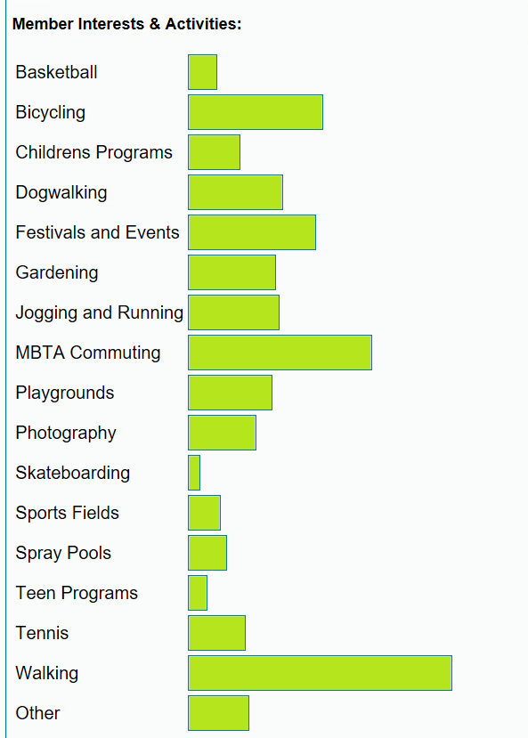
About PMAC strength & advocacy
How PMAC Members Use the Park
240+ PMAC Members
500+ Social Media Followers
2000+ Volunteer Hours Per Year
15- 30 Volunteer Days Per Year (with BostonCares, Northeastern University, Corporate and School Groups)
200+ Community Gardeners
1500+ Bicycle commuters per day
10,000+ MBTA commuters per day
150+ participants in youth programs & childrens’ gardening

Slide 8
(From our 2018 Annual Meeting Presentation) Advocacy & Advisory Work: Our Volunteer Network
We track garden stewardship volunteer hours through an online tracking screen… approximately 2,000 hours each year. We estimate that our other volunteer roles account for a contribution of an estimated 1,500 to 2,000 hours.

Slide 9
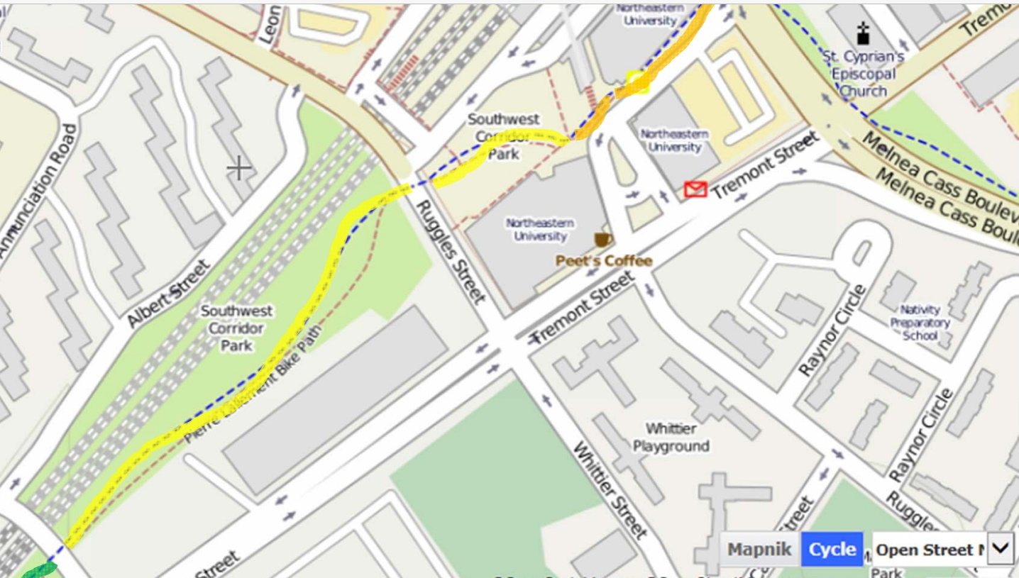
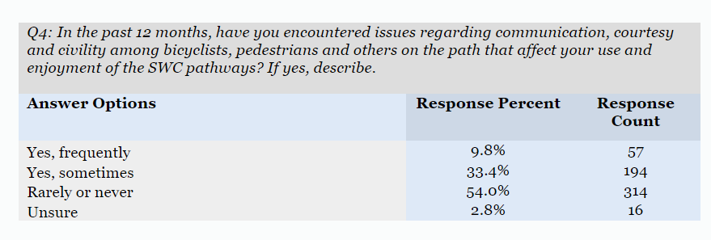
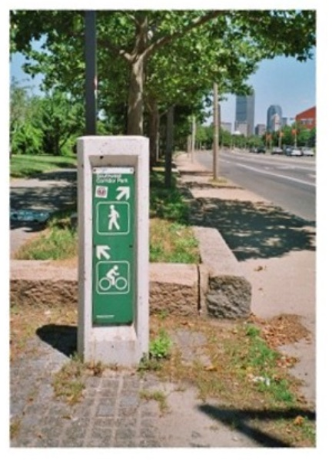
BICYCLE PATH RESEARCH & ANALYSIS

Slide 10
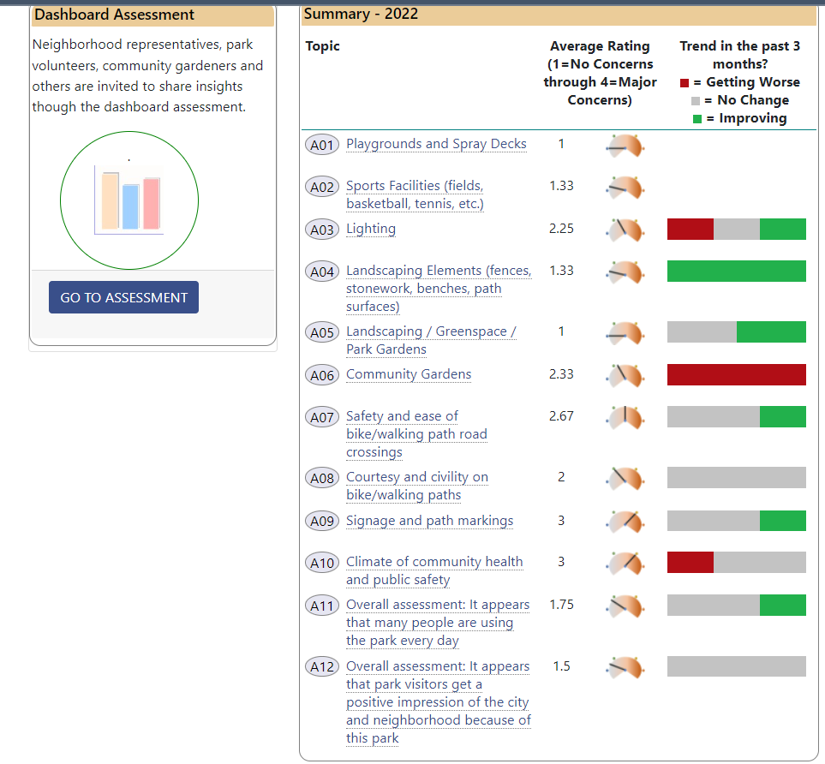
PARK DASHBOARD

Slide 11
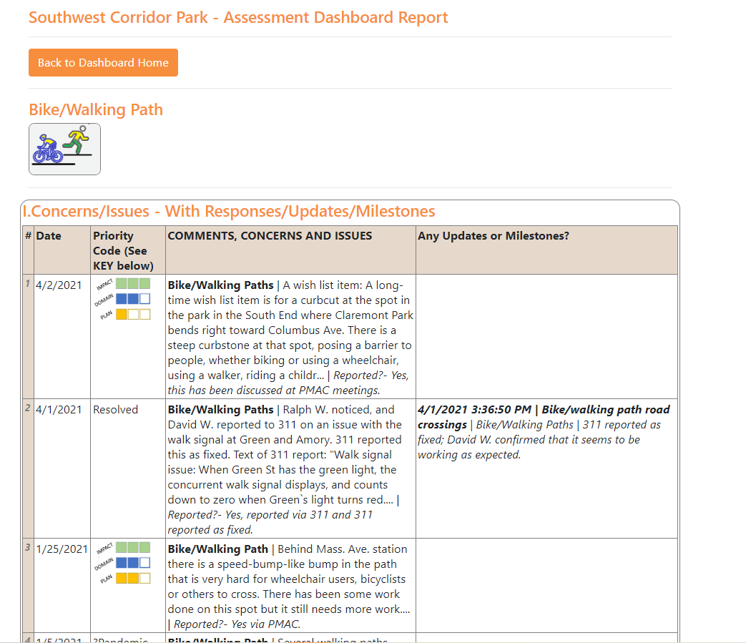

Slide 12
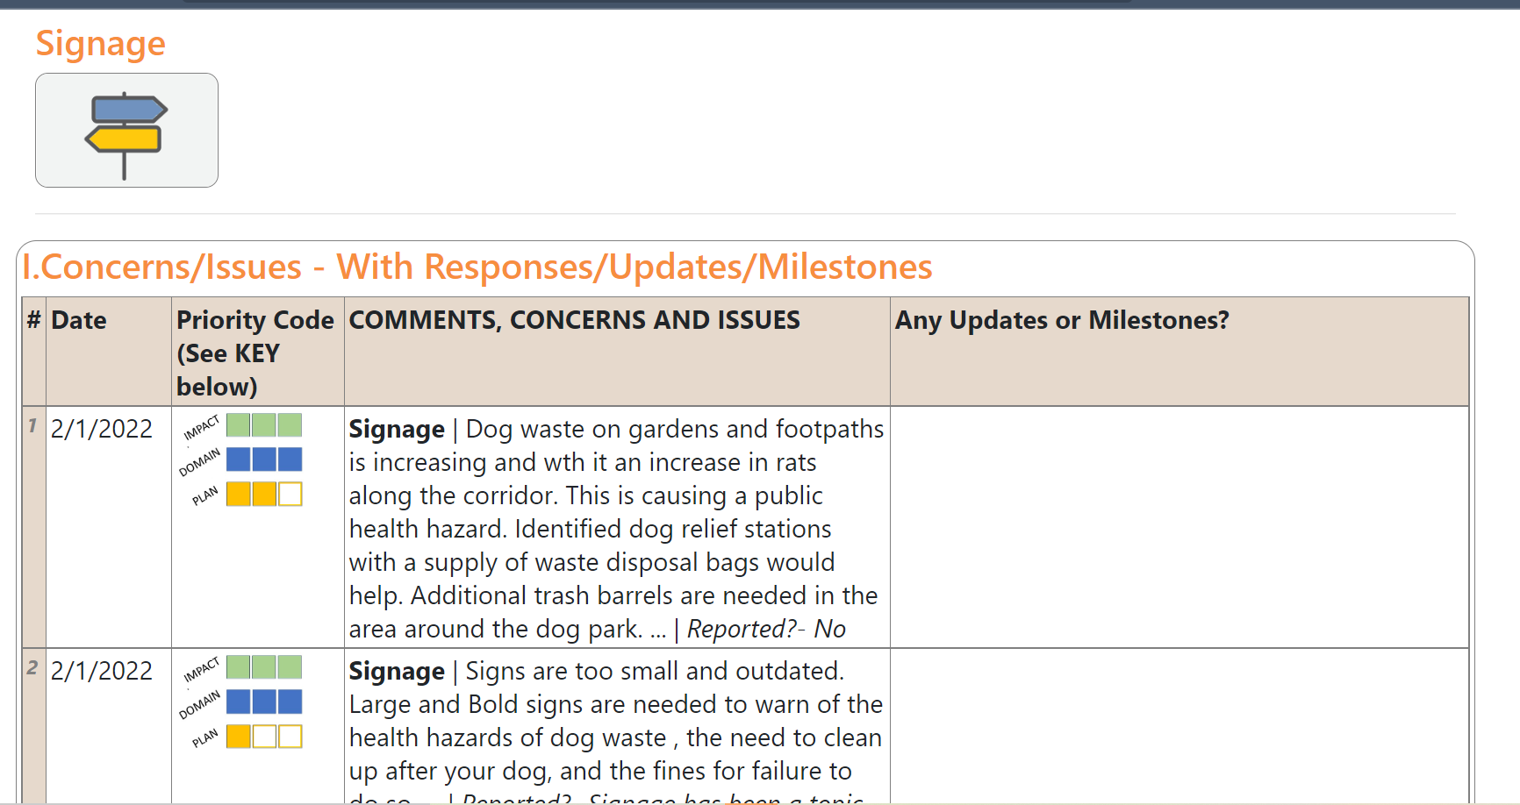

Slide 13
SOME FAVORITE IMAGES …

Slide 14
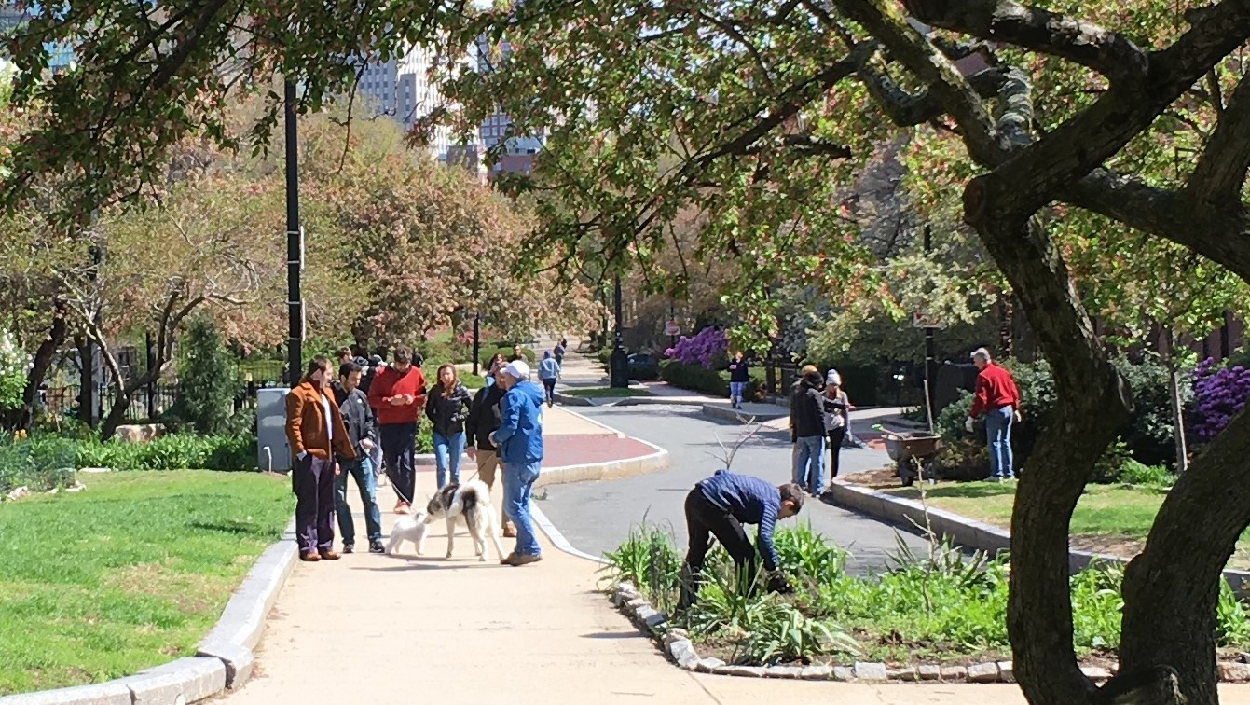
SOME FAVORITE IMAGES …

Slide 15
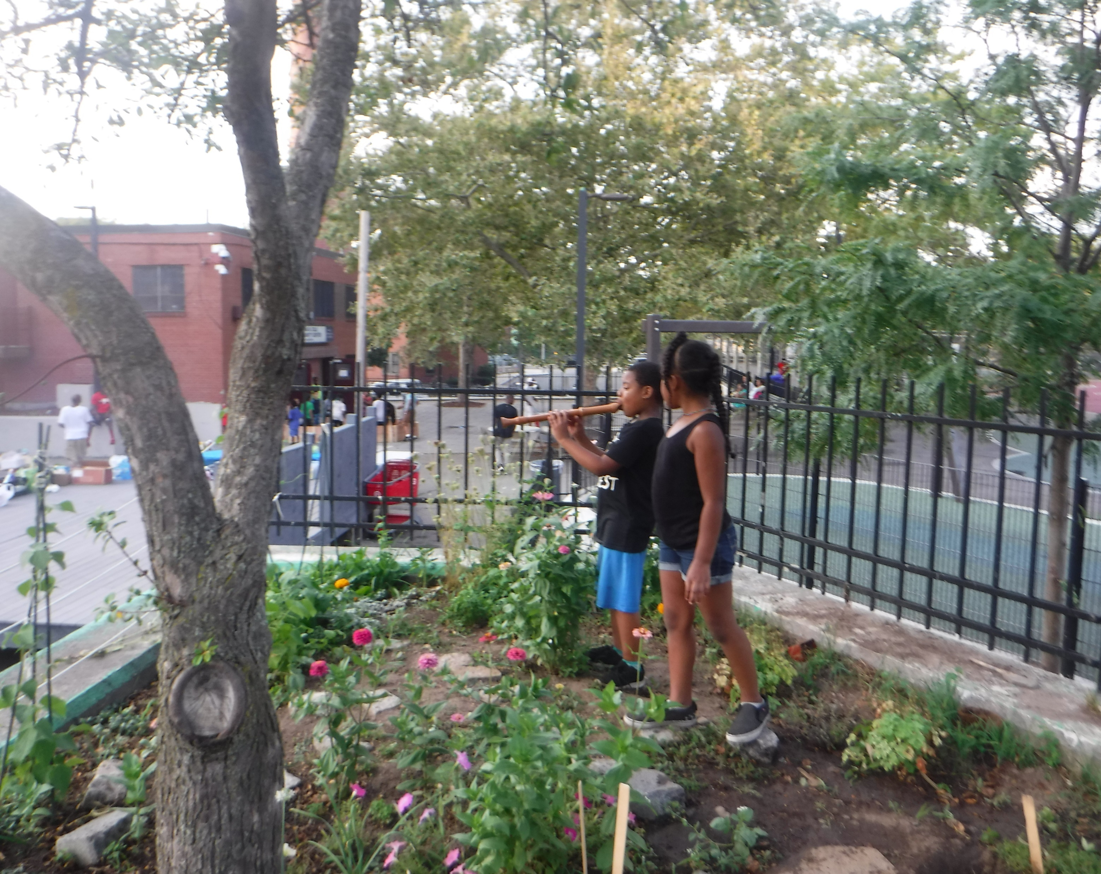
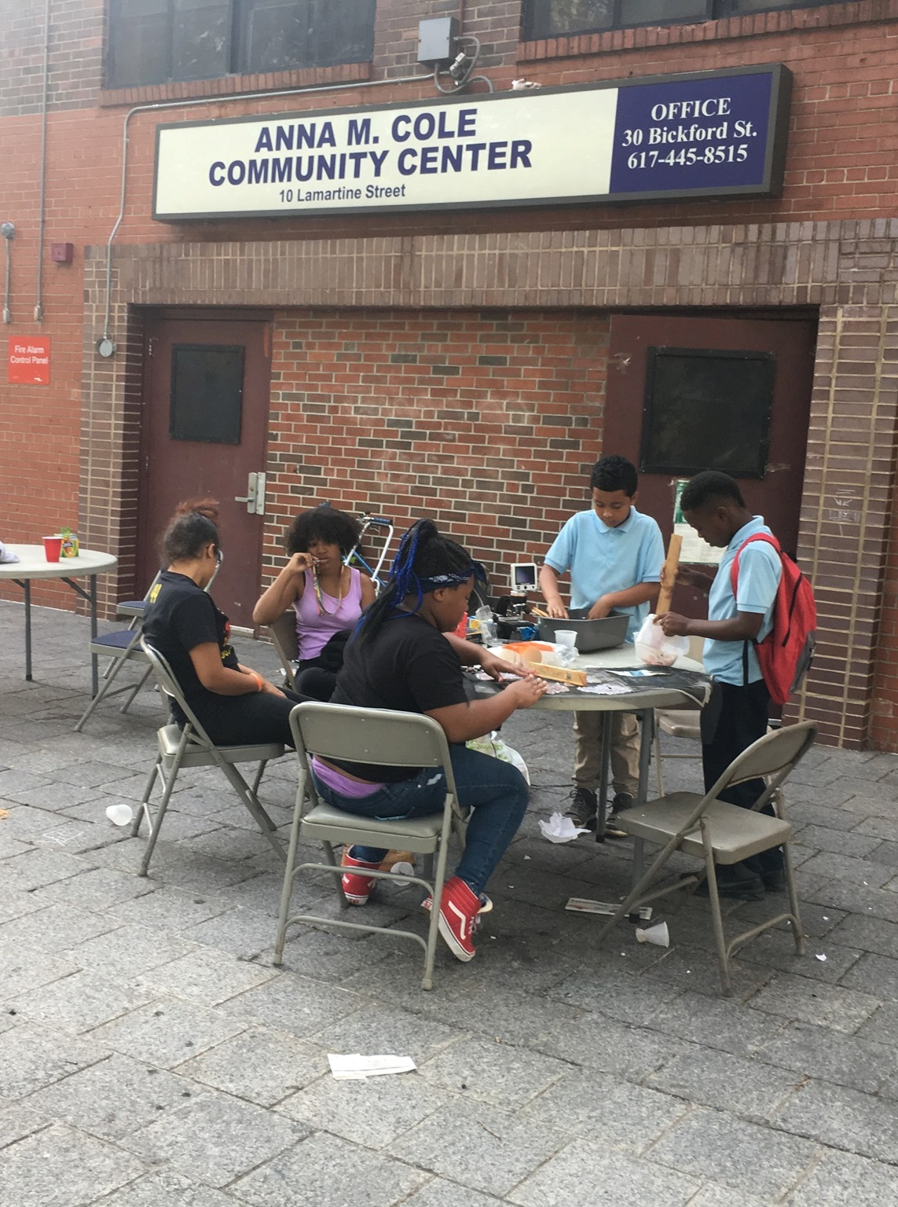
SOME FAVORITE IMAGES …

Slide 16
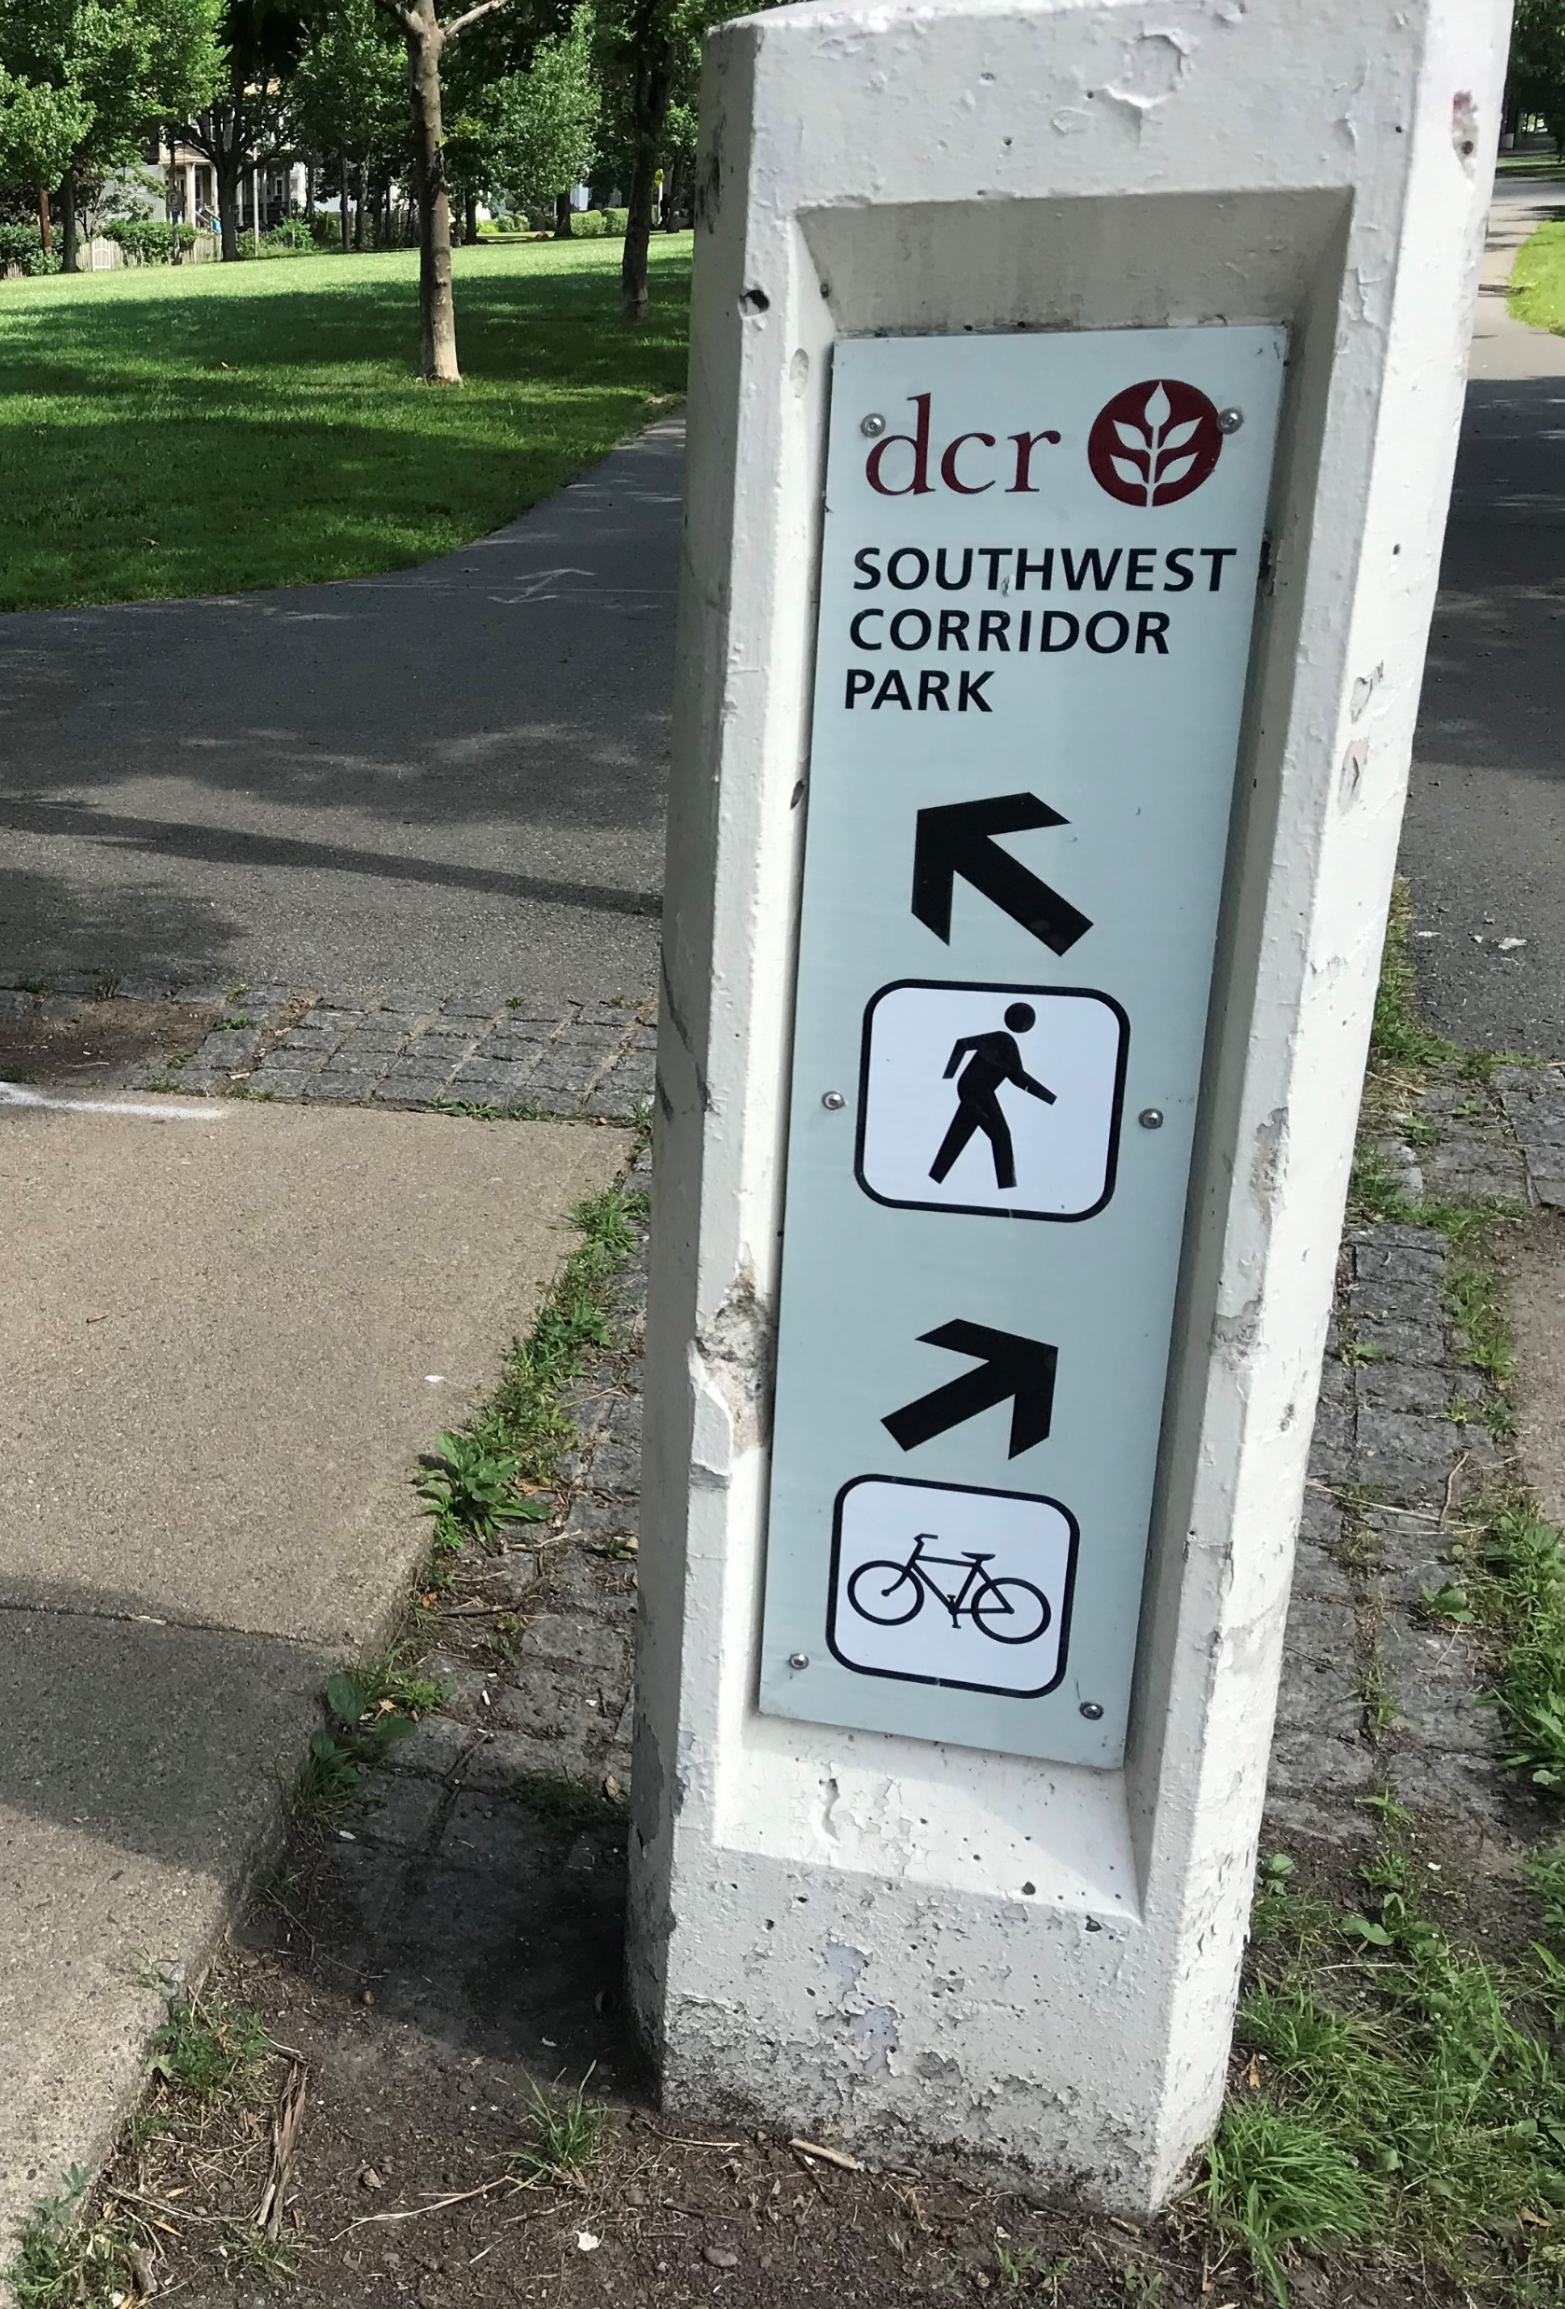
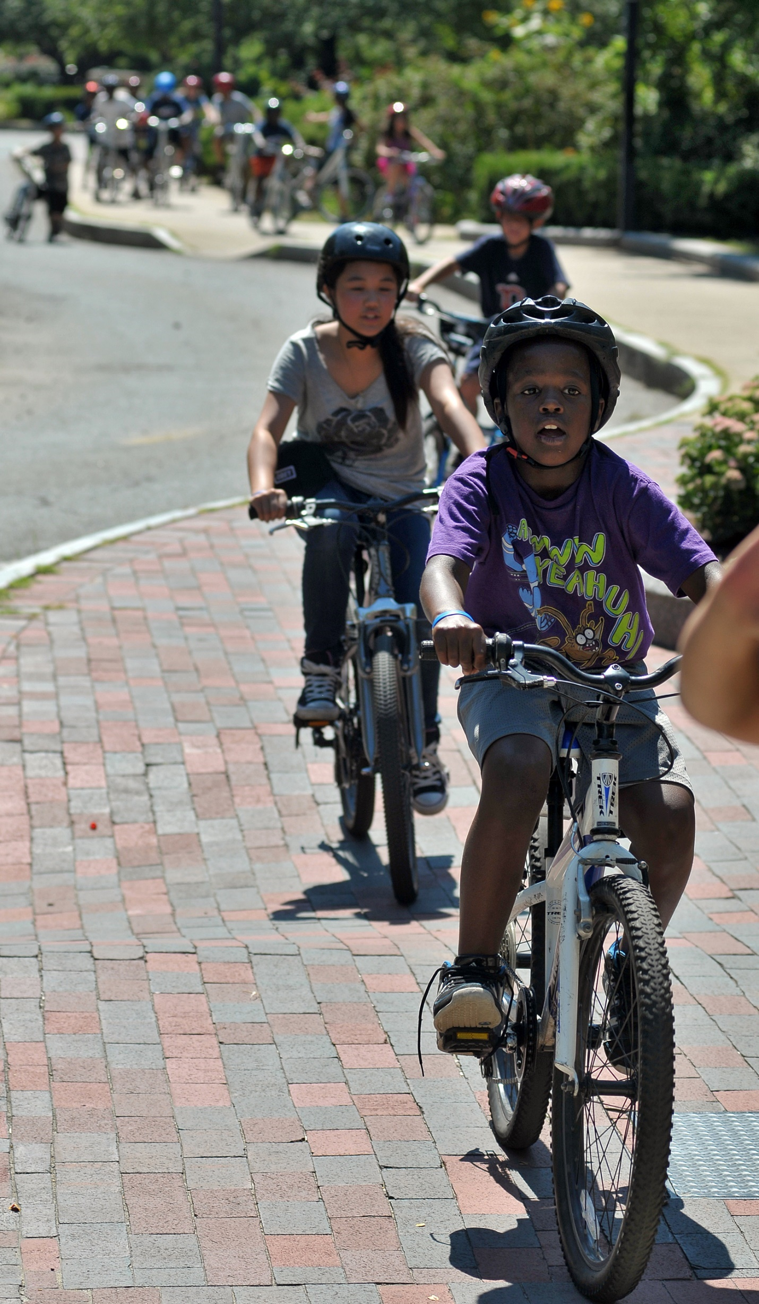
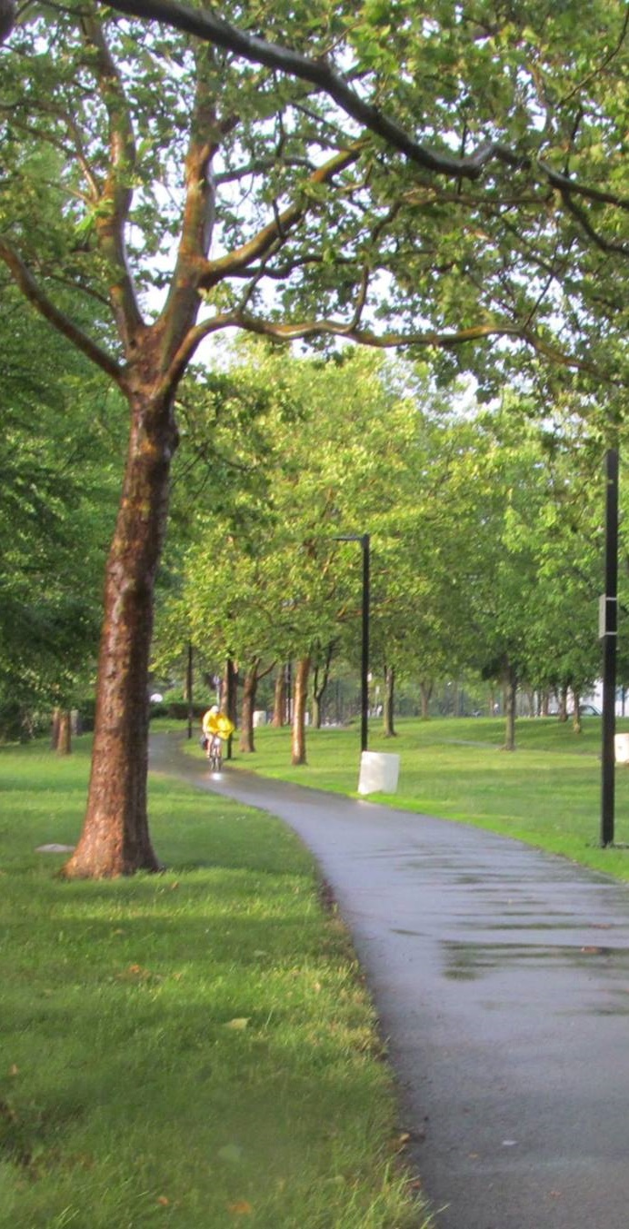
SOME FAVORITE IMAGES …

Slide 17
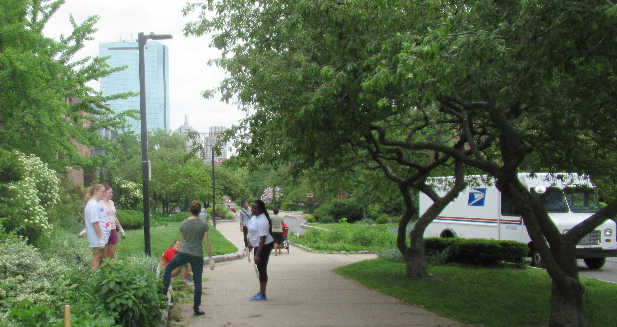
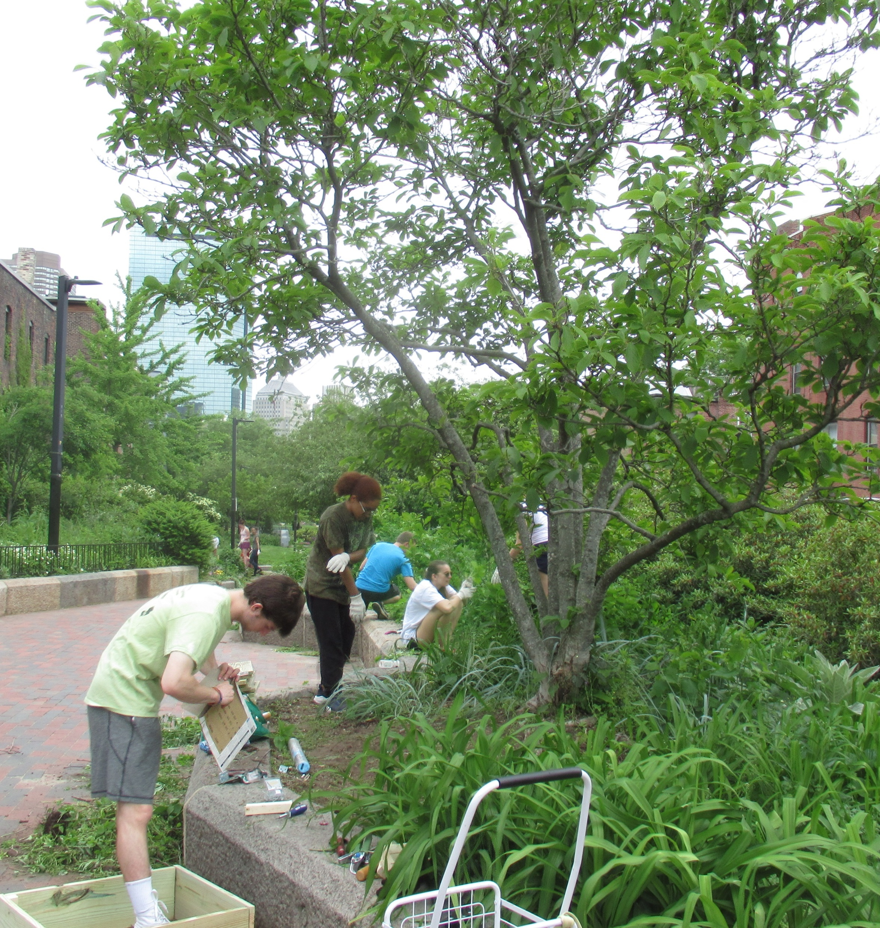
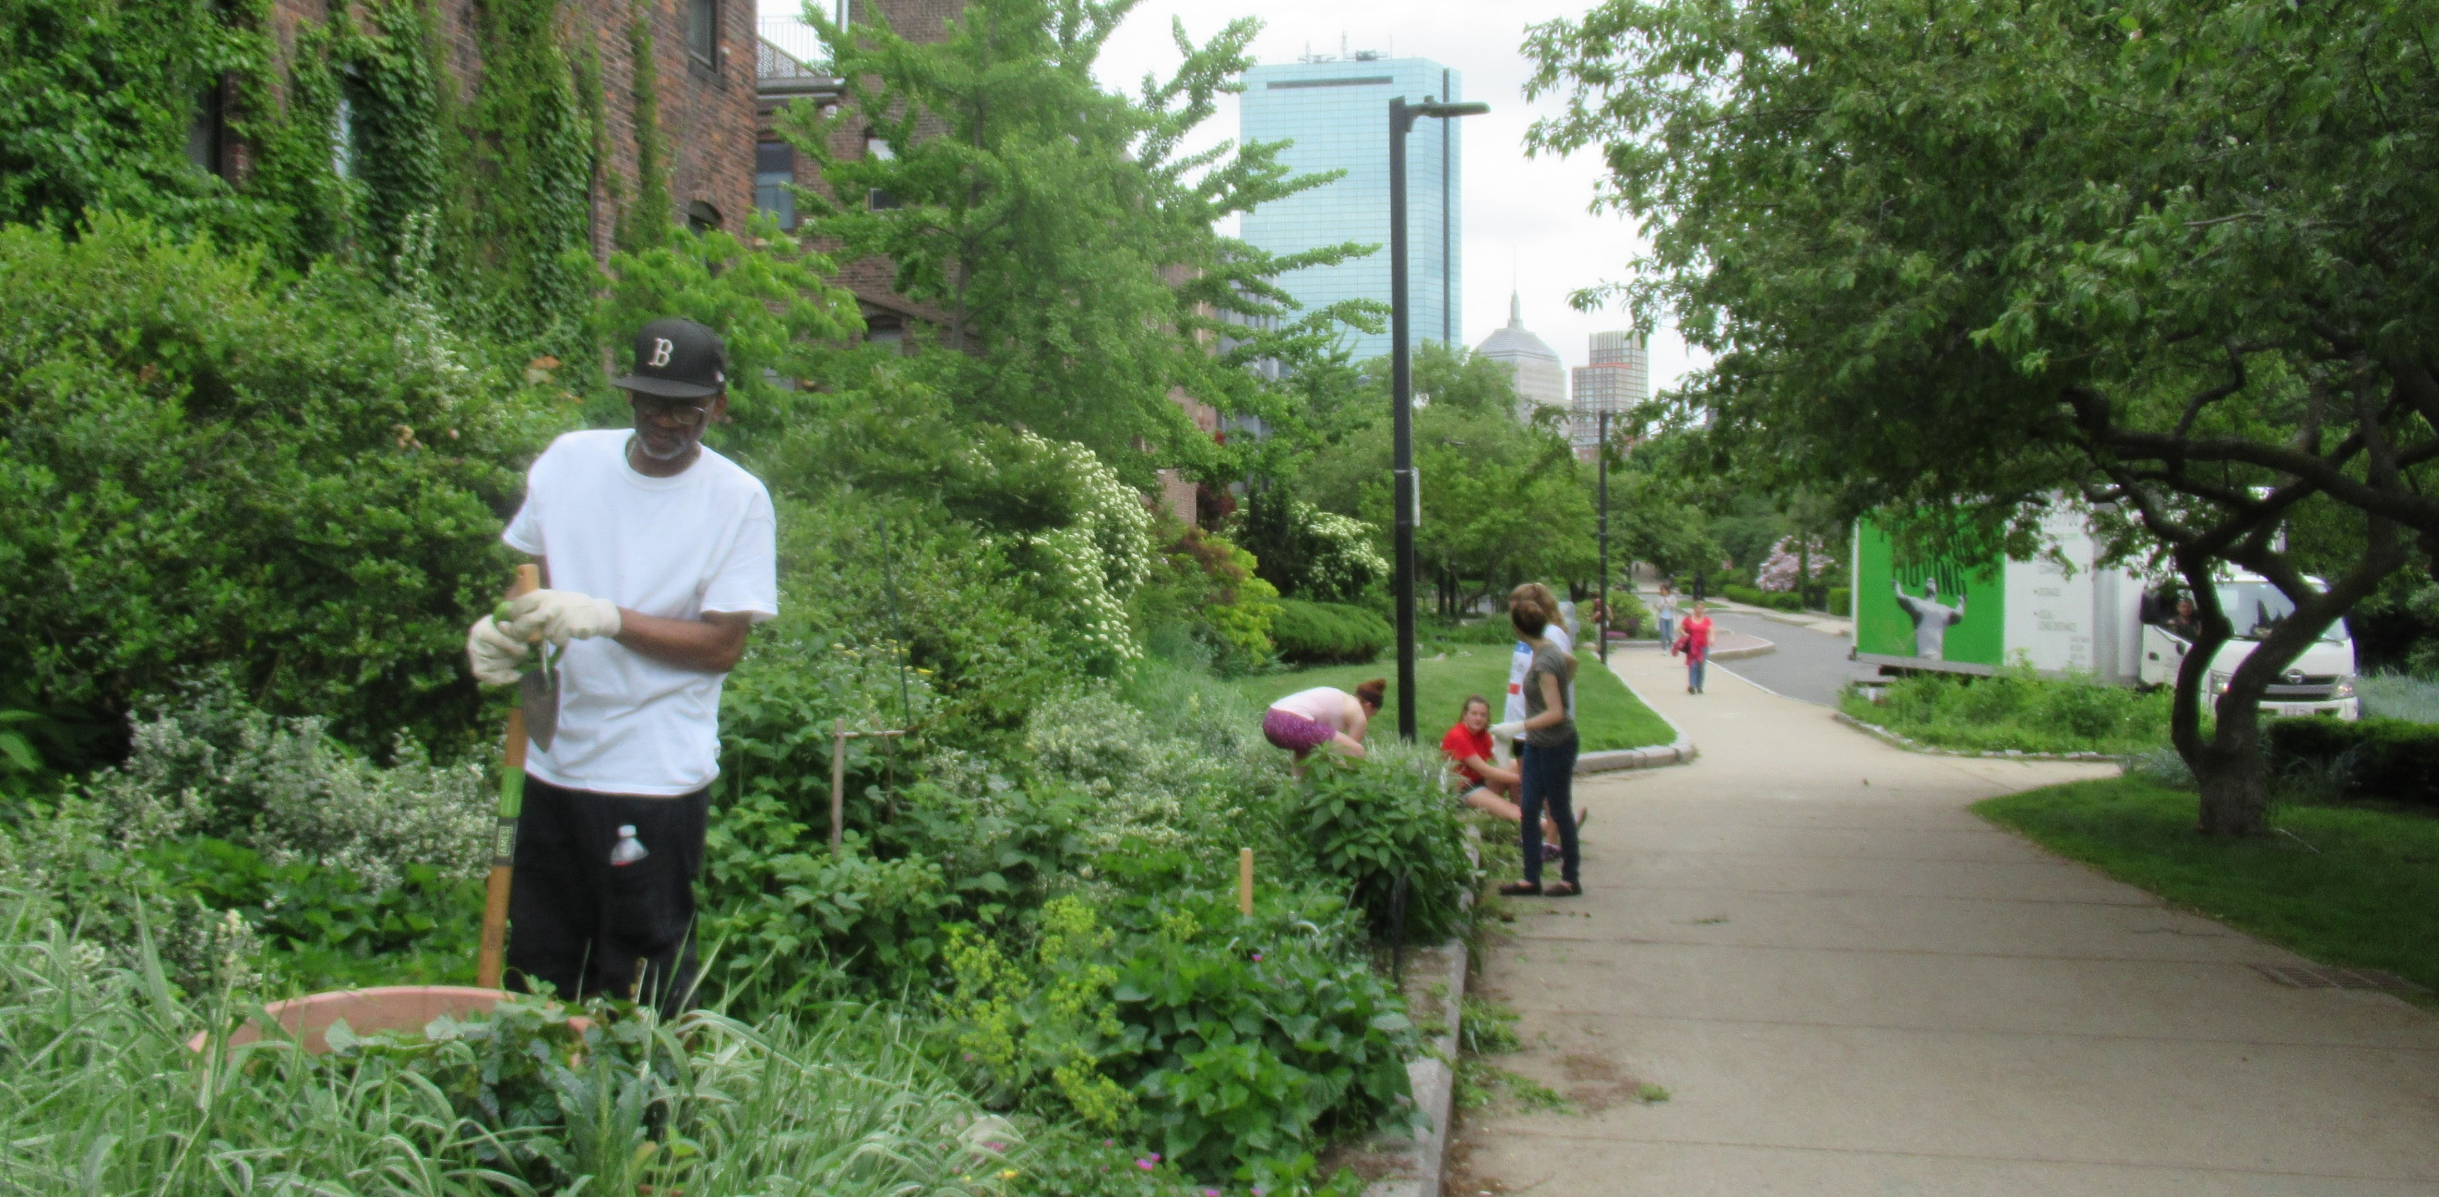
VOLUNTEER DAY WITH NORTHEASTERN UNIVERSITY STUDENTS AND NEIGHBORHOOD VOLUNTEERS
SOME FAVORITE IMAGES …
Notes:
Jenny Jones coordinates a network of volunteers and volunteer events in Section 3 of the park. In this photo, a project at Anson Street outside the community garden.

Slide 18
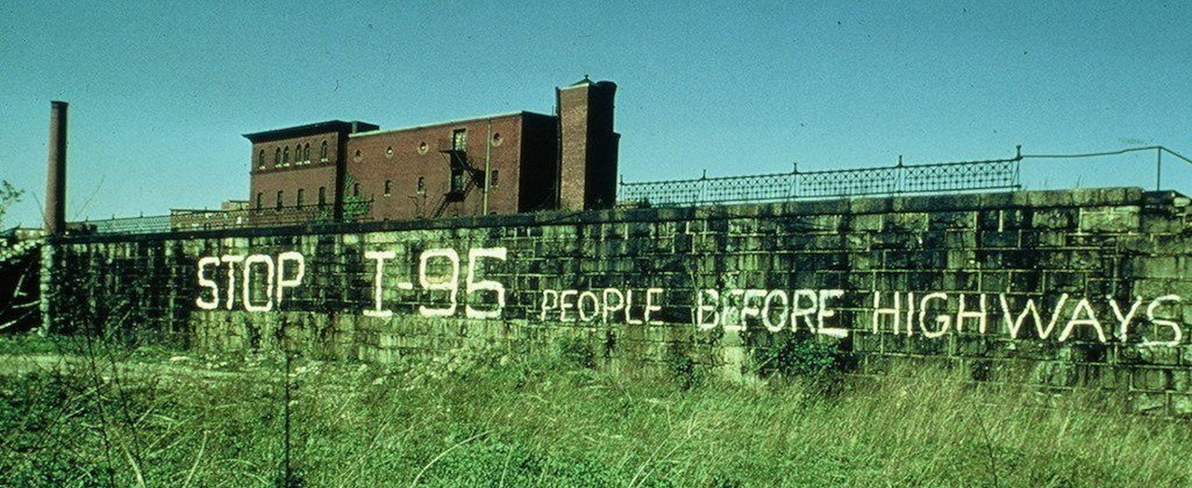
PARK HISTORY
The history of the People Before Highways movement is well-known and celebrated in the Boston area. The history that follows is just as significant in providing blueprints for civic engagement.
(1.) The park design process pioneered a high level of community involvement, with Station Area Task Forces (SATF’s) plus PMAC providing neighborhood forums for the design, construction and operational planning for the park and the MBTA stations.
(2.) There were many community conversations about the importance of land use choices for the surrounding parcel of land; including Roxbury Community College, Tent City, and other key developments, with many of these conversations continuing today.
(3.) Our long history of community gardening and volunteer park stewardship was built into the design of the park, with 11 (now twelve) community gardens, as well as numerous raised bed and pocket gardens built into the park design.

Slide 19
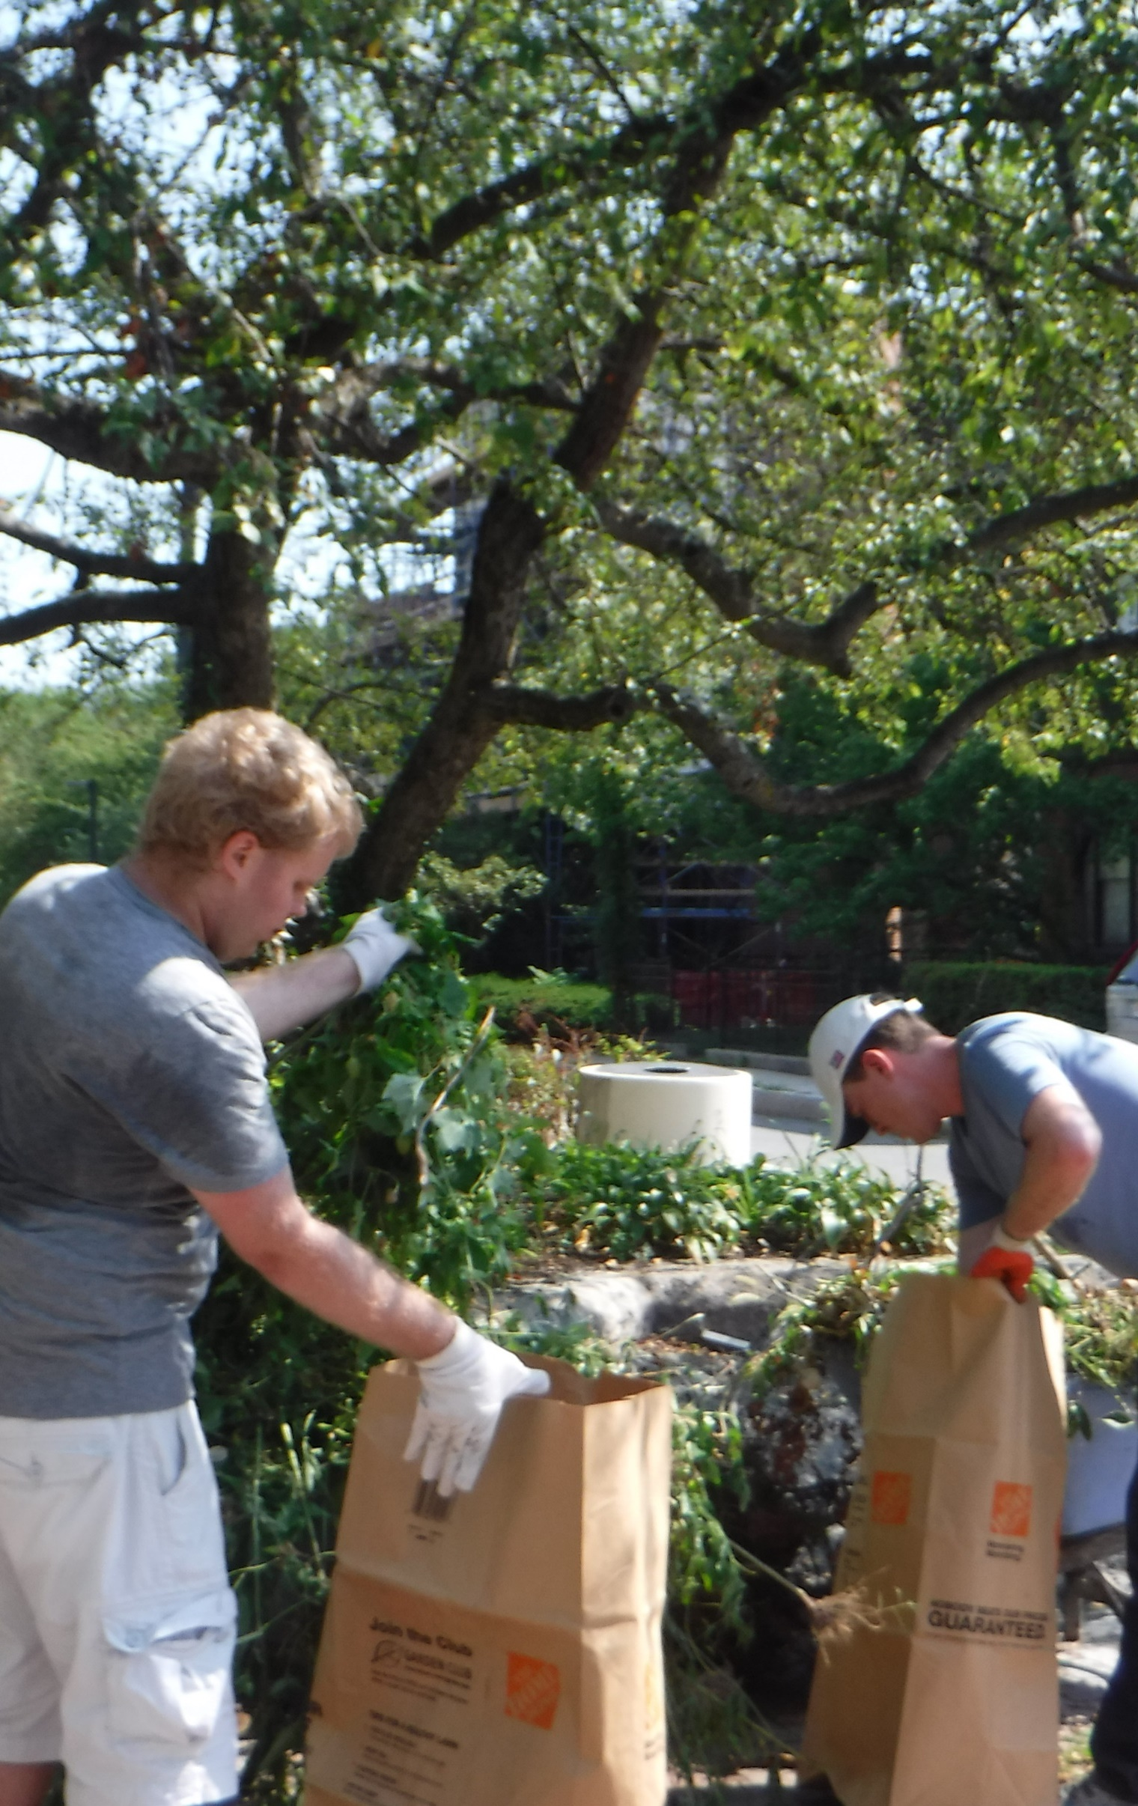
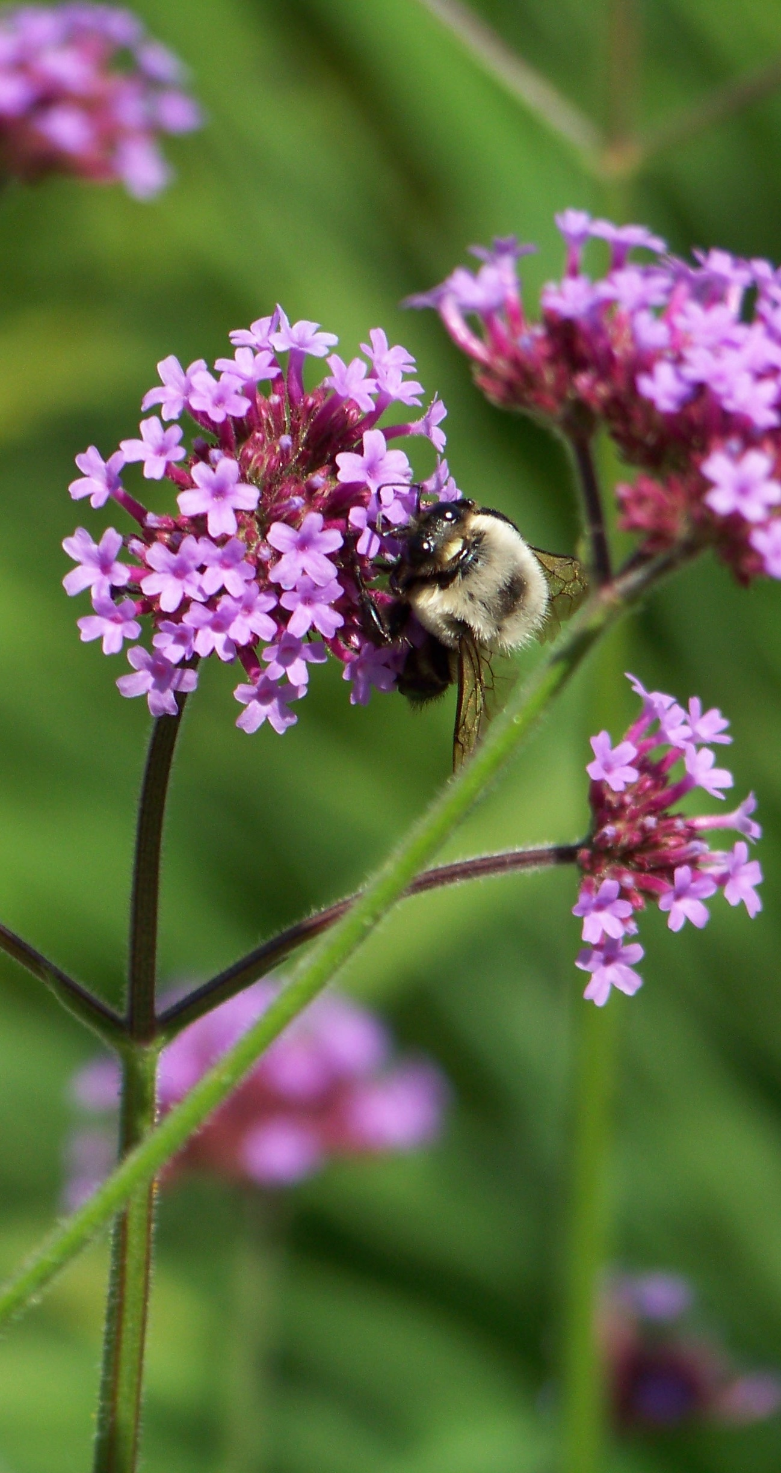
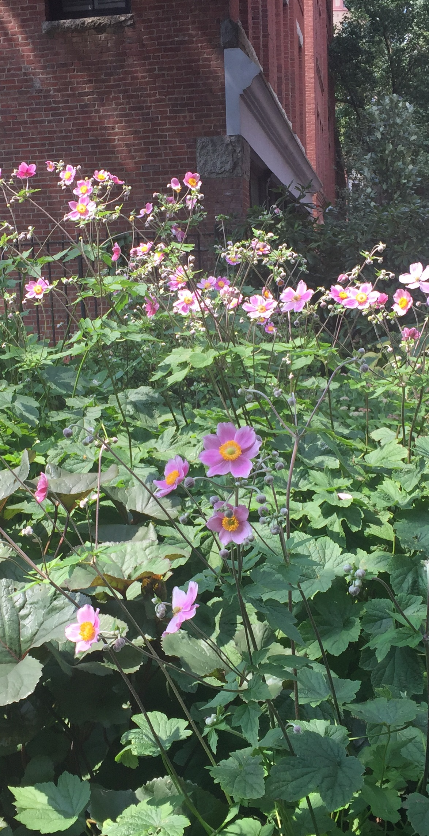
Notes:
Jenny Jones coordinates a network of volunteers and volunteer events in Section 3 of the park. In this photo, a project at Anson Street outside the community garden.

