Slide 1
Photos & screen prints // dog park files

Slide 2
120 Boylston St. lot

Slide 3
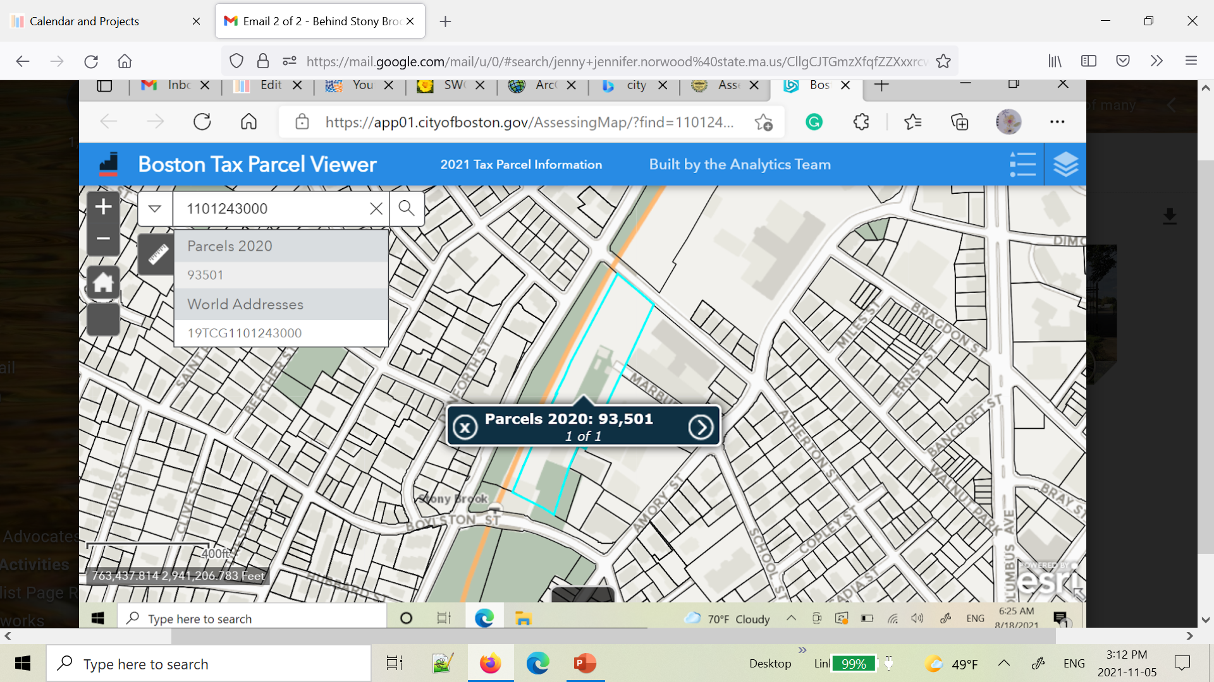
From City Assessing – showing location (and MBTA ownership) of 120 Boylston St. lot

Slide 4
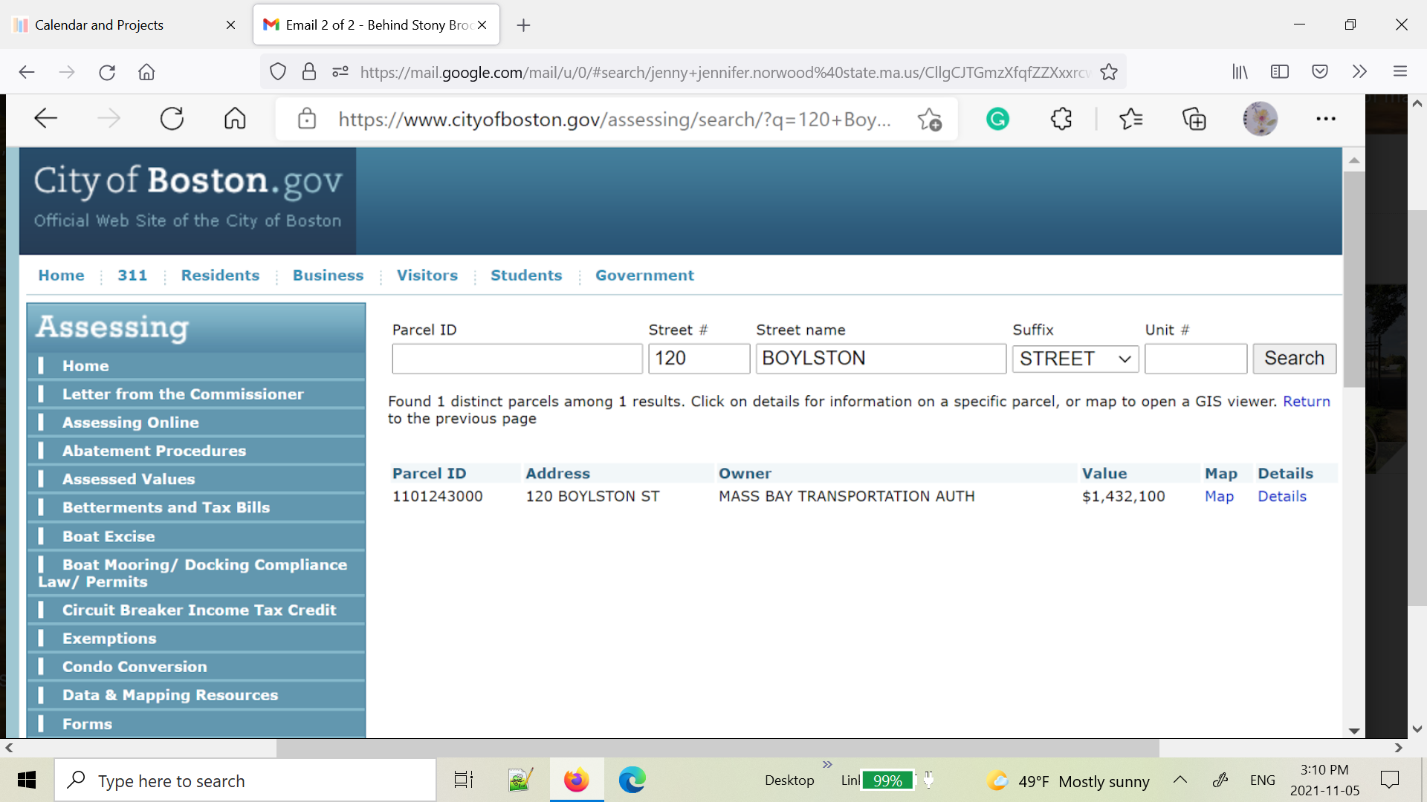
From City Assessing – showing MBTA ownership of 120 Boylston St. lot

Slide 5
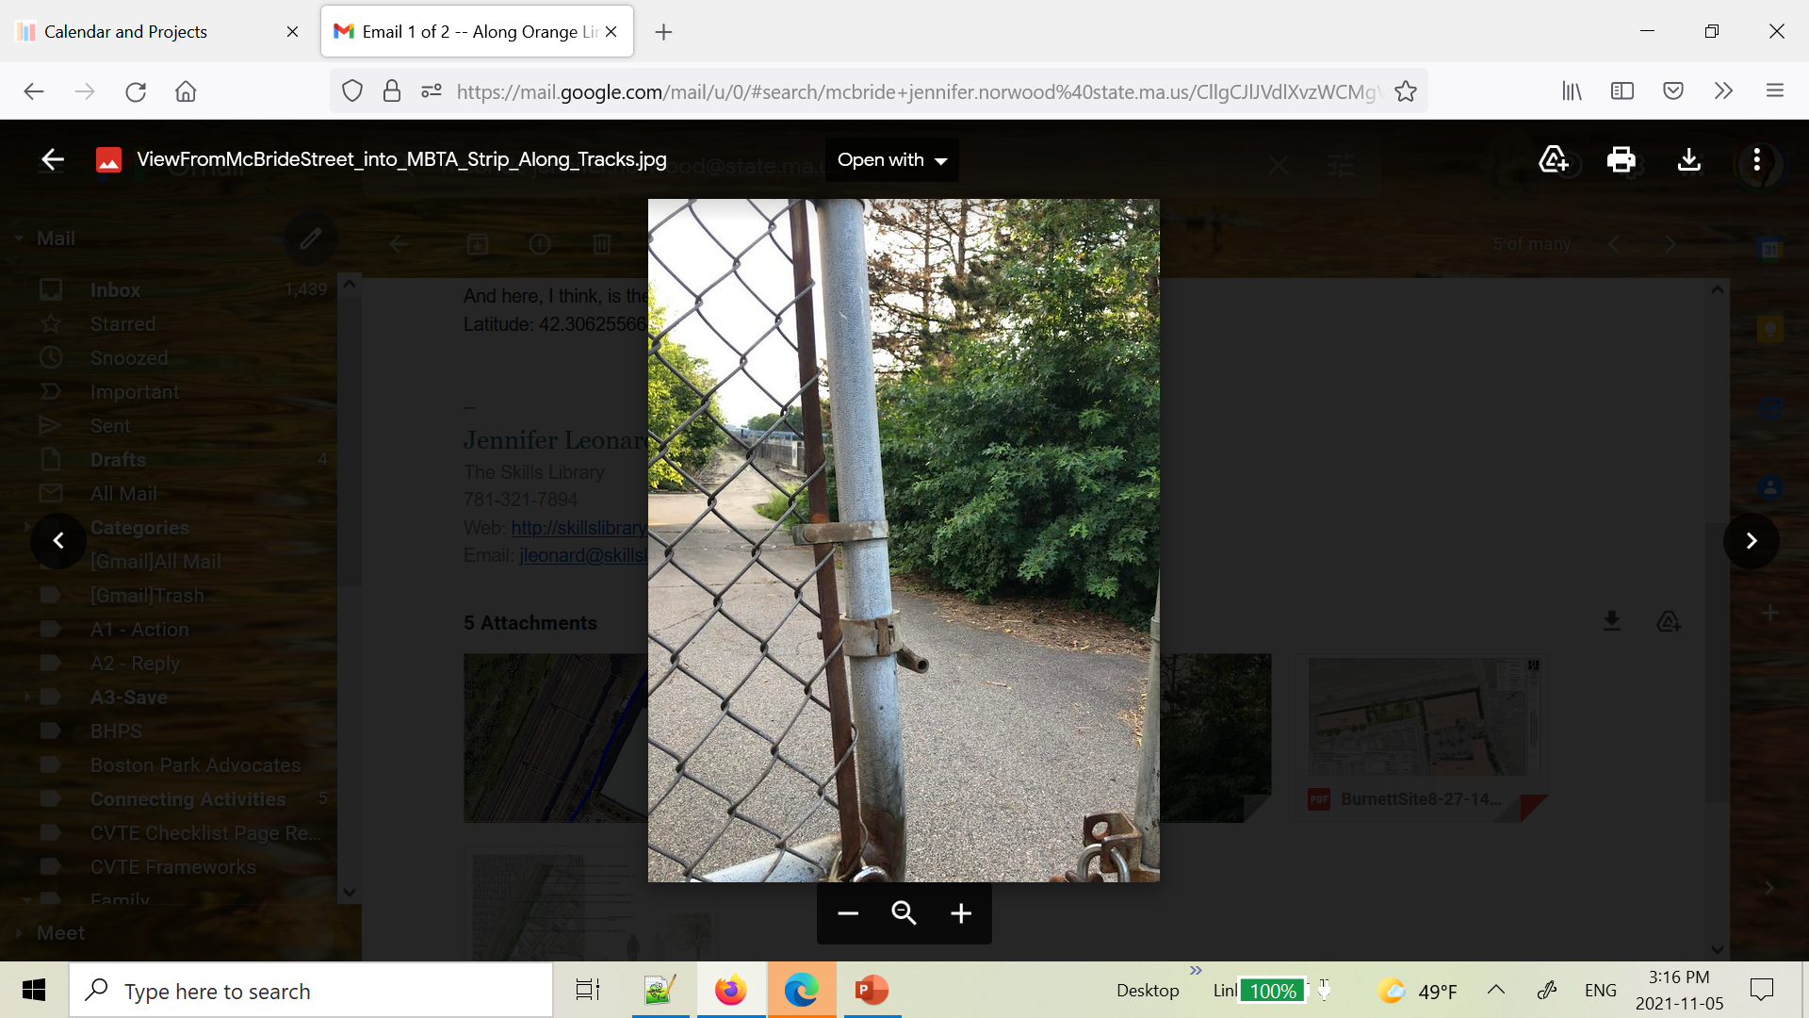
Photo from McBride St. looking into “Extension”

Slide 6
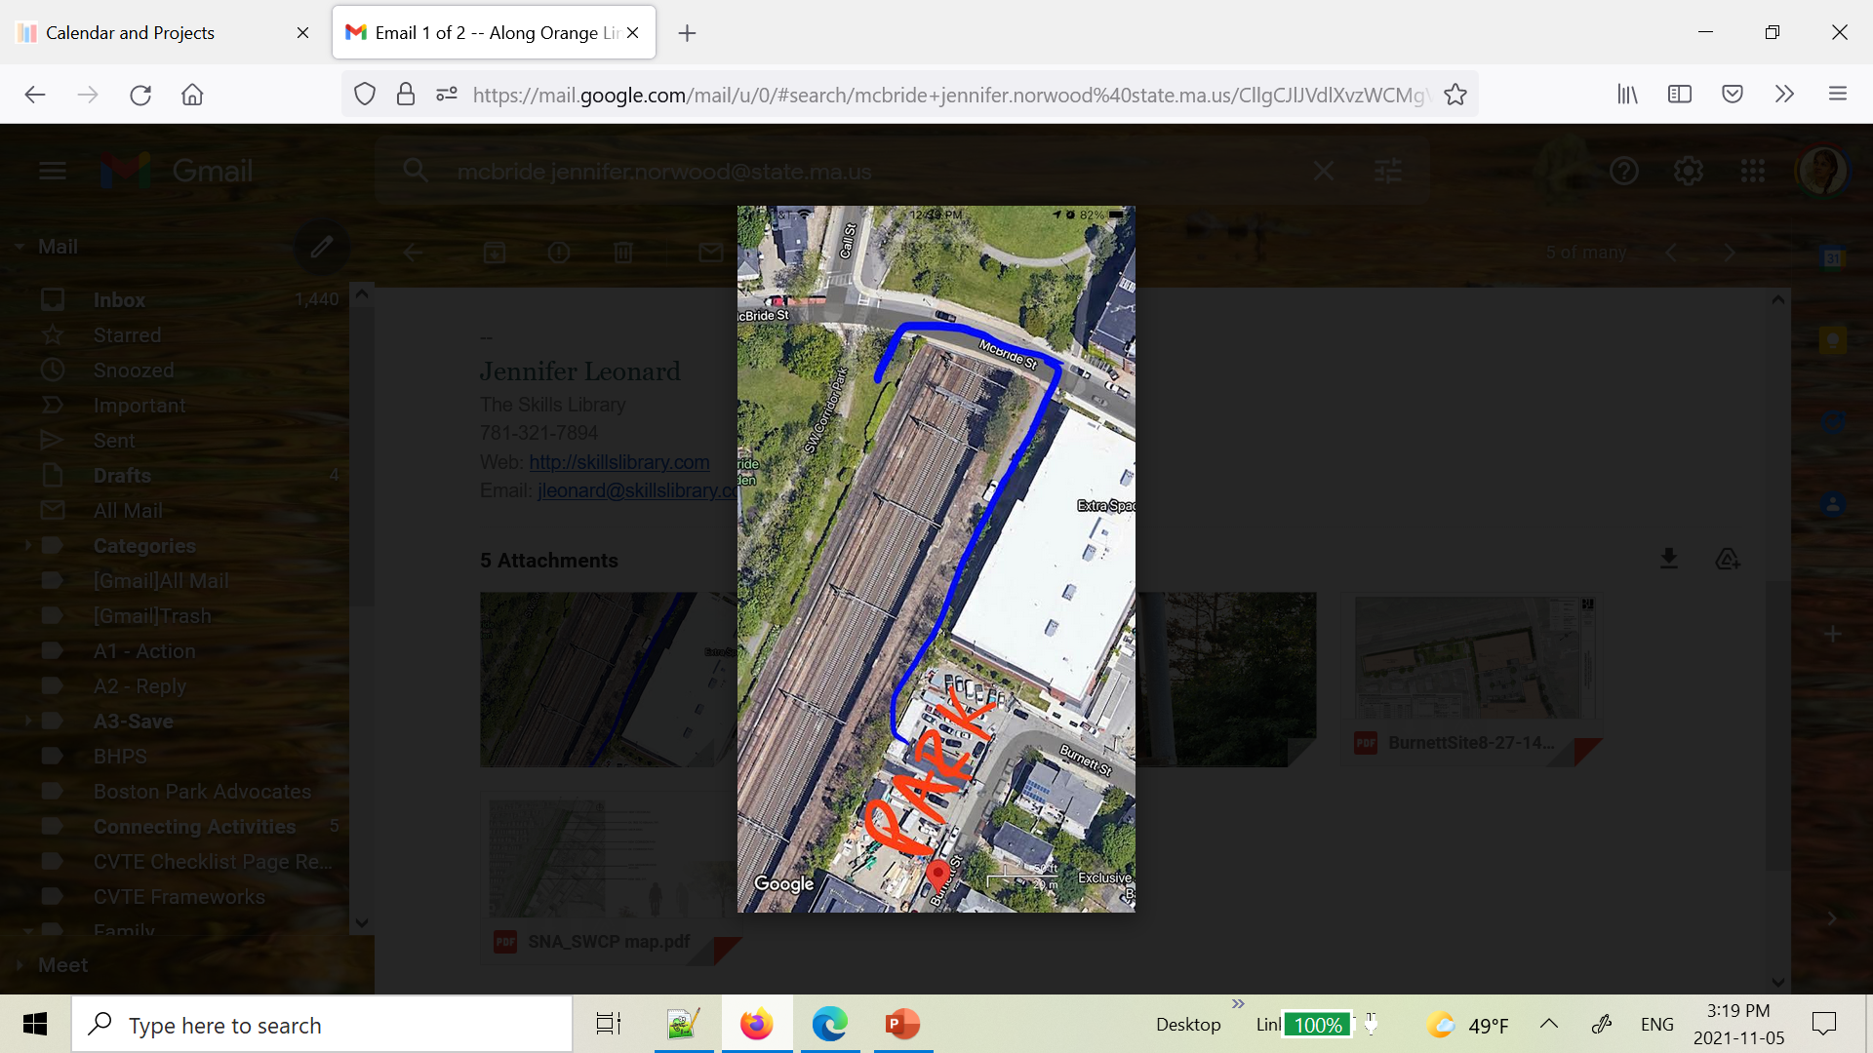
Google view

Slide 7
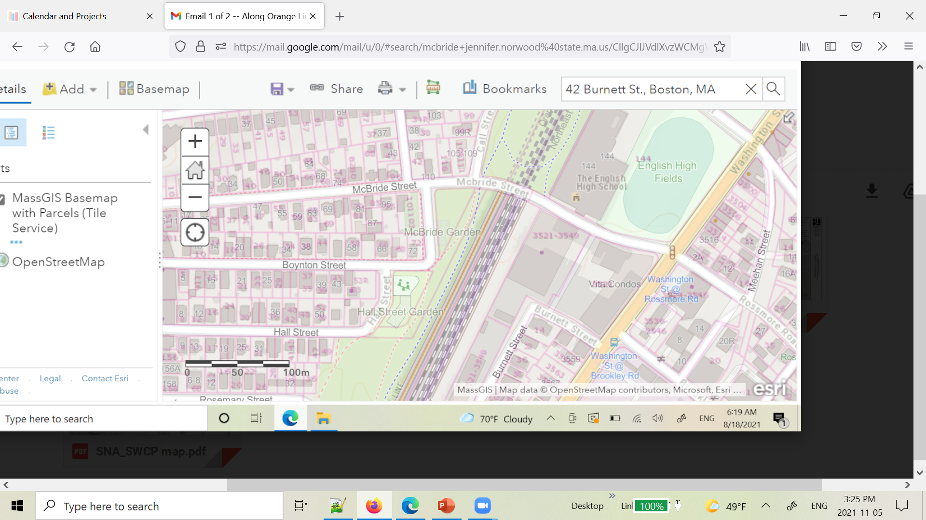
Map – McBride St. / Burnett St. area

Slide 8
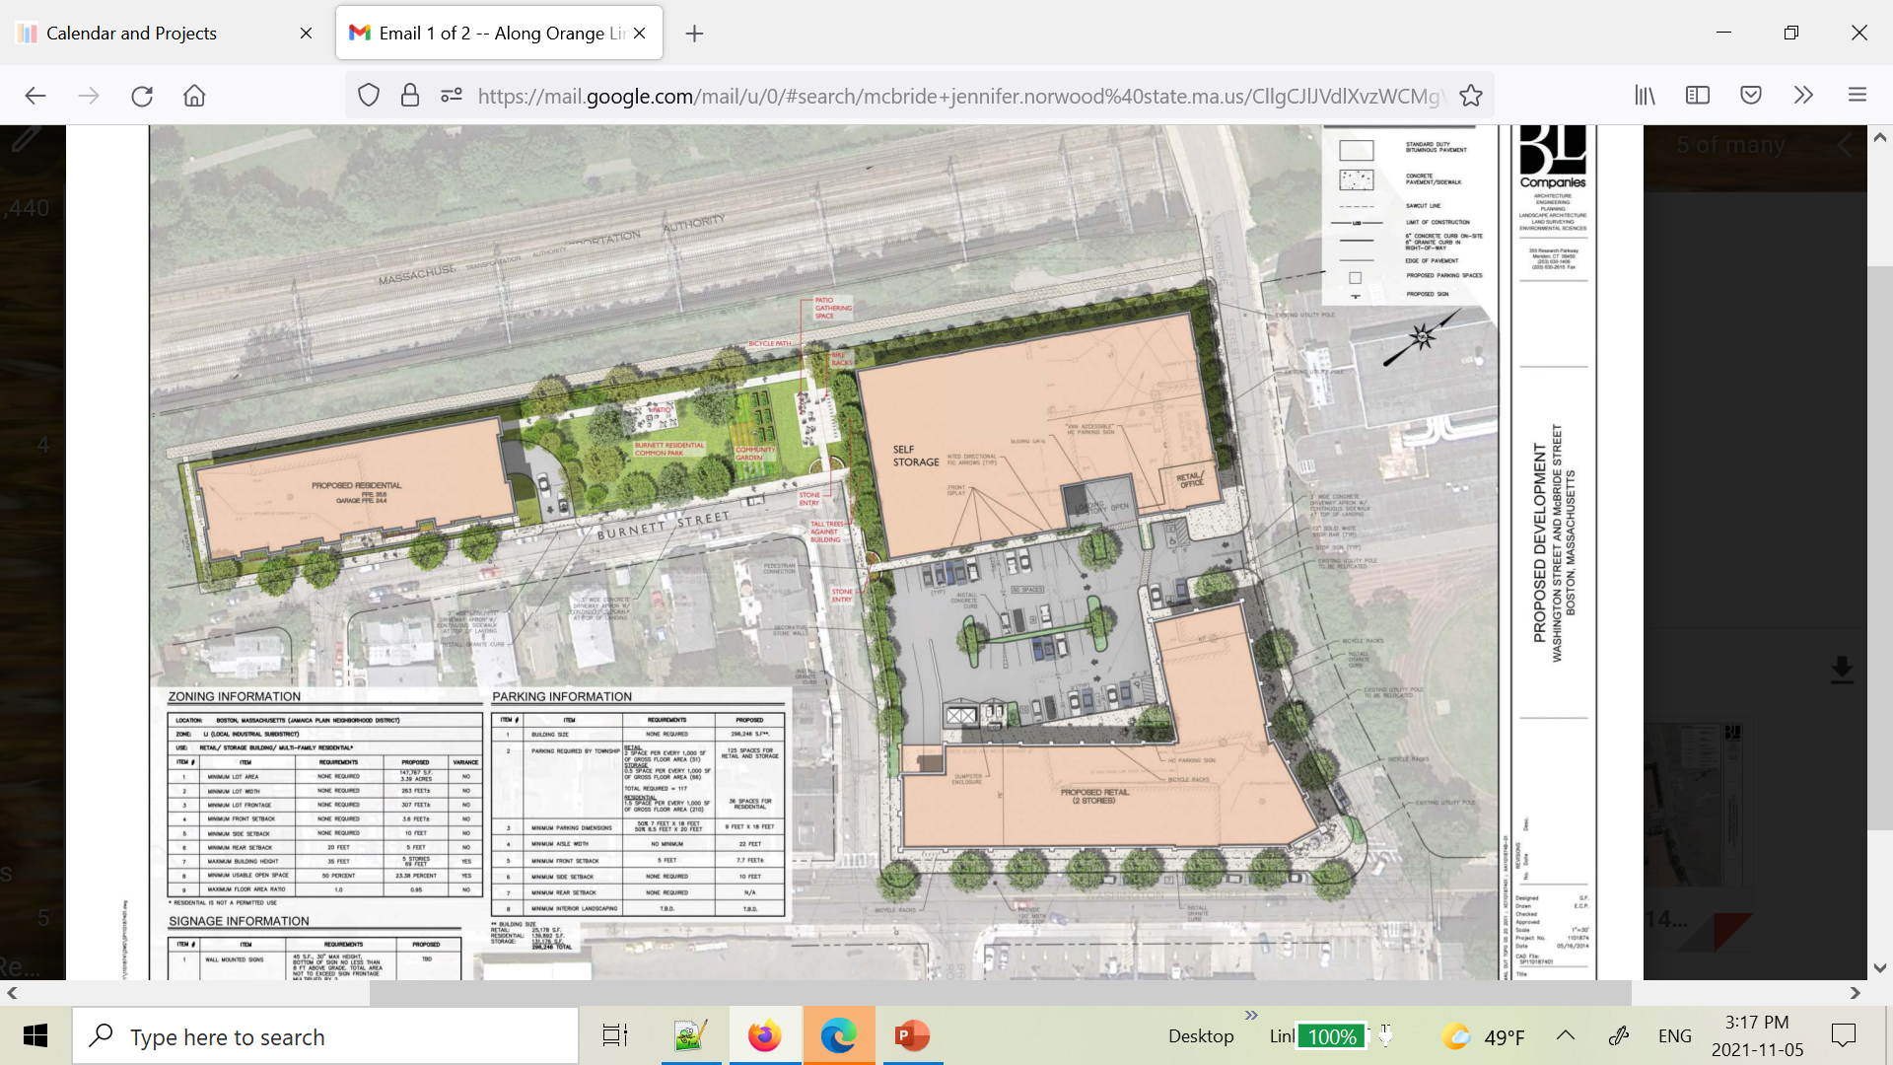
From SNA

Slide 9
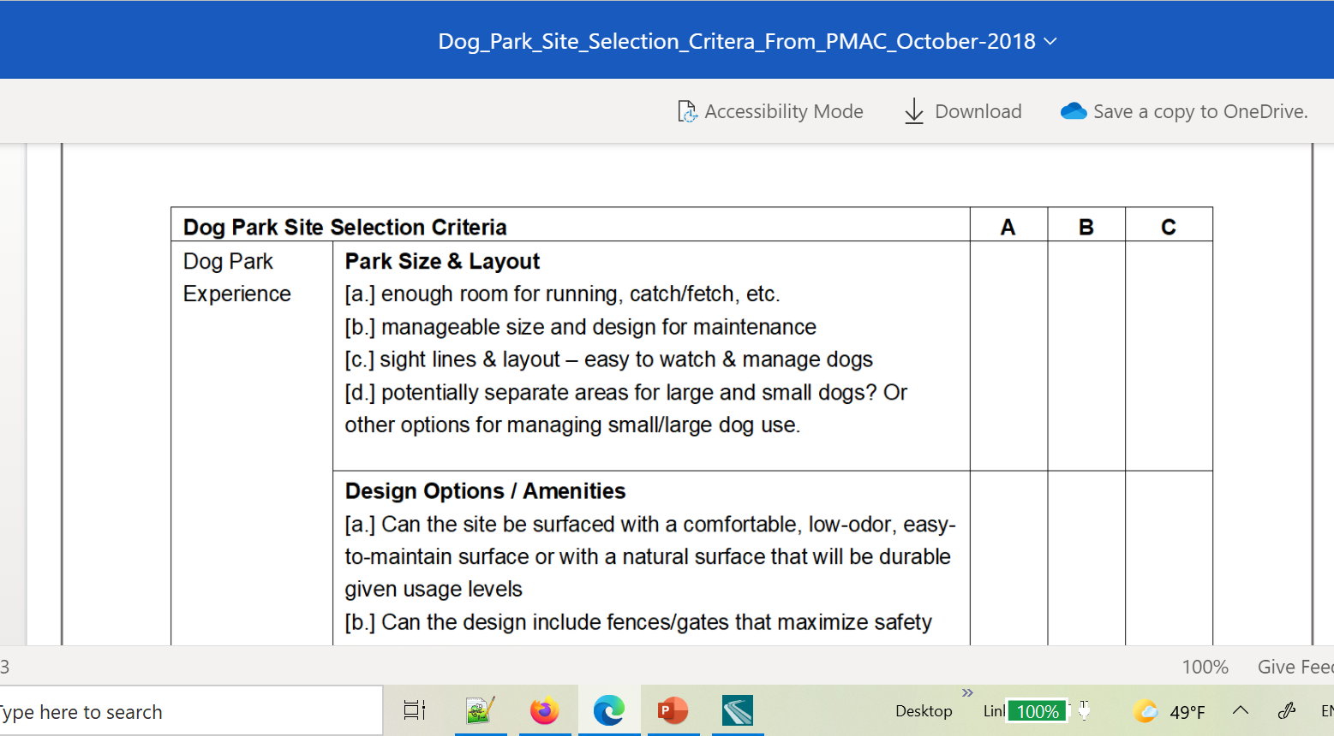
Dog Park Site Selection Criteria - From PMAC - October 2018 -Uploaded 10/12/2018
View/Download: Dog_Park_Site_Selection_Critera_From_PMAC_October-2018.docx
This is a memo we wrote in 2018, still relevant, outlining considerations for dog park site selection.

Slide 10
https://jamaicaplaingazette.com/2018/11/23/dcr-moving-forward-with-site-a-dog-park-location/
JP Gazette Article from 2018

Slide 11
District Six City Councilor Candidate, Kendra Hicks' responses to our dog park survey:
Question #1: Do you support building enclosed dog parks in all Boston neighborhoods?
Yes, I believe we have the space and the ability to make this happen. Particularly in the aftermath of the pandemic as more people become dog owners to support their own mental well-being, the city of Boston needs to stop thinking of dog parks as less of a luxury and more of a service we need to provide to our residents.
Question #2: How will you work with the state and DCR to reallocate state land and/or share public spaces such as athletic fields?
To my knowledge, DCR has been unresponsive to the request of community members and local elected officials to join in the conversation regarding the location of a dog park in the district. I would be excited to collaborate with DCR to make this happen and anticipate doing some work at the state level to get them to come to the table for a conversation.
Question #3: Are you familiar with the Brookline Green Dog Program? Do you think such a model will work in Boston? If not, why?
Yes, I am familiar with the program, it’s an innovative way to use already available space and keep it active during different times of the year. I think given the socio-economic makeup of the city of Boston I would like to explore making this a free program or one that uses a sliding scale based on income.
Question #4: Would you be open to meeting with our group to hear our concerns?
Absolutely. Our last meeting shouldn’t be the last.
Text of Friends of JP Dog Parks questionnaire response from new District 6 City Councilor (Q&A from Sept. 2021 / posted on FB page)

