Slide 1
Southwest Corridor Park
Dashboard Assessment
Initial Concept & Discussion – November 10, 2020

Slide 2
Elements of the Dashboard
Dashboard Assessment
Statistics about the park
Integrated with a new network of NEIGHBORHOOD REPRESENTATIVES as part of the PMAC network

Slide 3
Other Potential Data Sources: SWCP Website Data
Statistic | Current Year
Park Stewardship Volunteer Hours | 2156
Community Gardeners – Total Gardens Assigned
Community Gardeners – Newly Assigned this Year
PMAC Email List / Membership

Slide 4
Other Potential Data Sources: MBTA Station Data

Slide 5
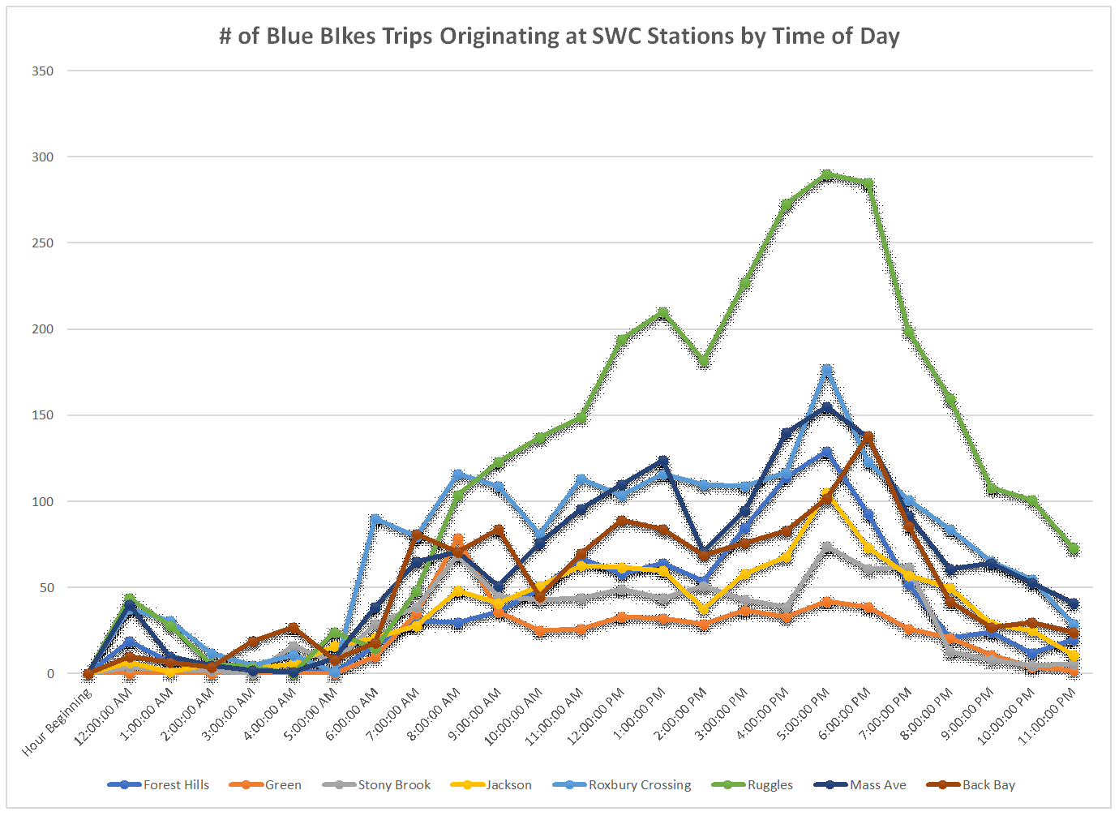
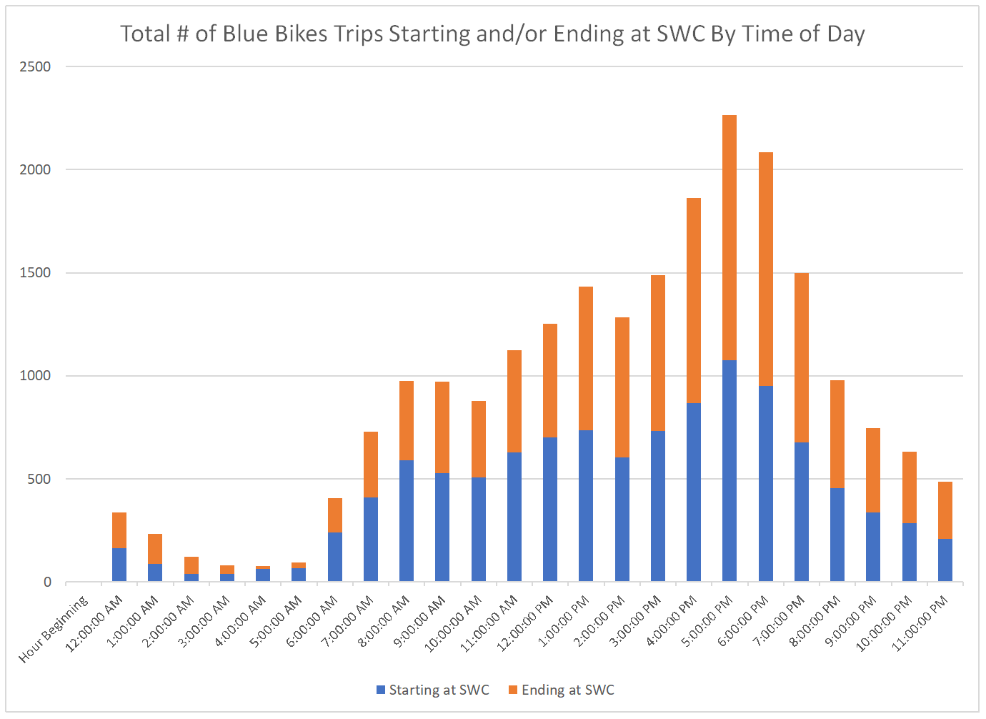
Other Potential Data Sources: Blue Bikes Data

Slide 6
Other Potential Data Sources: Blue Bikes Data
in September 2020, there were nearly 19,000 trips involving docks on the Corridor. There were 3,000 trips that started and ended in the Corridor, so the number that rode on the SWCP path is somewhere in between.
18,975 total trips either starting or ending at one of the eight docks on the corridor, regardless of destination or origin
3,045 Blue Bike trips that started and ended at one of the eight docks on the SWCP
Or 3,919 trips that started and ended at one of the 12 docks on or very close to the SWCP.

Slide 7
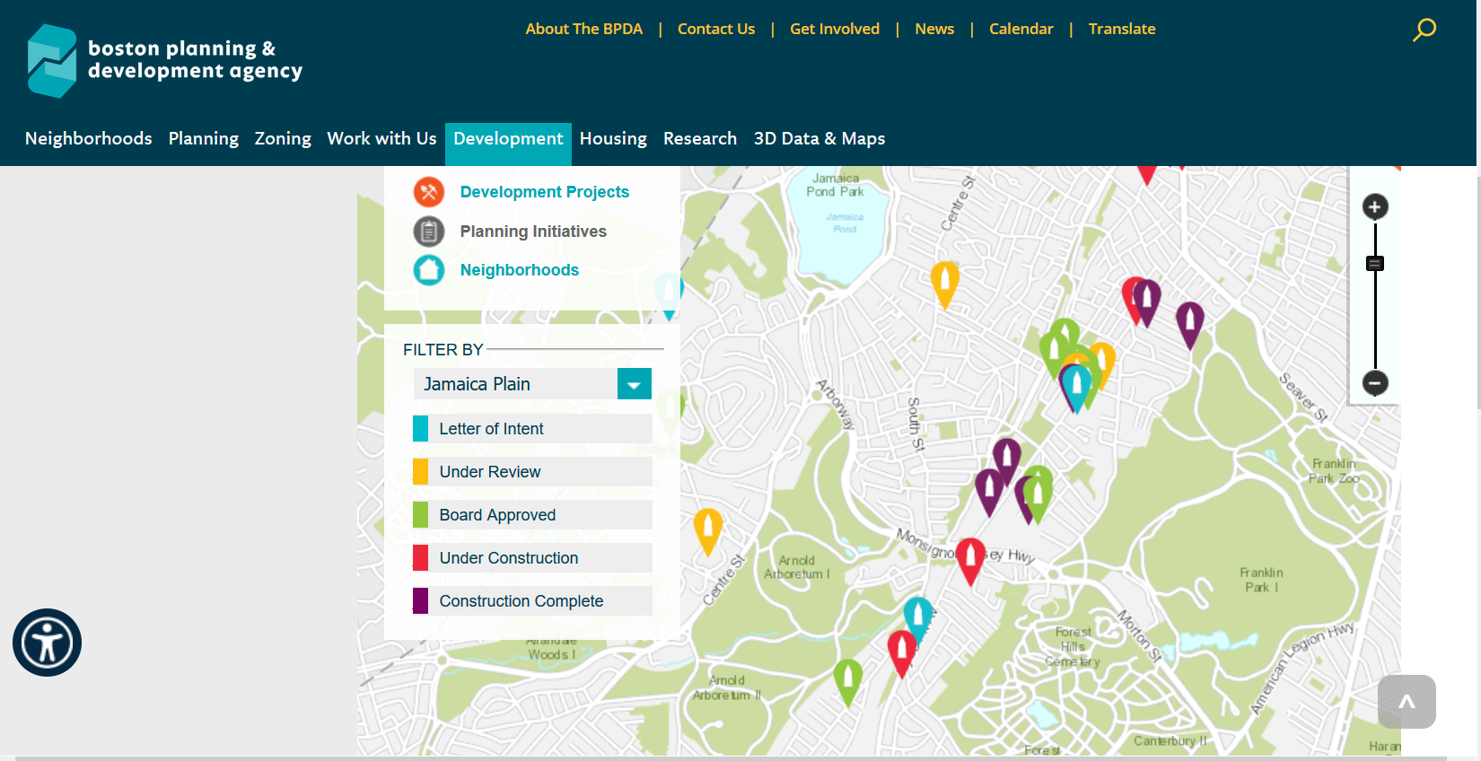
Other Potential Data Sources: BPDA Development Data / With PMAC Liaison Info

Slide 11
Maintenance
Landscaping
Public Safety
Bike/Walk Path
Etc.

Slide 13
Key Points
Will ask neighborhood representatives (a new role!) to complete this at least quarterly; or more often as issues arise.
Other park neighbors and volunteers may also complete this dashboard assessment anytime.
Automated email will go to PMAC & DCR when updates are added.
Emphasize that this does not replace direct reporting.
PMAC leadership team will fill out updates with milestones, challenges/setbacks, and statistics. For example – updates about the lighting repairs, milestones for the skatepark project.
Other statistics will also appear on the dashboard, such as 311 reports; bike traffic and BlueBikes counts; other items.

Slide 14
For Discussion
Identify areas for neighborhood representative system.
Identify ways to reach out to invite neighborhood representatives.
Define additional parts of the role of a neighborhood representative.
Refine questions to be included in the dashboard assessment.
List other statistics (such as the BlueBikes counts).
Describe ways of promoting, sharing and using this information.

