Slide 1
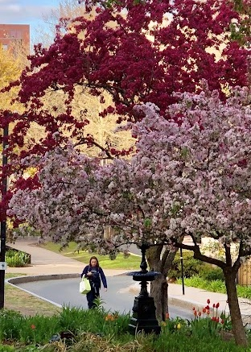
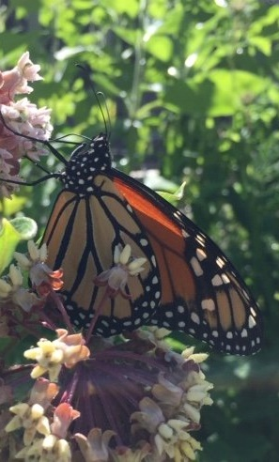
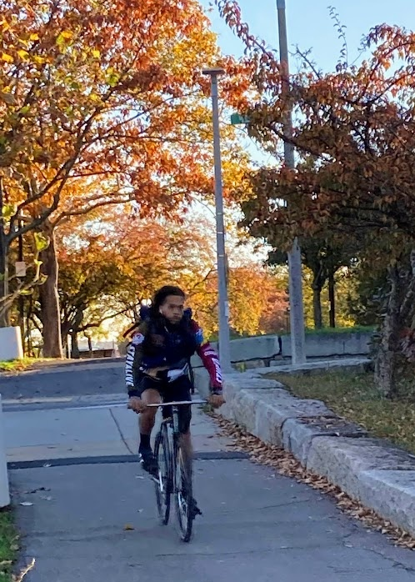
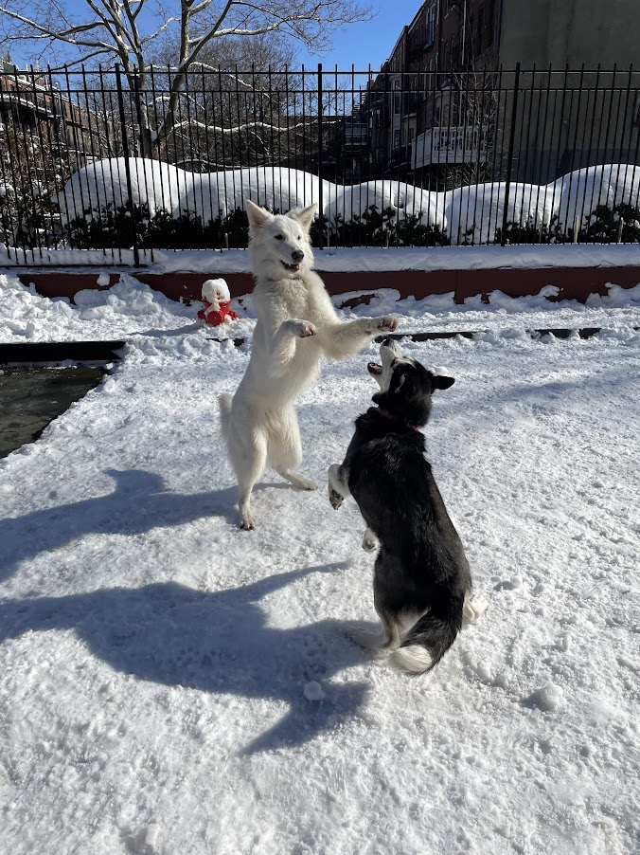
Southwest Corridor Park Management Advisory Committee (PMAC)
November 2022
Annual Meeting Presentation
Four Seasons in the Park

Slide 2
Southwest Corridor Park Management Advisory Committee (PMAC)
Annual Meeting Agenda
Presentation: Four Seasons in the Park
Themes:
Focus on the many park neighborhoods and park activities
The breadth of the Southwest Corridor Park volunteer network
The importance of the park to residents, across four seasons
DCR Updates:
Playground improvement projects
Bike/Walking path work
Looking ahead: Master planning process
Election/Re-Election of PMAC Leadership Team

Slide 3
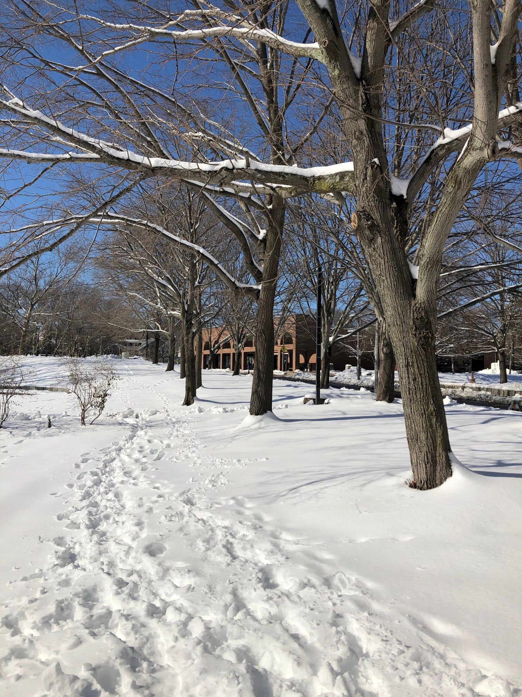
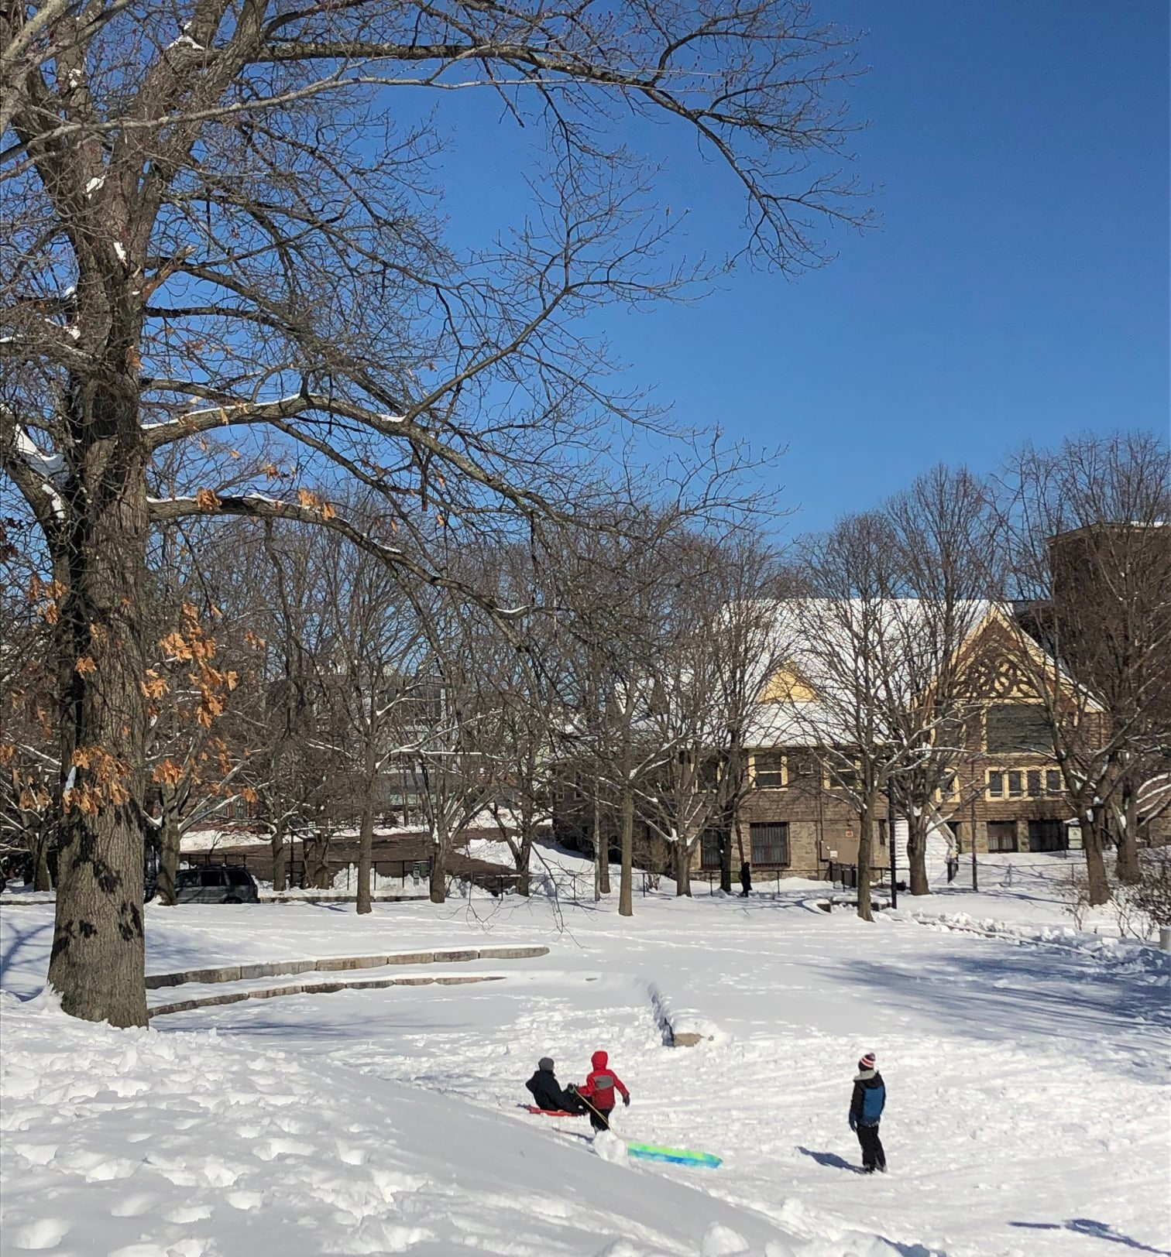
Winter

Slide 4
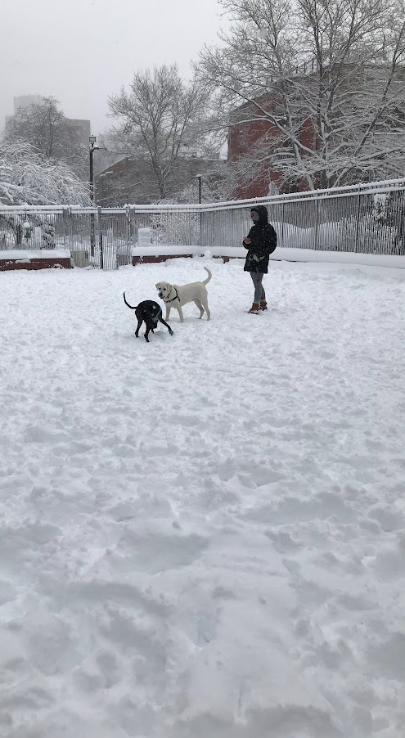
Winter Day in the Carleton Court Dog Park

Slide 5
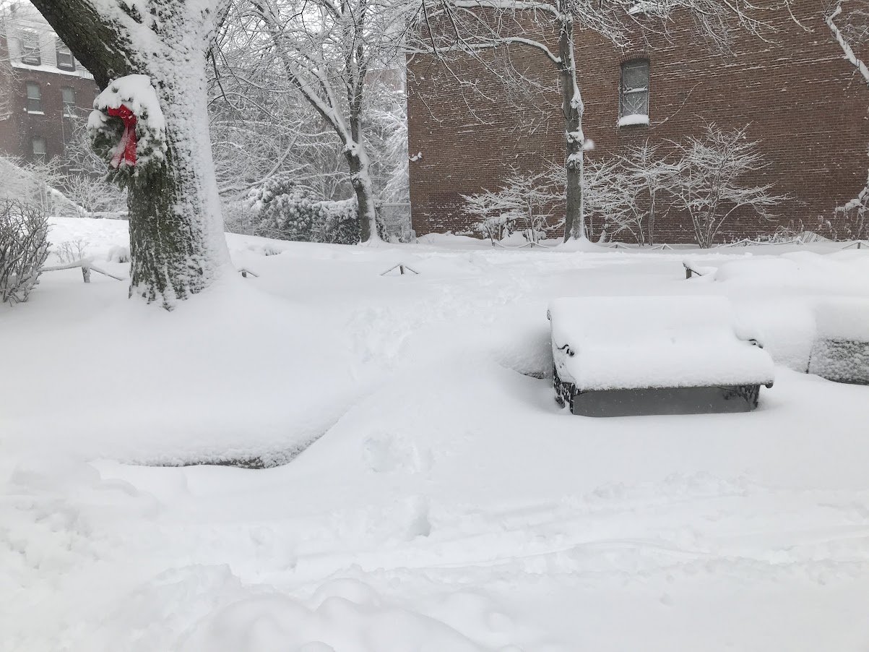
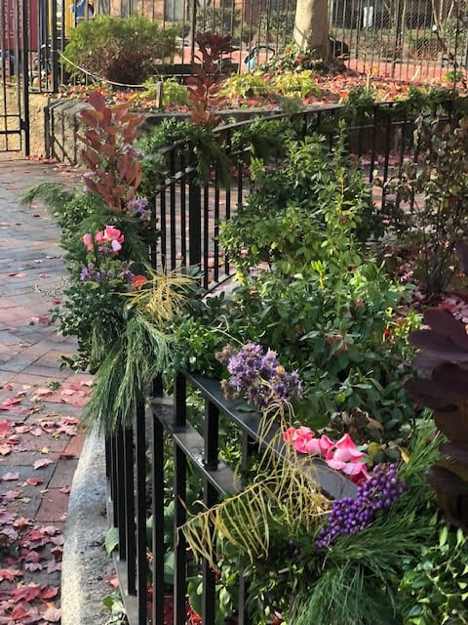
Holiday Decoration by
Southwest Corridor Park Conservancy

Slide 6
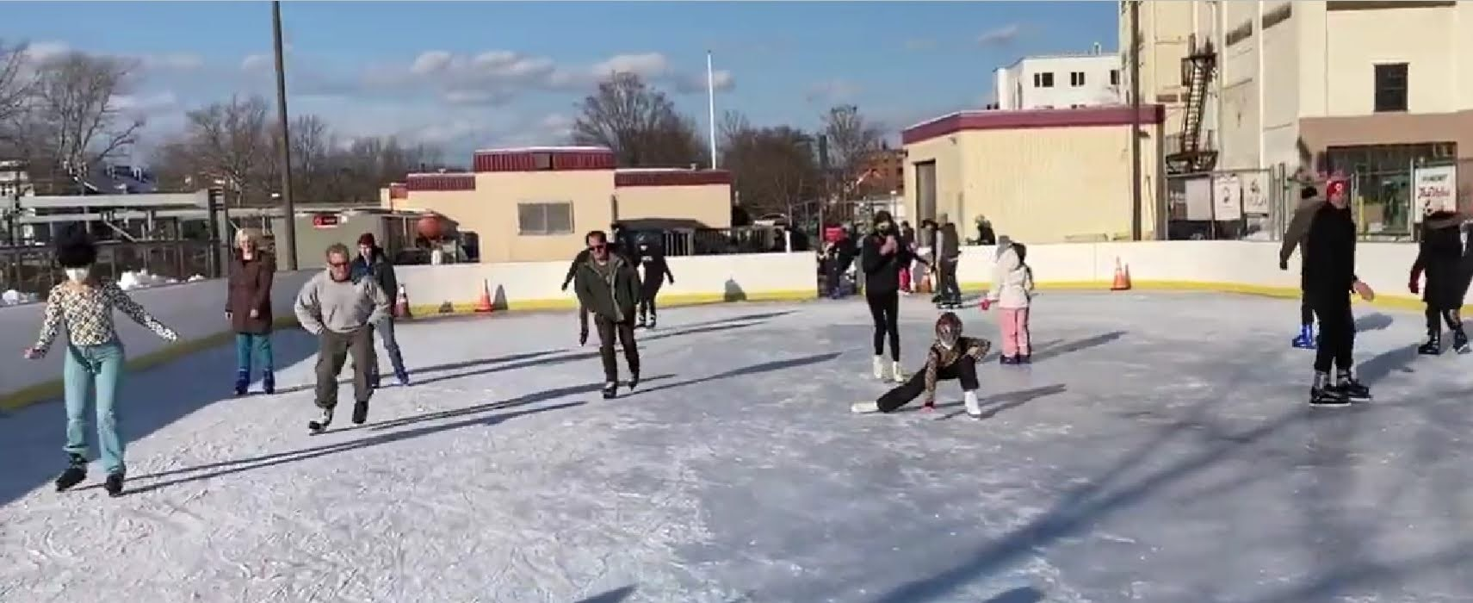
Skating at the Kelly Rink

Slide 7
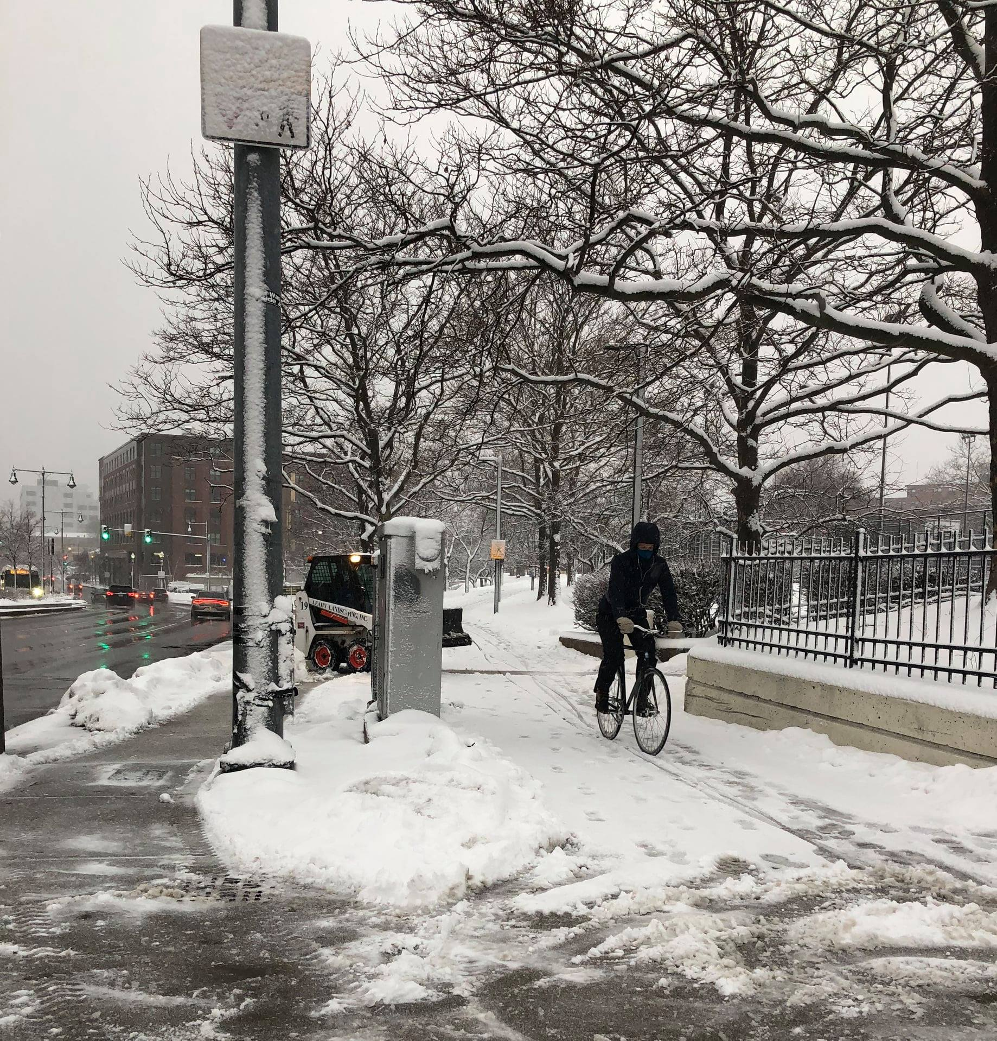
Bicycling in all seasons

Slide 8
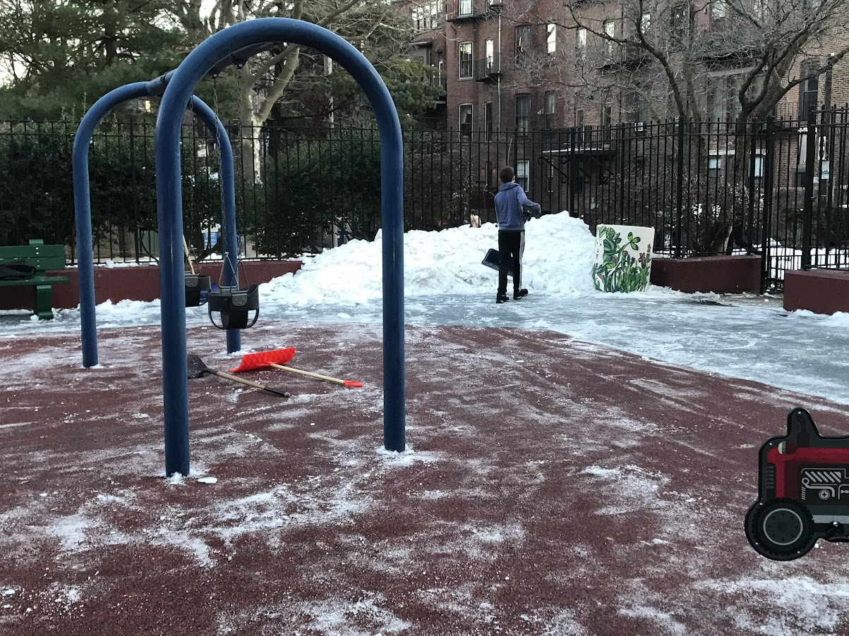
Year-round roles of park volunteers

Slide 9
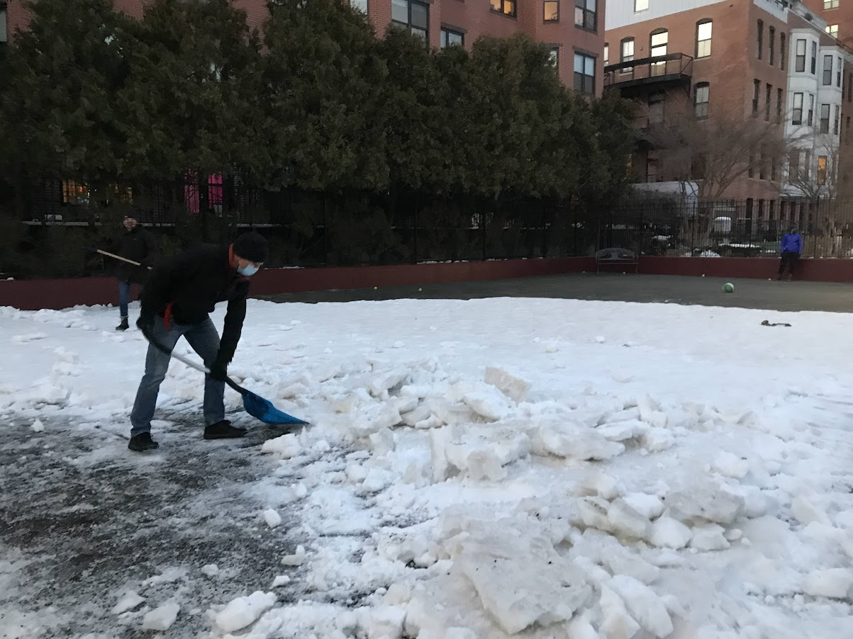
Year-round roles of park volunteers

Slide 10
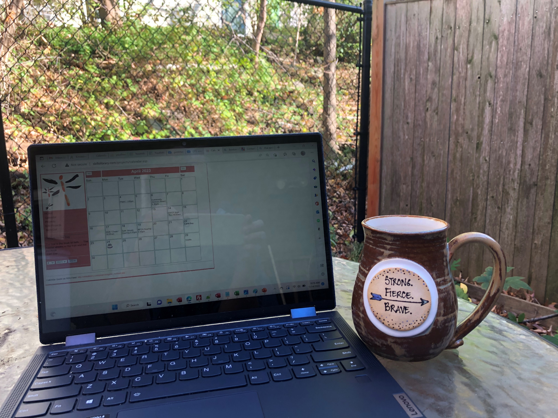
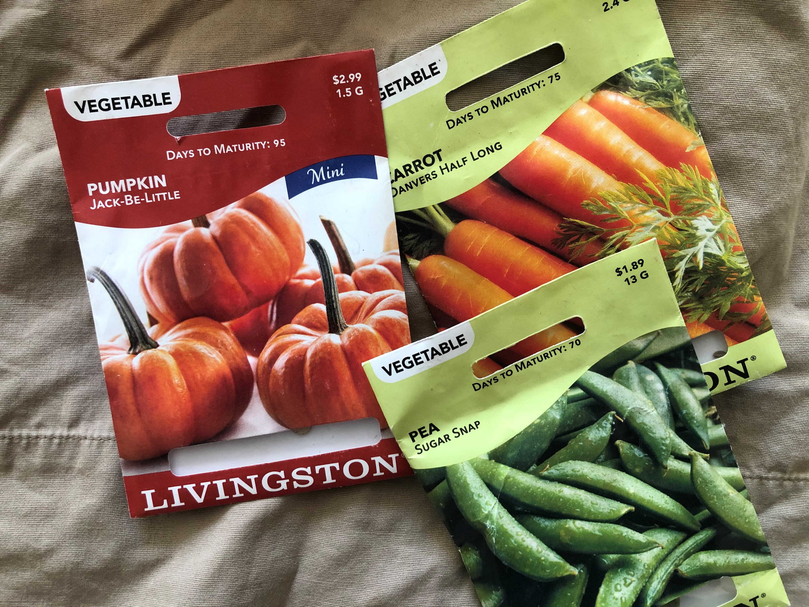
Year round: behind the scenes…

Slide 11
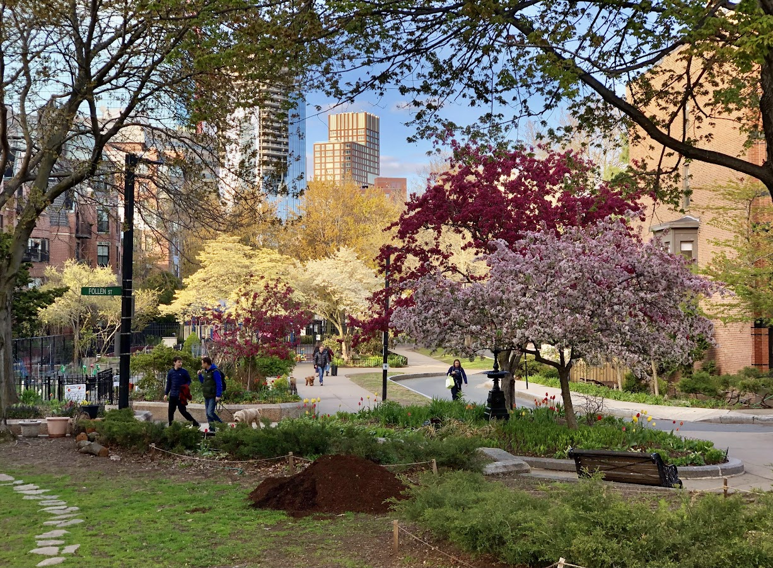
Spring

Slide 12
Park Serve Day – April 2022

Slide 13
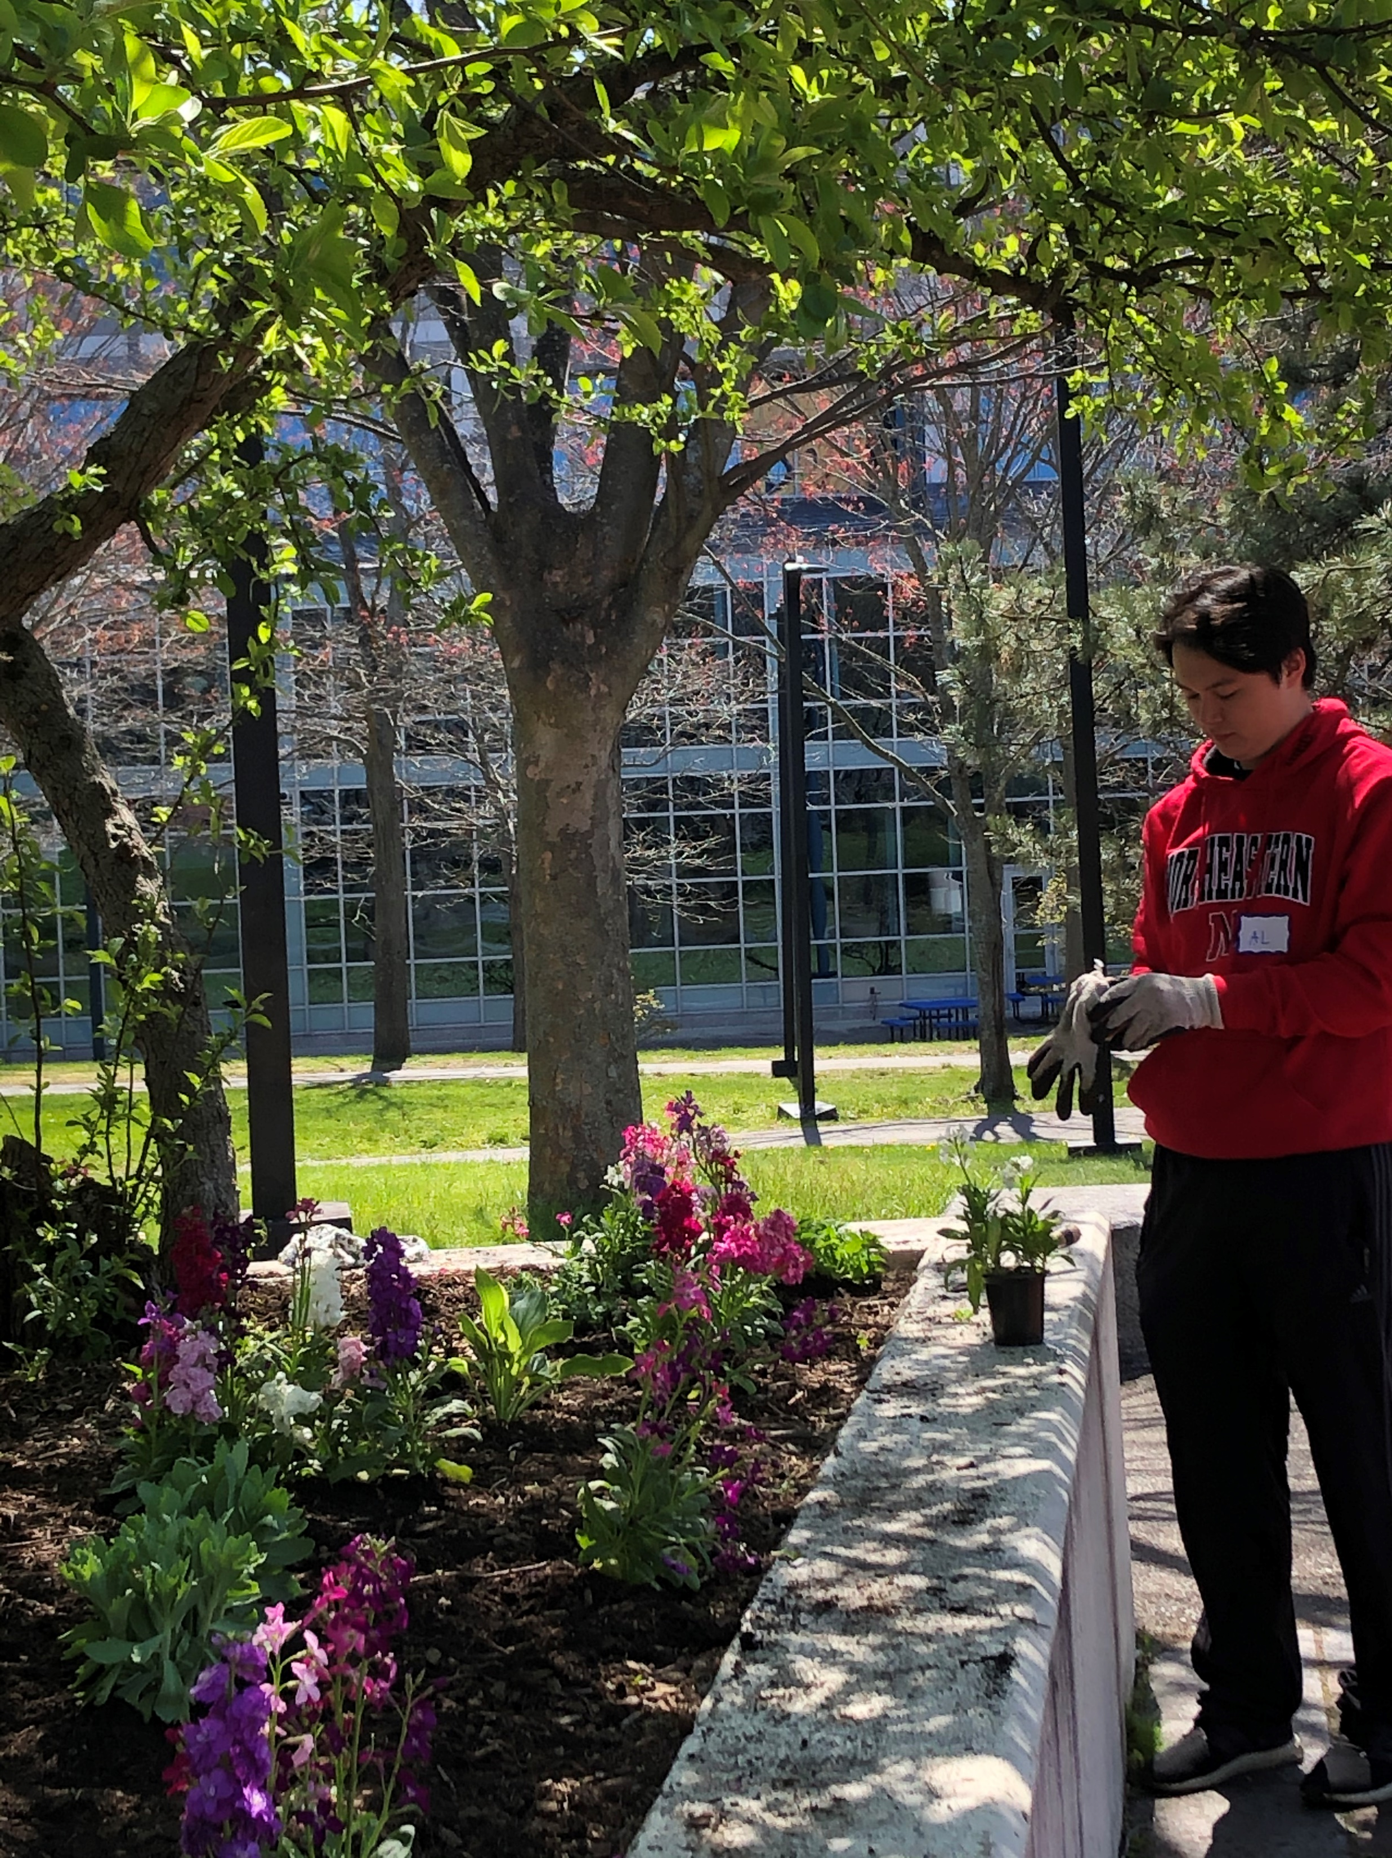
Park Serve Day was celebrated by PMAC, SWCPC & NEU volunteers, with DCR, in two locations (Mission Deck and South End)….

Slide 14
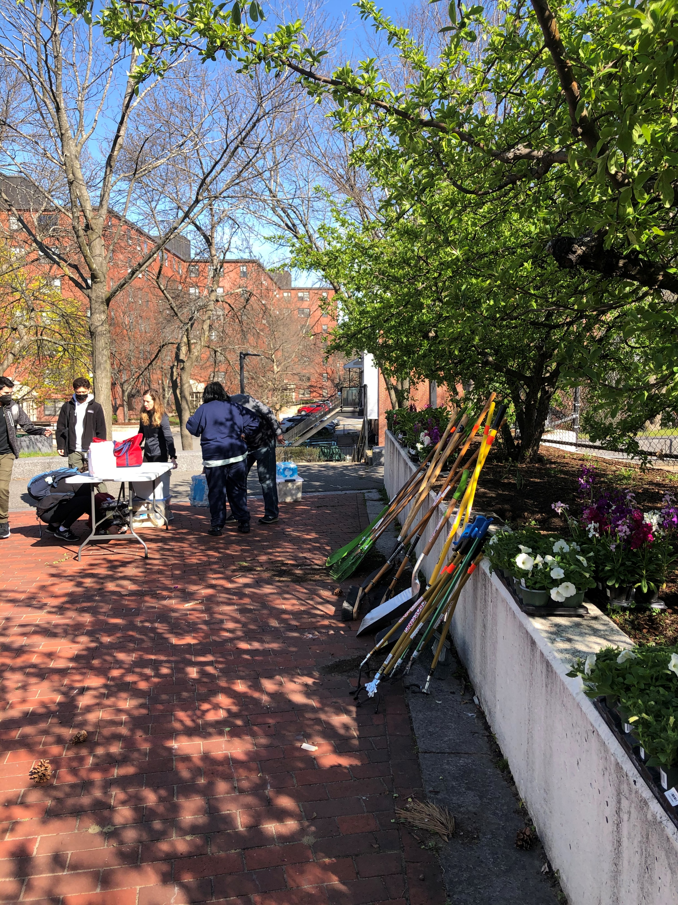
... coinciding with Northeastern University’s spring day of service.

Slide 15
One of many highlights of the day: enjoying the spring daffodils; planted by many of the same PMAC/neighborhood and NEU student volunteers in Fall 2021.

Slide 16
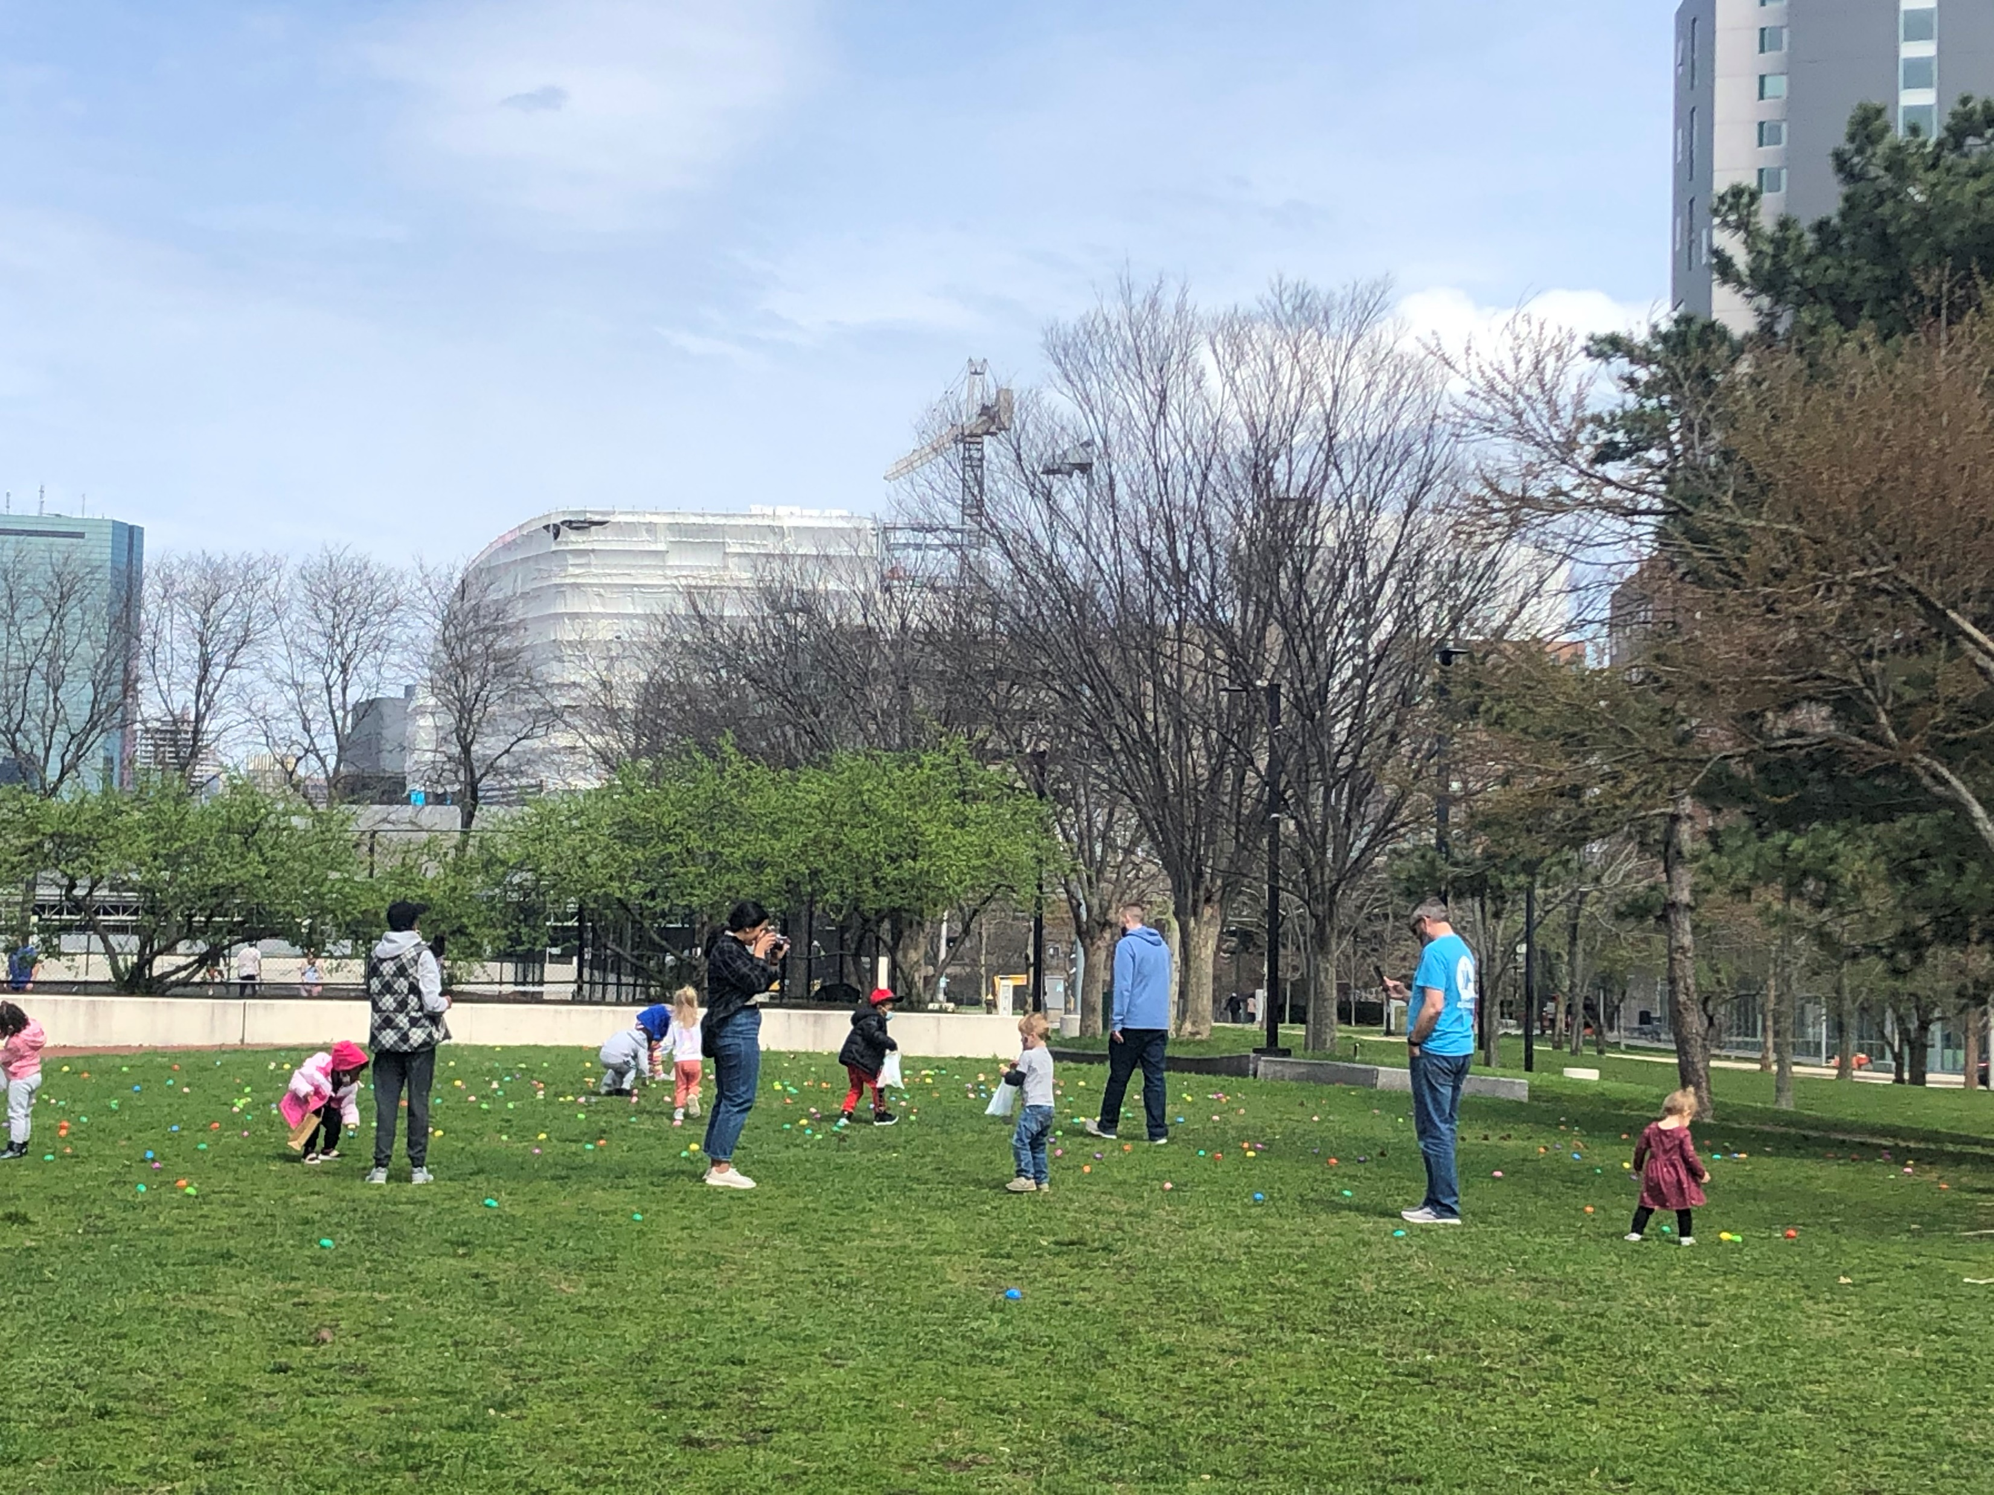
April 2022: Easter Egg Hunt at Mission Deck

Slide 17
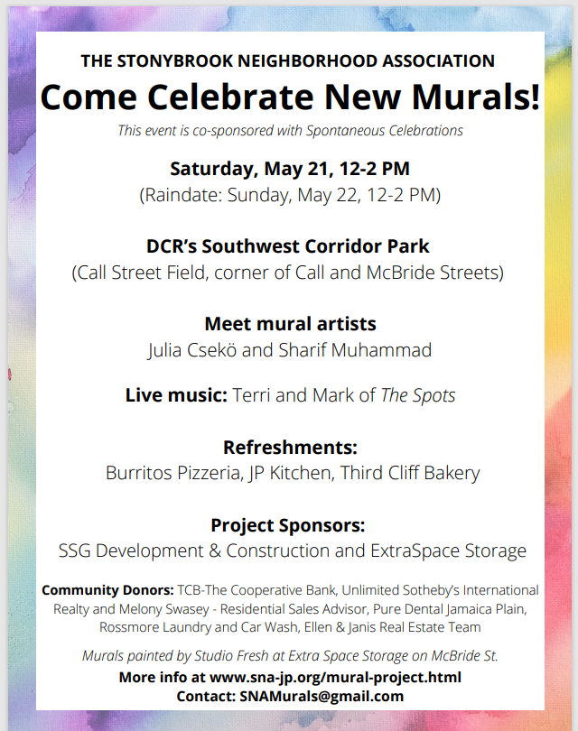
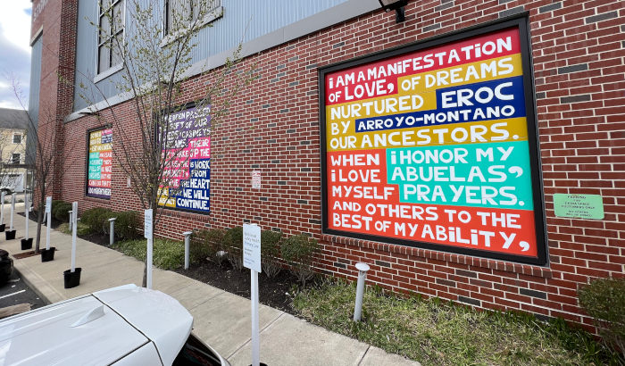
May 2022: Celebration of new SNA murals

Slide 18
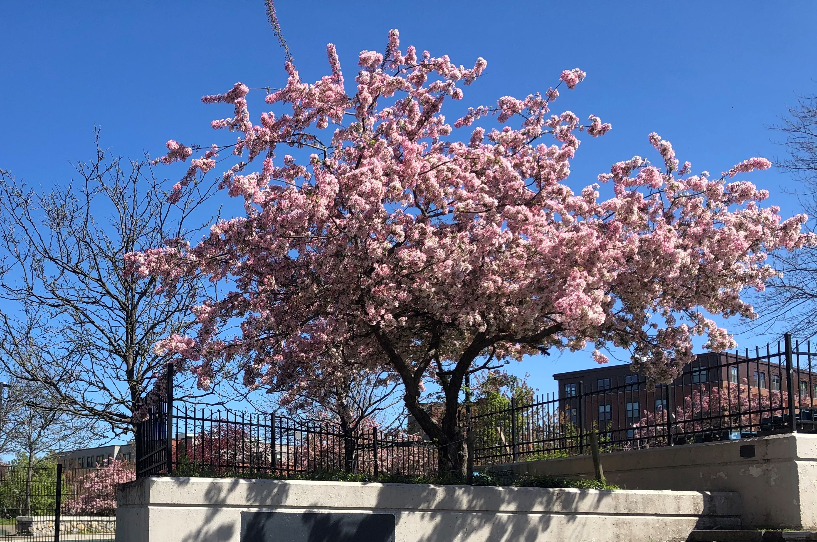
Crab Apple in Jackson Square Children’s Garden

Slide 19
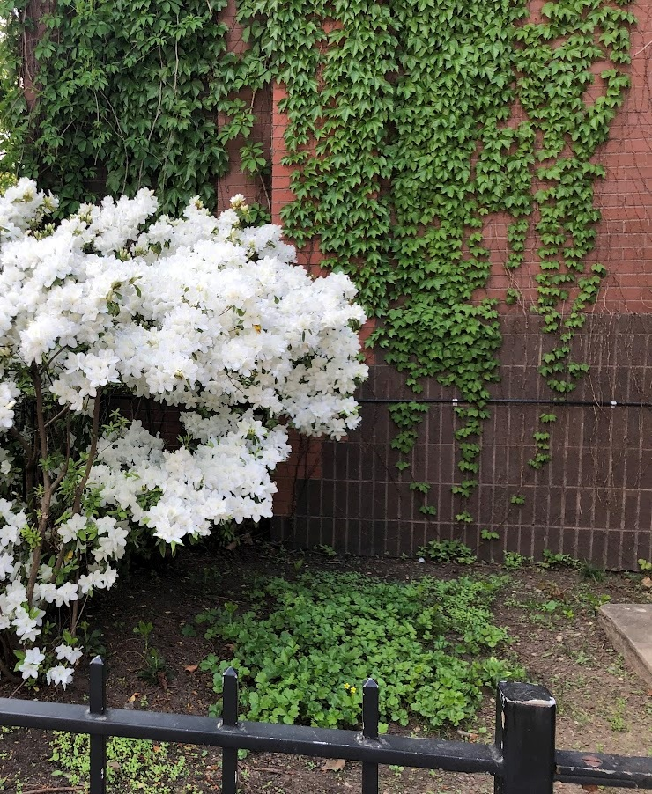
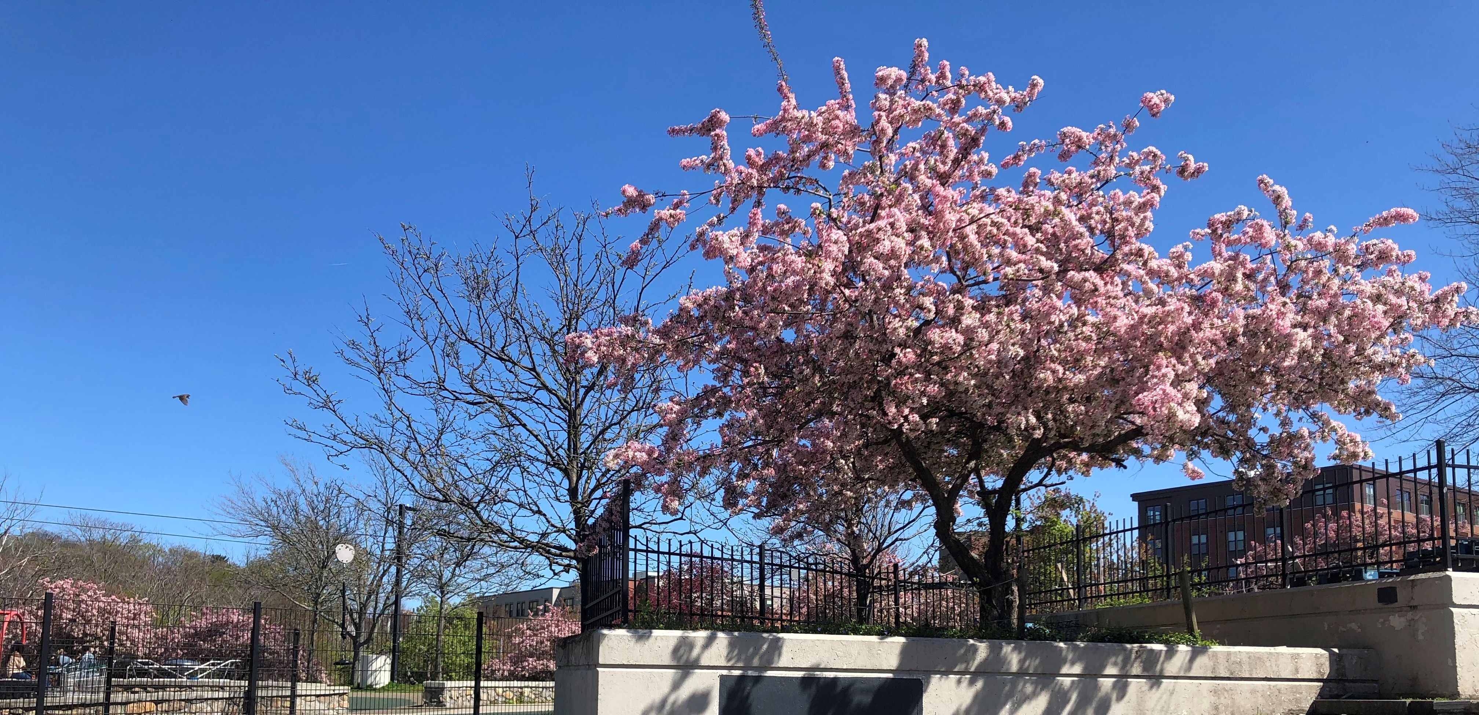
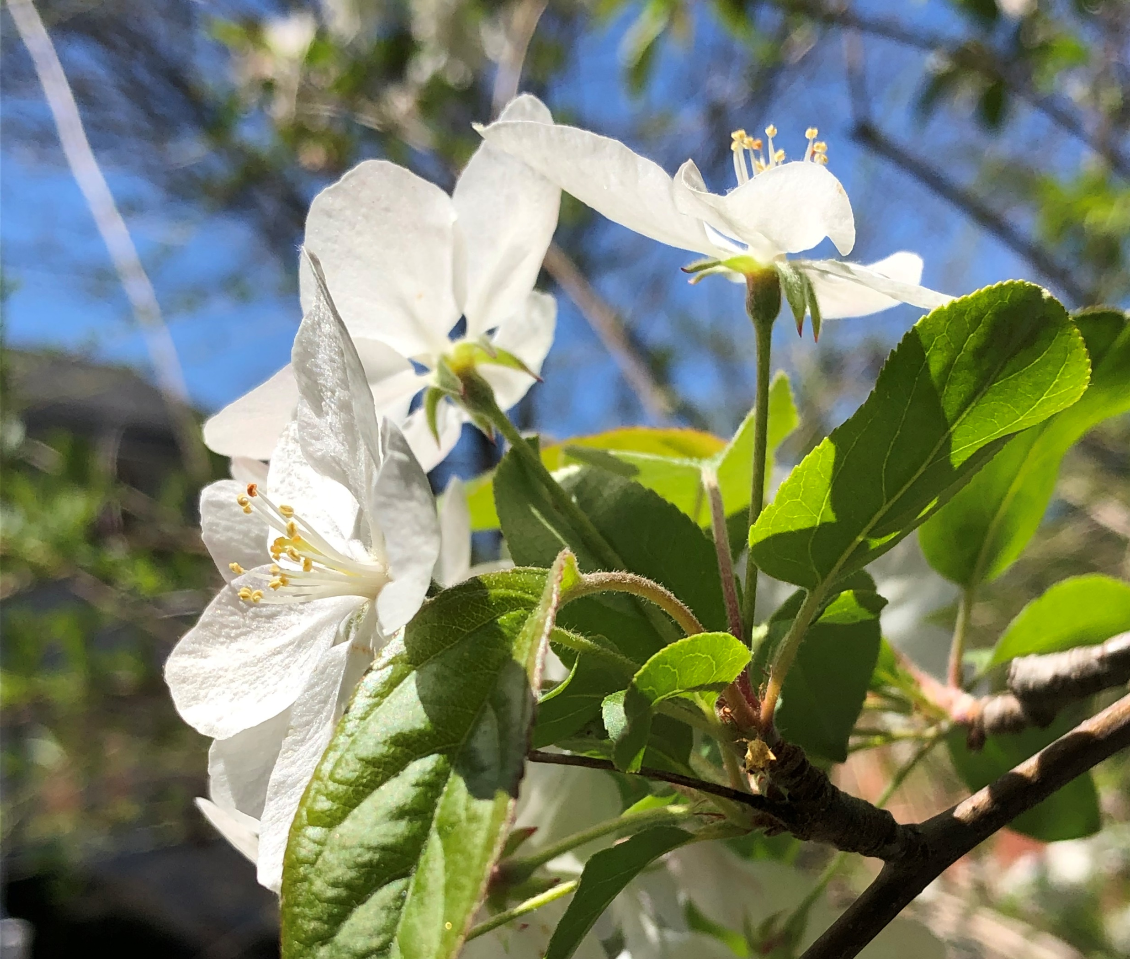
More -- Spring Blossoms

Slide 20
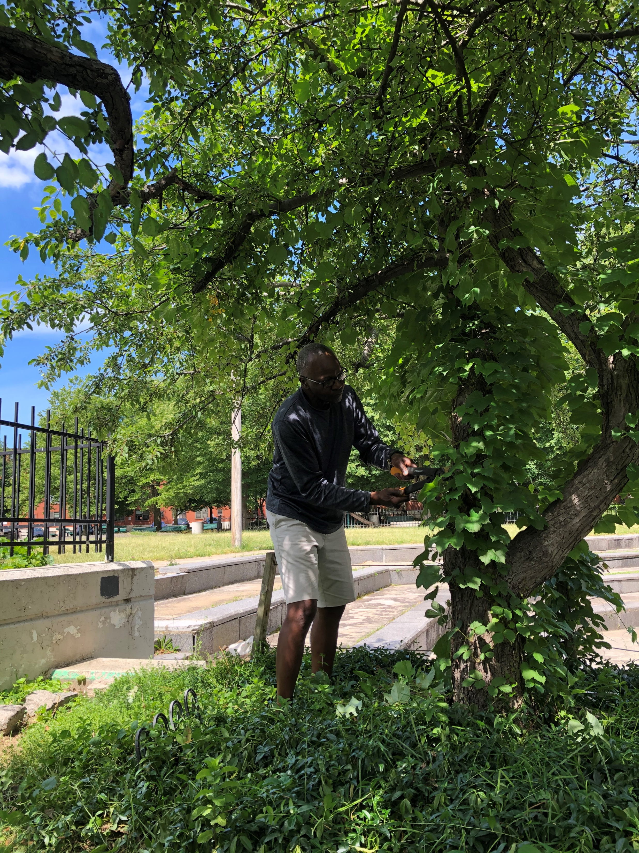
Summer

Slide 21
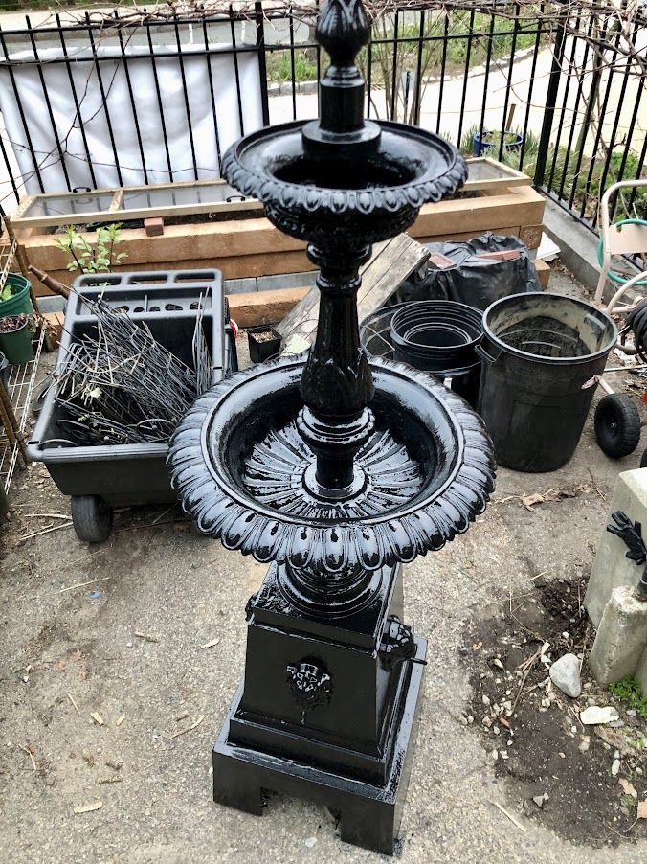
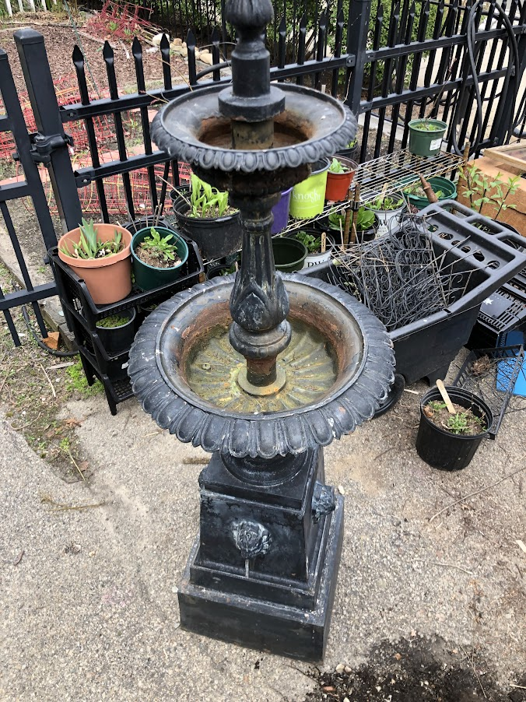
Park Stewardship Projects

Slide 22
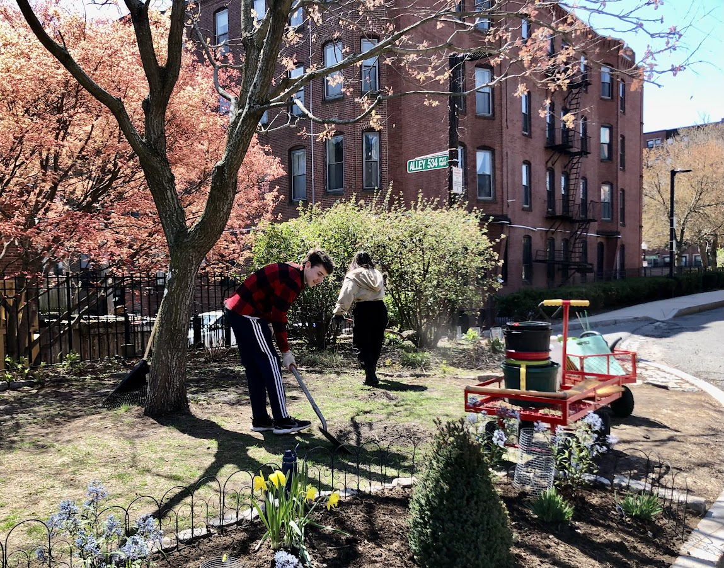
Park Stewardship Projects

Slide 23
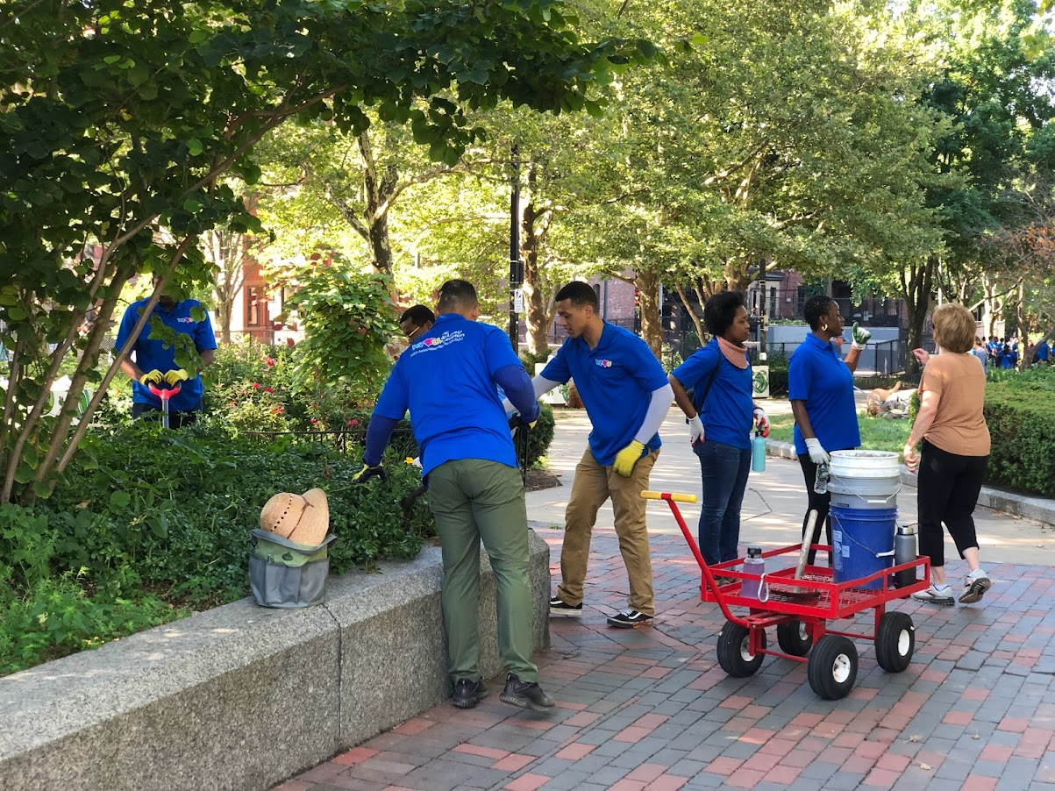
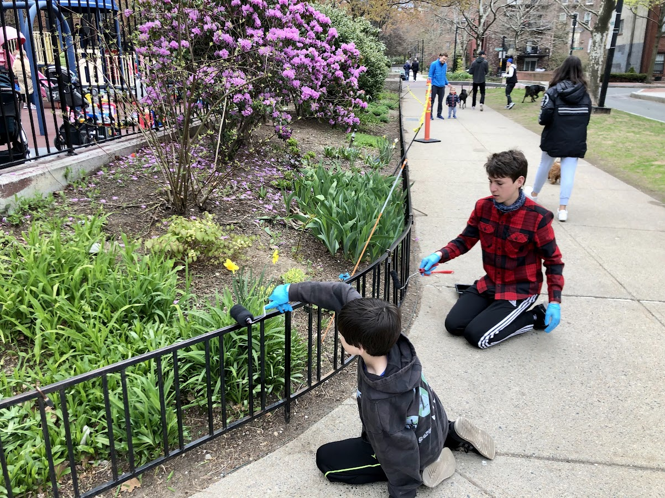
Park Stewardship Projects

Slide 24
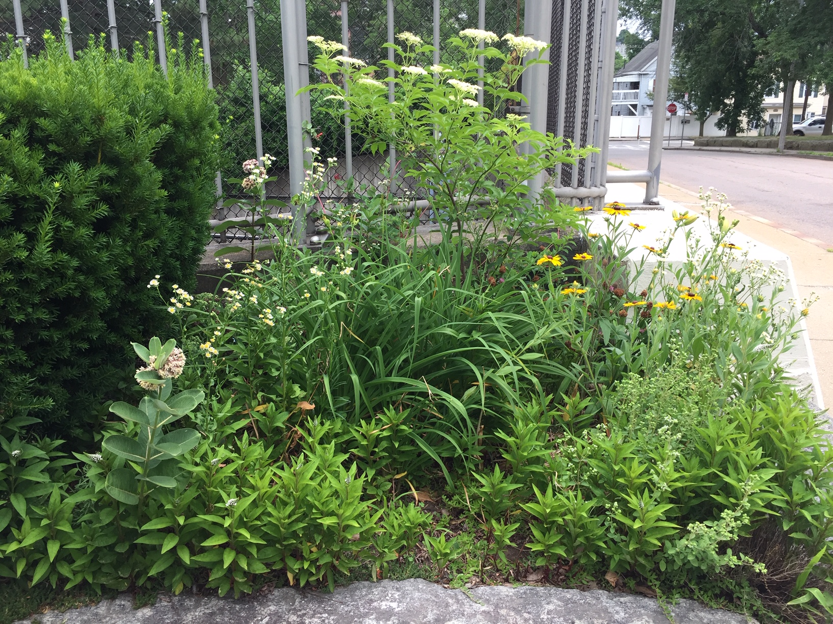
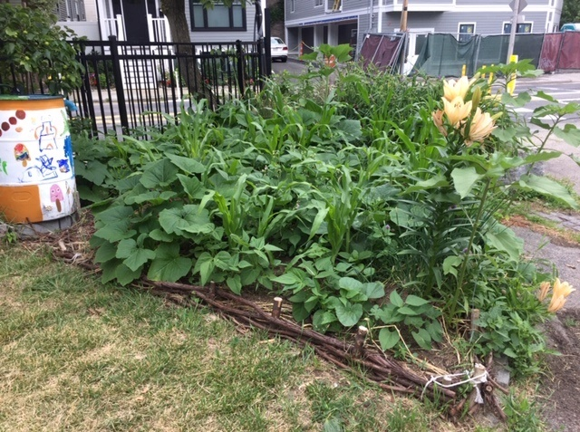
Park Stewardship Projects

Slide 25
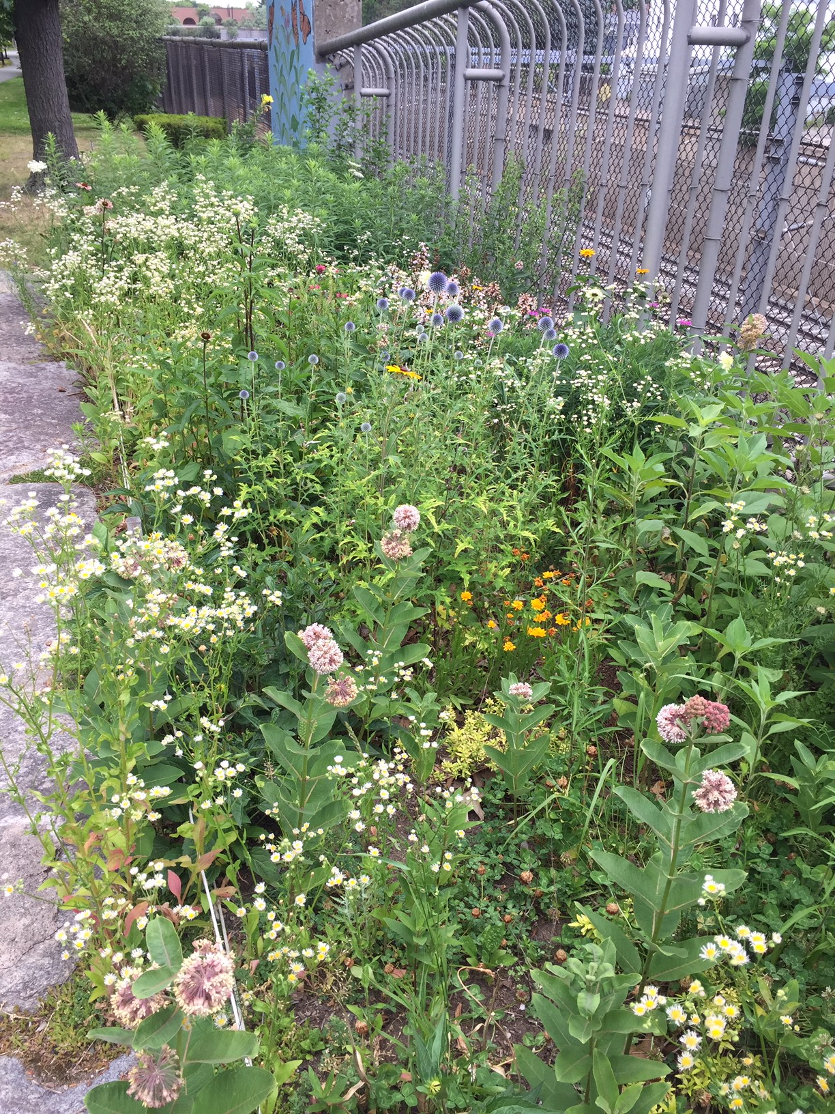
Park Stewardship Projects

Slide 26
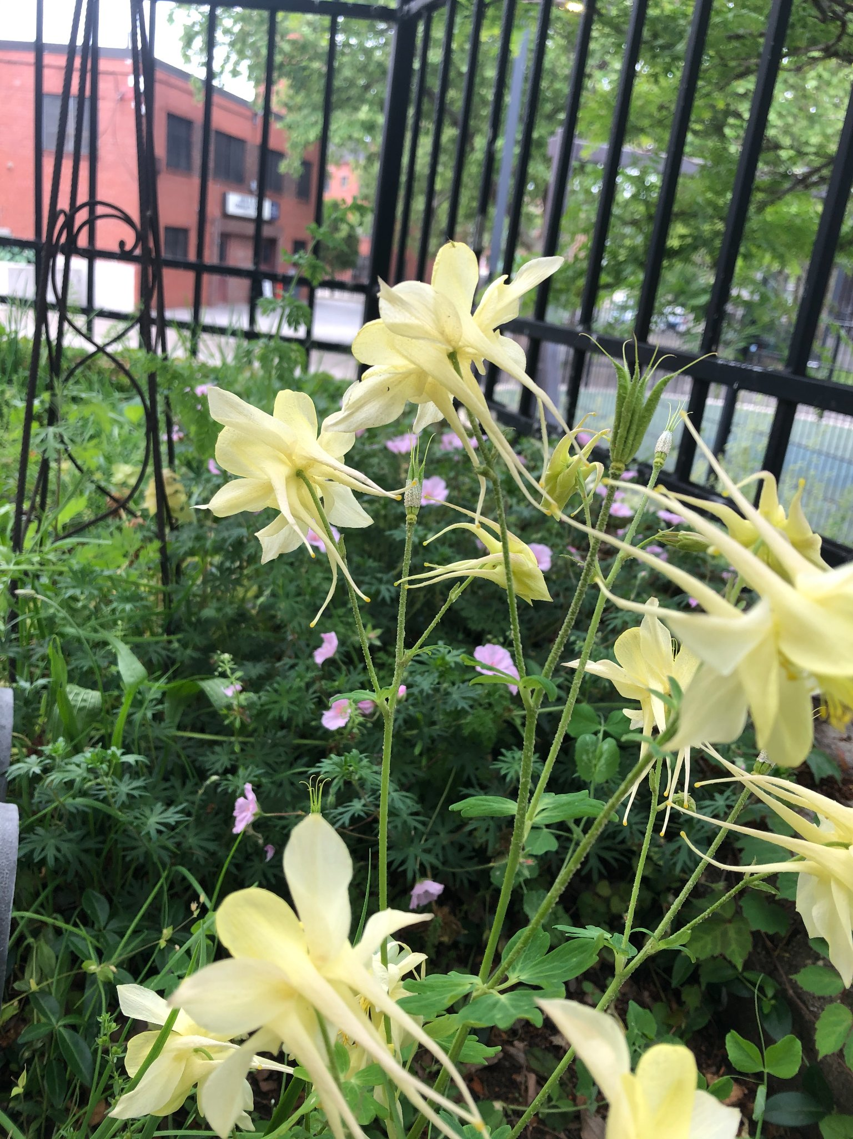
Park Stewardship Projects

Slide 27
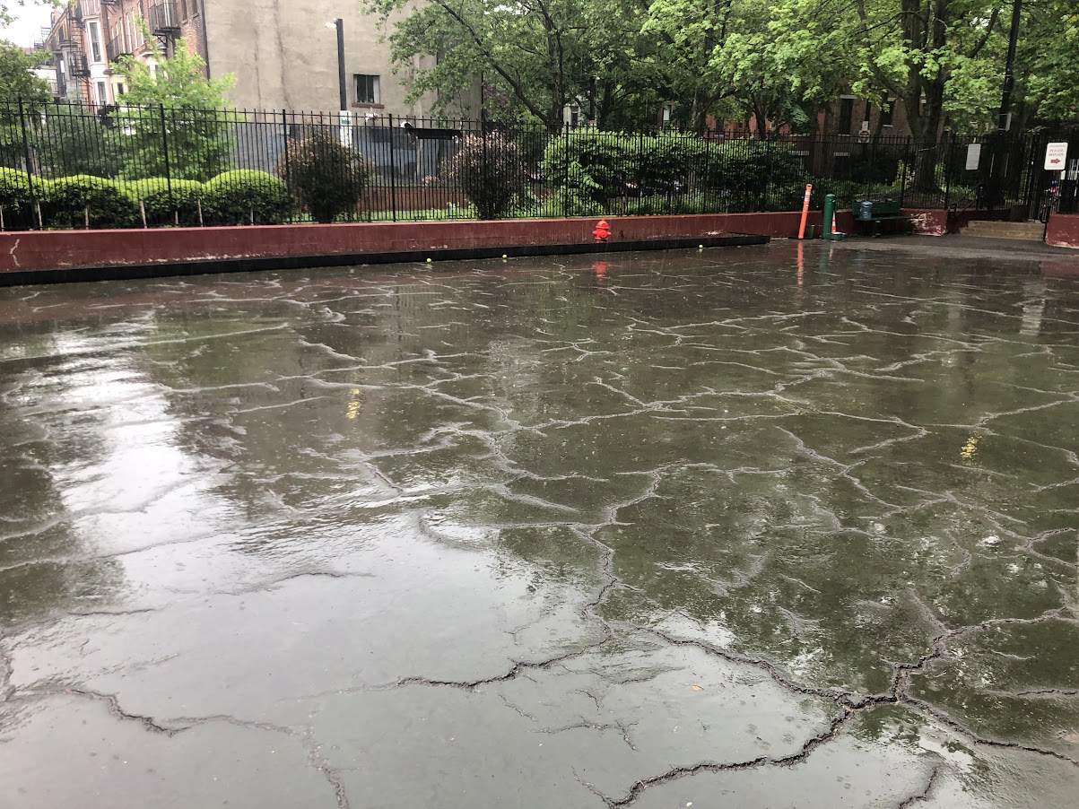
Carleton Court Dog Park Re-surfacing project

Slide 28
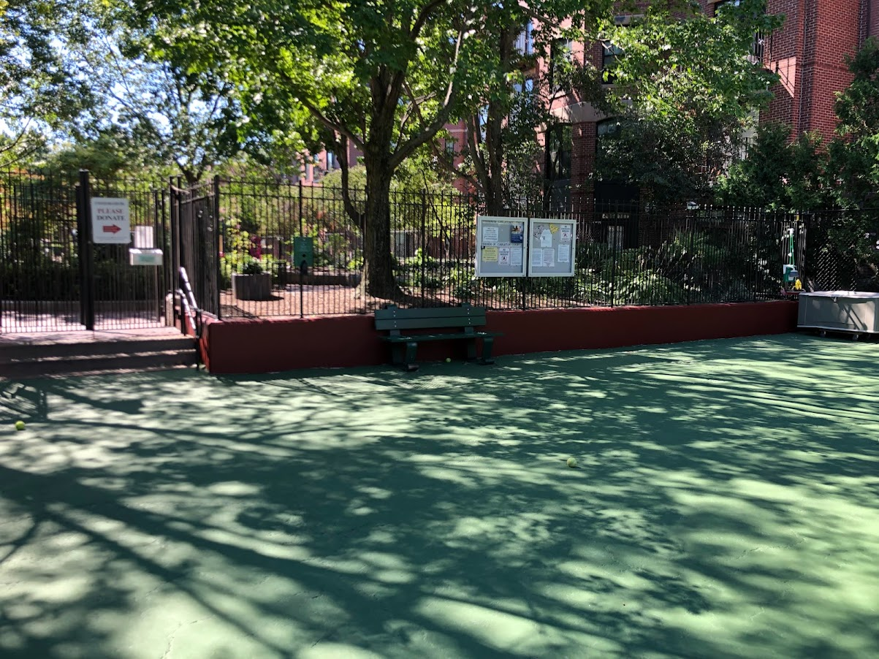
Carleton Court Dog Park Re-surfacing project

Slide 29
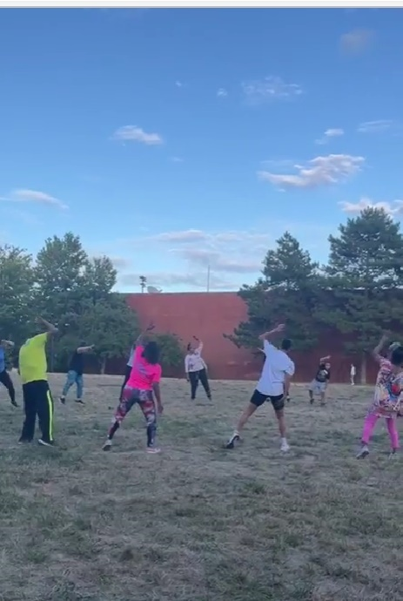
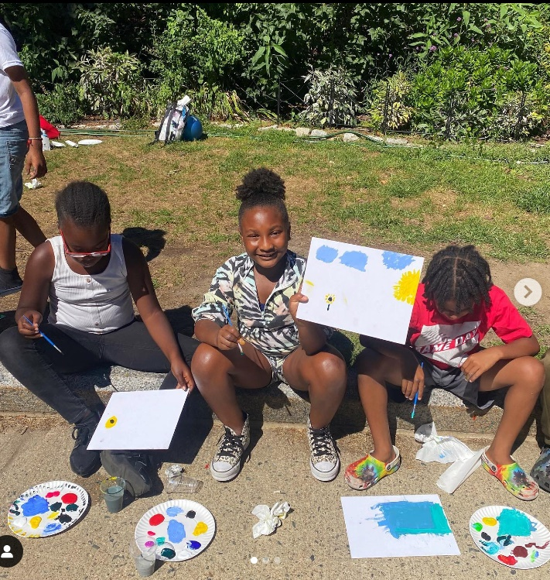
Mini-Grants, Children and Family Programs and Children’s Garden

Slide 30
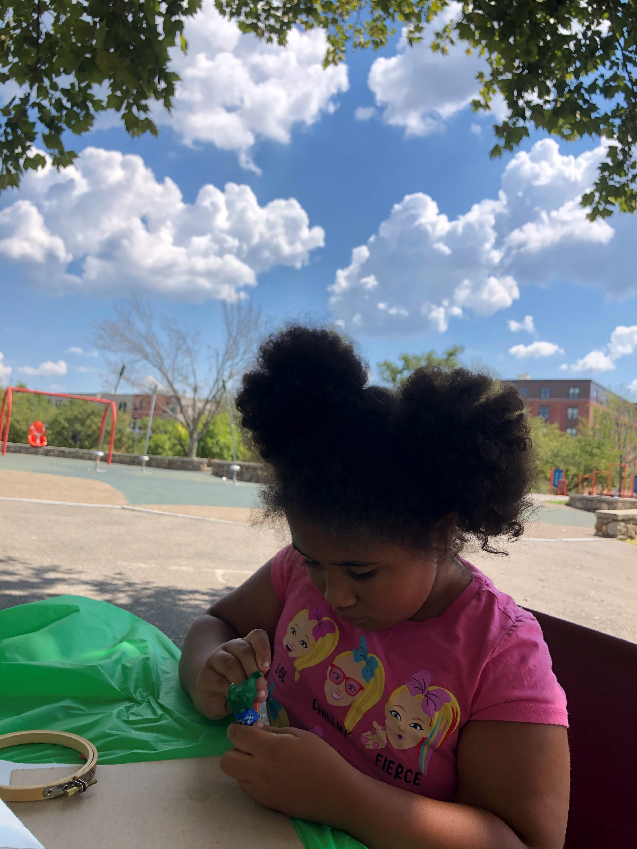
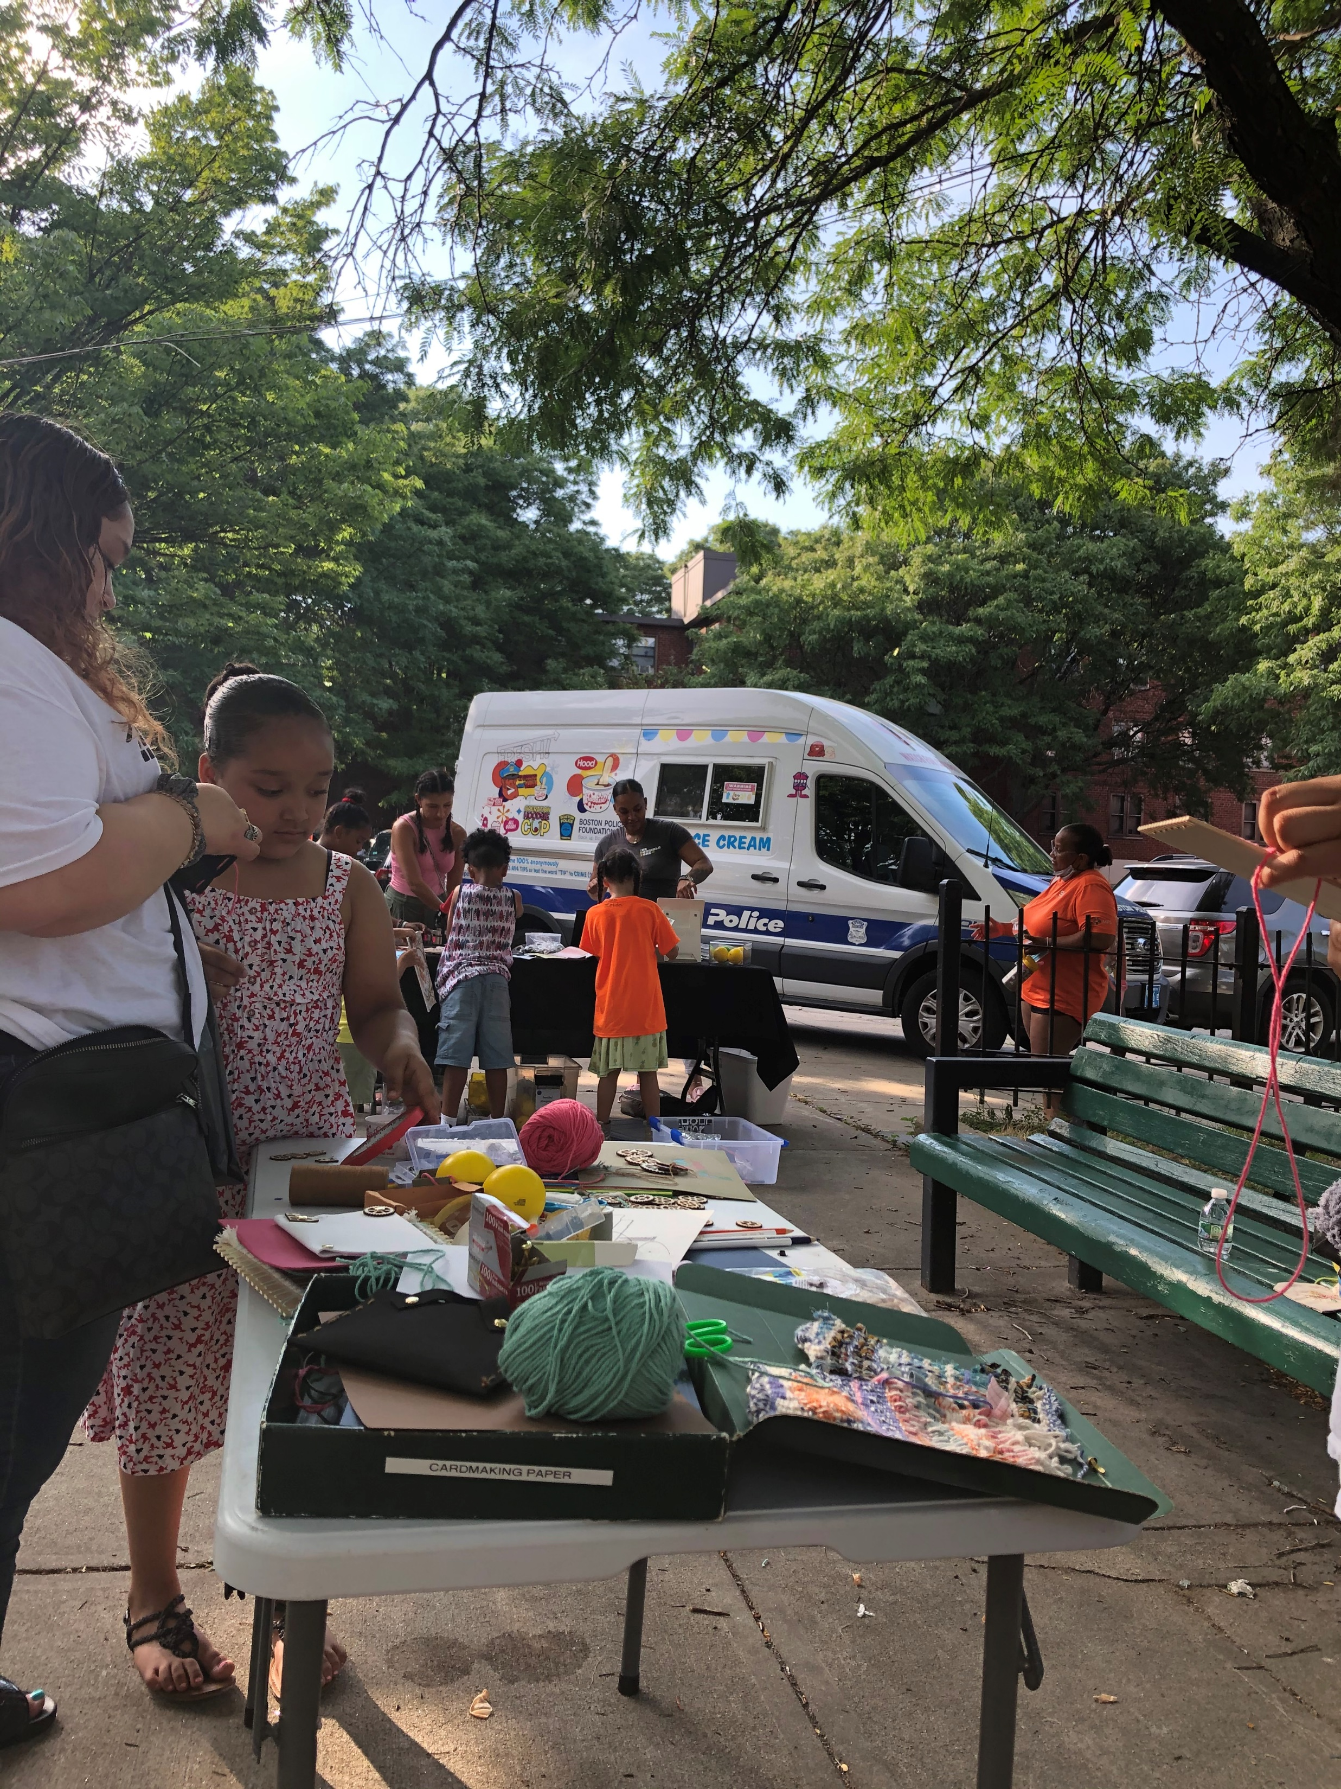
Mini-Grants, Children and Family Programs and Children’s Garden

Slide 31
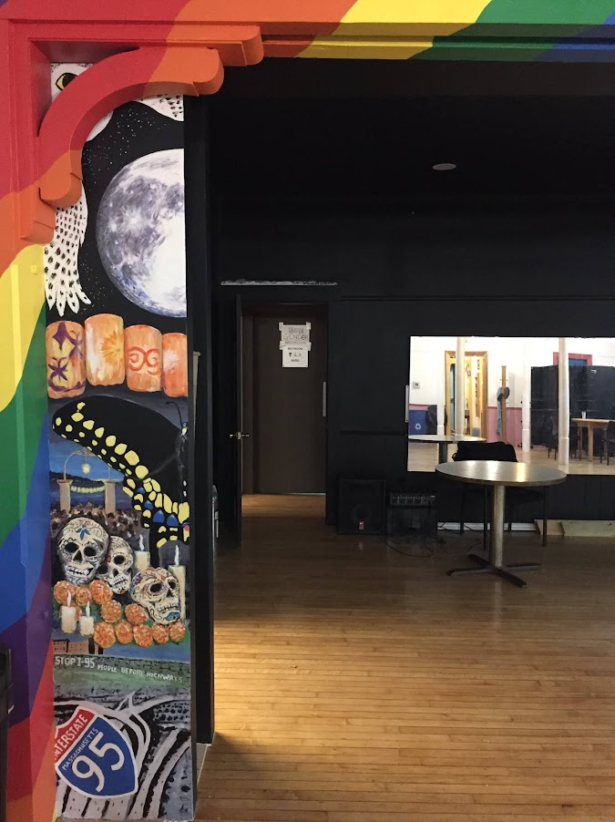
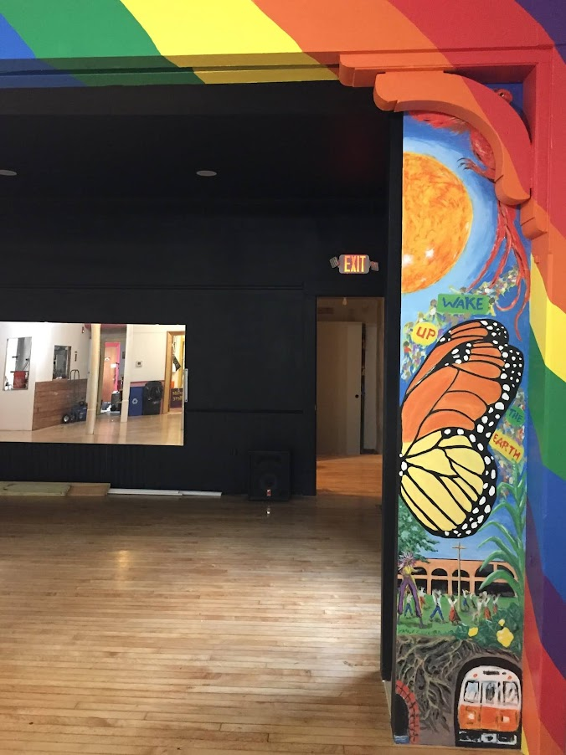
Mural at Spontaneous Celebrations

Slide 32
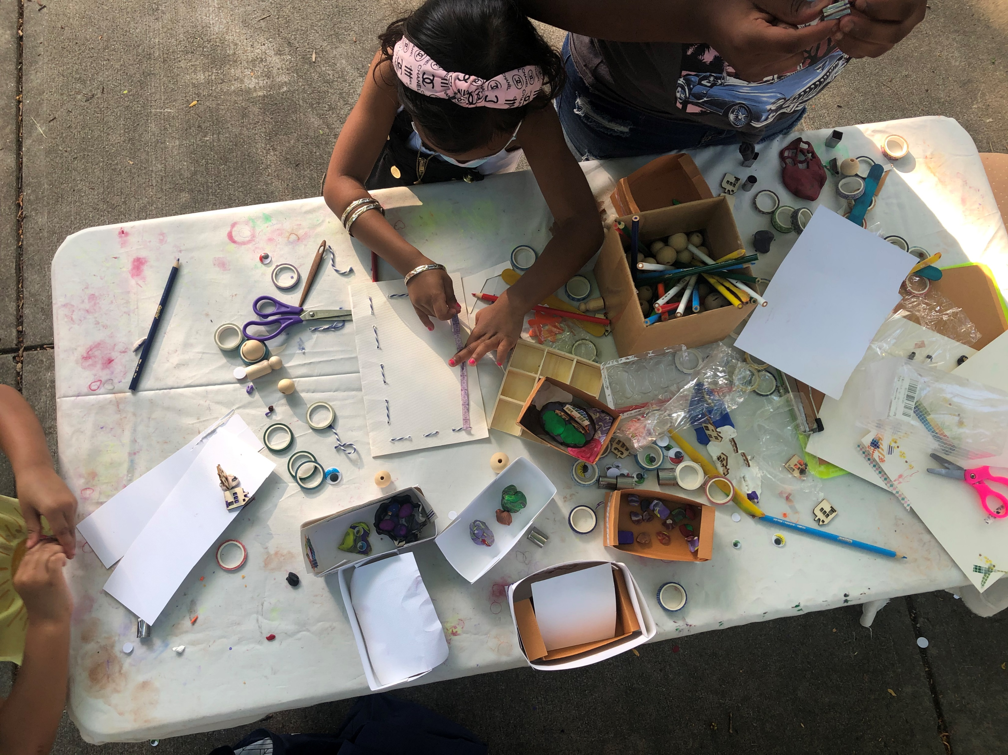
Unity Day at Mildred Hailey Apartments

Slide 33
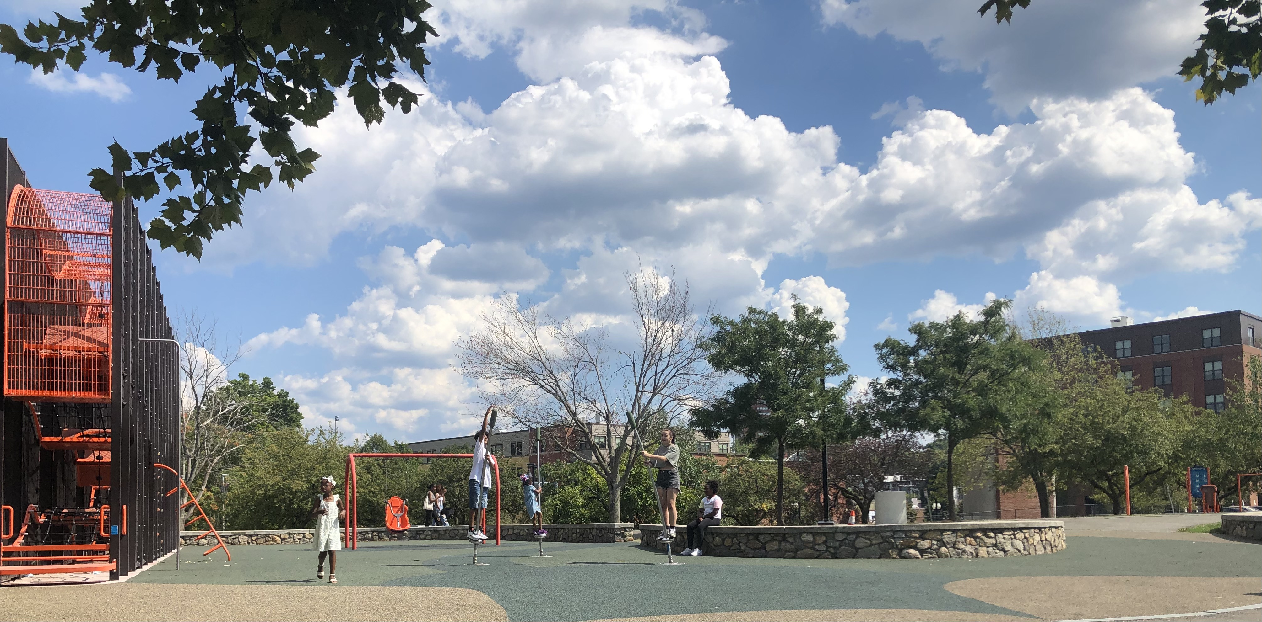
On the Lorber Family Playground (During Unity Day at Mildred Hailey Apartments)

Slide 34
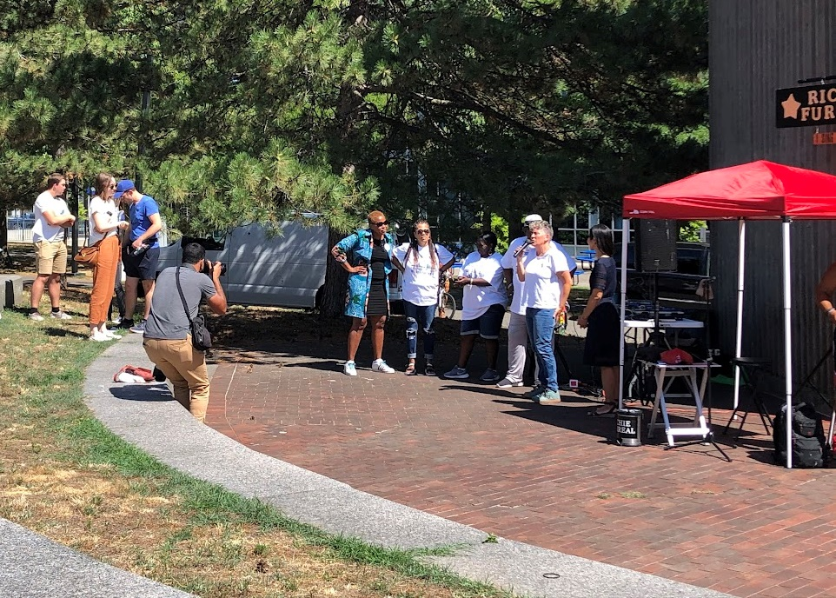
Unity Day at Alice Taylor Apartments

Slide 35
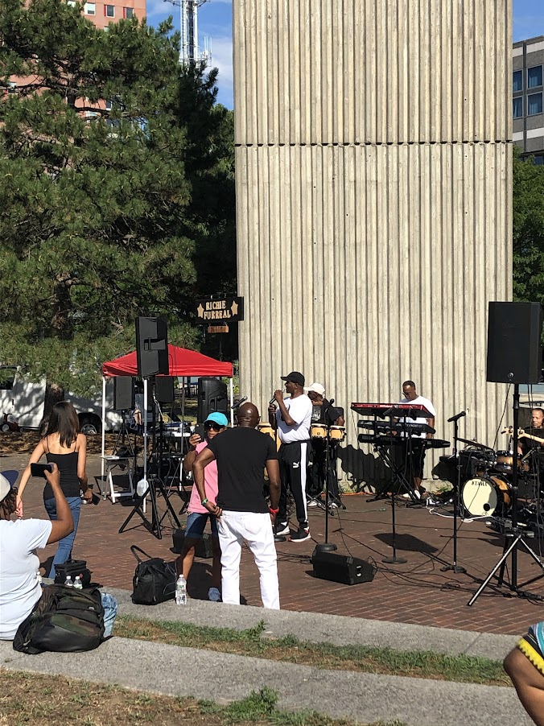
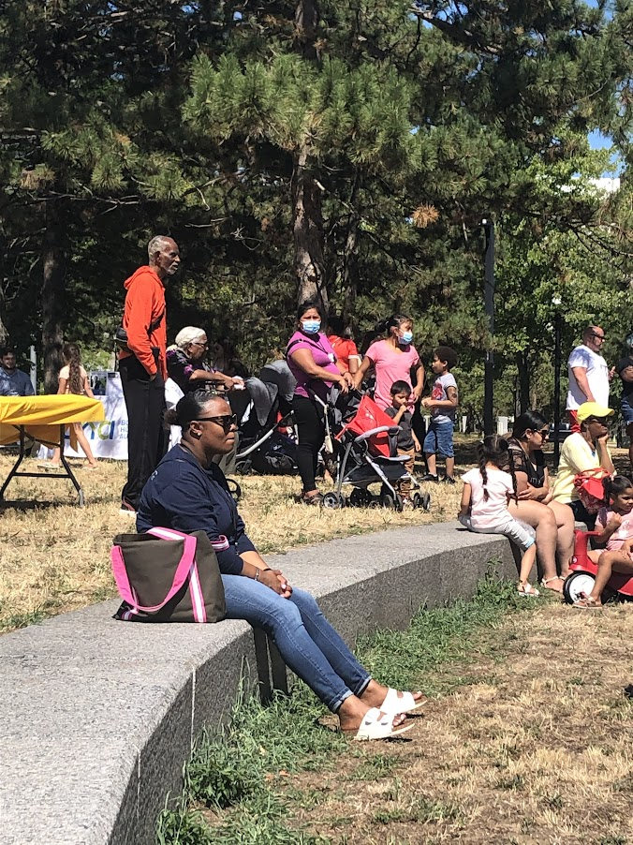
Unity Day at Alice Taylor Apartments

Slide 36
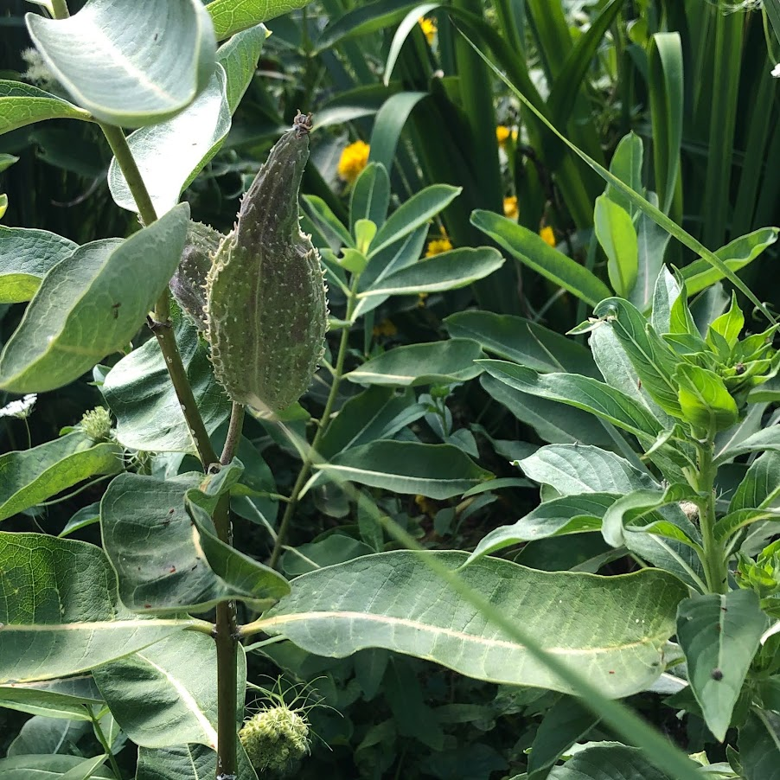
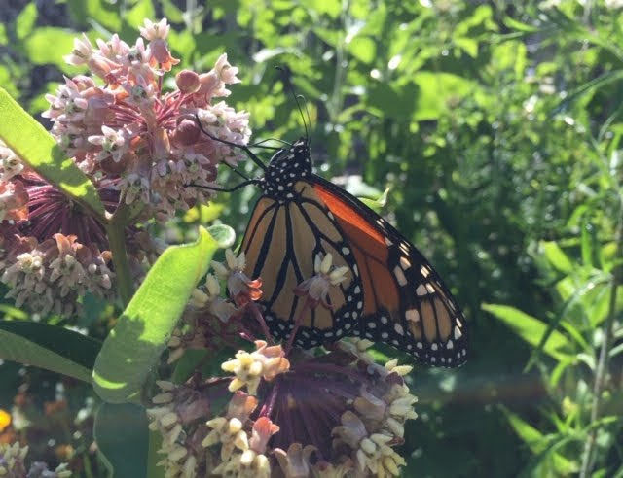
Summertime Plants, Butterflies, Birds

Slide 37
Summertime Plants, Butterflies, Birds

Slide 38
Fall

Slide 39
Fall

Slide 40
Fall

Slide 41
Fall

Slide 42
Fall

Slide 43
Events/Themes Impacting the Park…

Slide 44
Continuing impact of pandemic…

Slide 45
Drought and hand-watering…

Slide 46
Heat wave…

Slide 47
Orange Line Shutdown…

Slide 48
Focus on Active Transportation…

Slide 49
Focus on Active Transportation…

Slide 50
Focus on Active Transportation…

Slide 51
Looking forward to…

Slide 52
Looking forward to…
Discussion: Current and upcoming initiatives

Slide 53
PMAC Leadership Team Election/Re-Election
Leadership Team | Roles
Jennifer Leonard | Chair; Children/Family Initiatives; Website
Tracy O’Brien | Community Garden Committee Chairperson
David Wean | Bike/Walking Path Committee Chairperson
Fred Vetterlein | Greenway Extension Project; Burnett St. Garden
Scott Romney | Carleton Court Dog Park Representative; Southwest Corridor Park Conservancy Representative
Jenny Jones | Park Stewardship Volunteers / JP
Franco Campanello | Park Stewardship Volunteers / SWCPC / South End
John Burke | Neighborhood Representatives / South End
Matilda Drayton | Neighborhood Representatives / Mission Deck
Sage Carbone (NEW / Nominated) | Neighborhood Representatives / Fenway

Slide 54
Web Links:
The Southwest Corridor Park website:
http://swcpc.org
New members and friends → Join our email list at http://swcpc.org/pmac.asp
Also please follow The Southwest Corridor Park @SWCorridorPark on Facebook; and find us on other social media.
We (PMAC) are assembling some documents in support of master planning on our documents page:
http://swcpc.org/pmacdocuments.asp
And we invite you to view and comment on our DASHBOARD page, a page for sharing park issues, updates and milestones: http://swcpc.org/dashboard.asp
FYI: A recent project: The new Living Safely in Jackson Square (LSJS) Coalition website shares news about events and programs in the Greater Jackson Square area, (and providing space to share Southwest Corridor Park opportunities, DCR job listings, and other items of interest with the Jackson Square community).
https://jacksonsquareboston.org

